Slide 1
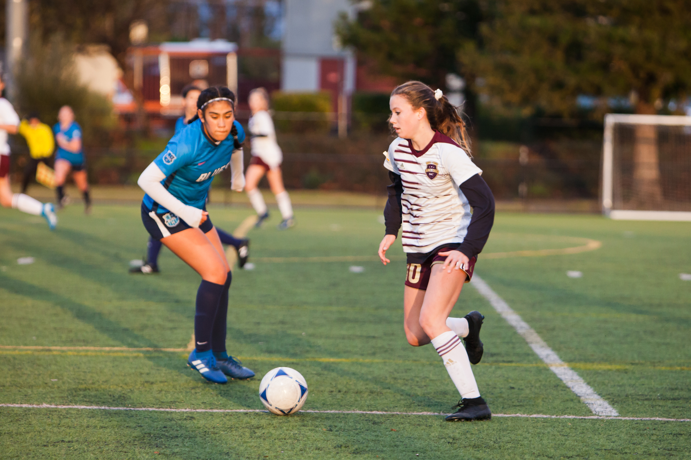

Fusion Technical Workouts
Week 1
3/23/2020 - 3/29/2020

Slide 2
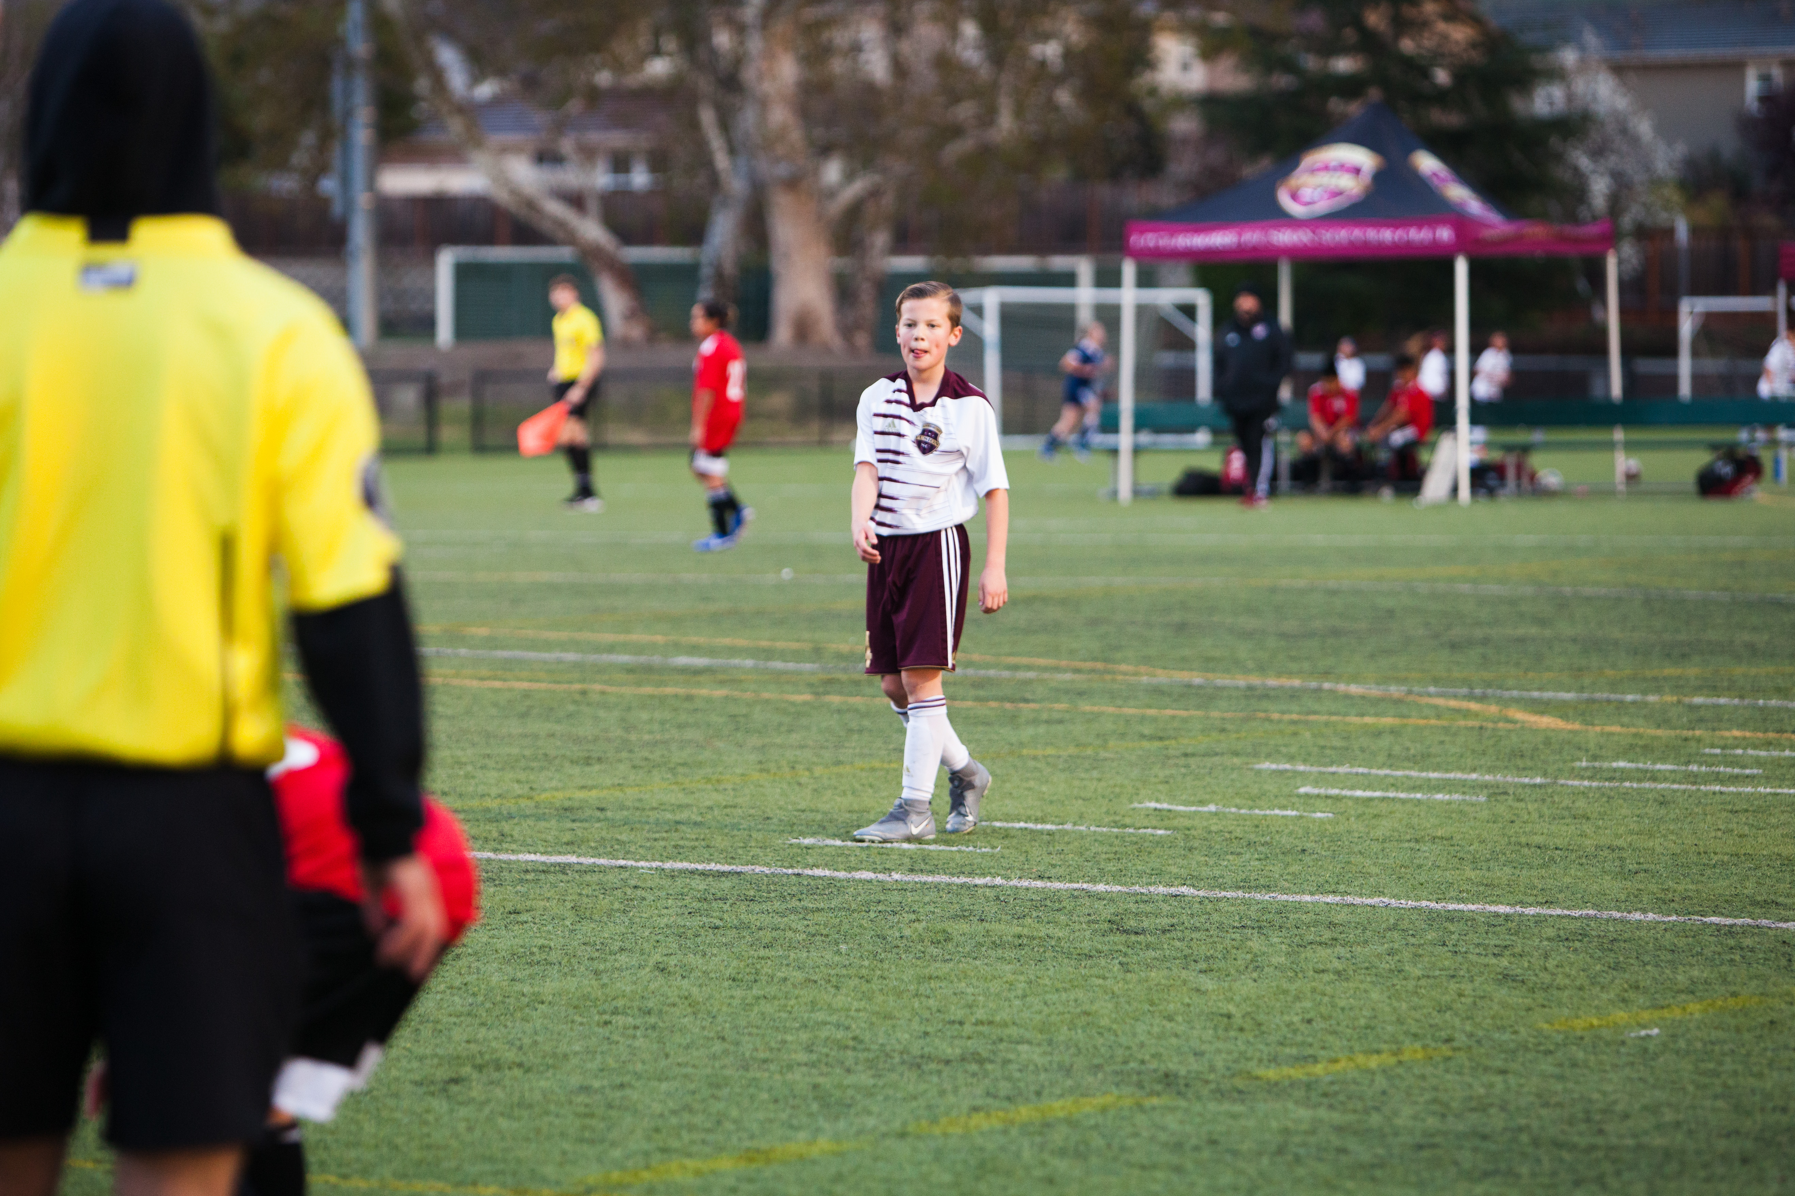
Technical Workout Guidelines
Hello and welcome to the Fusion weekly workouts! In this presentation you will find everything you need in order to complete the workouts of the week. If you have any questions, please feel to reach out for more information and support.
The program is designed for specific age groups and skill levels. If you feel you can advance to the next level, please feel free to do so AFTER you have completed your specific age group workout.
Coach Alexis Maurtua - alexis@fusionsc.org

Slide 3
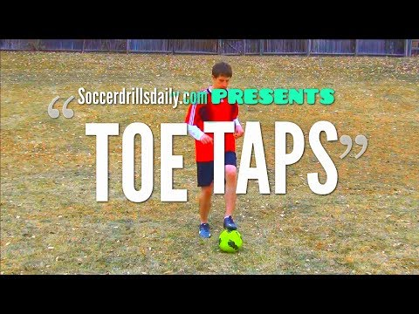
Discover Phase I Fusion Talent School
Workout: Walking Toe Taps
How: Ball is in front of you, touching the ball with the bottom toe portion of foot at a walking pace. Video is a reference and do the toe taps with the ball in place and not moving. If mastered toe taps with the ball in place, then begin to walk and move the ball forward while doing the toe taps
Where: Preferably outside on grass or driveway, inside garage, or inside the house
When: Do the exercise for 1 minute and then rest for 1 min. Repeat 10x
Why: These are the building blocks for the athletes to develop both the musculoskeletal and individual ball handling skills.

Slide 4
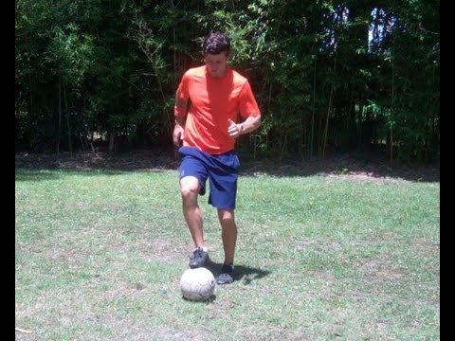
Discover Phase II U9-U10
Workout: Toe Taps
How: Ball is in front of you, touching the ball with the bottom toe portion of foot . Video is a reference and do the toe taps standing still with no ball movement, then progress to moving forward, backwards, and lastly sideways.
Where: Preferably outside on grass or driveway, inside garage, or inside the house.
When: Do the exercise for 1 minute and rest for 1 minute. Repeat 10x
Why: These are the building blocks for the athletes to develop both the musculoskeletal and individual ball handling skills while moving.

Slide 5
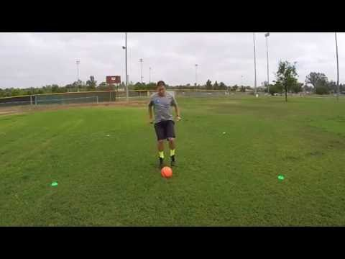
Evolve U11-U12
Workout: Toe Taps
How: Ball is in front of you, touching the ball with the bottom toe portion of foot . Video is a reference and do the toe taps standing still with no ball movement, then progress the skills demonstrated in the video
Where: Preferably outside on grass or driveway, inside garage, or inside the house
When: Do the exercise for 1 minute and rest for 1 minute. Repeat 10x
Why: These are the building blocks for the athletes to develop both the musculoskeletal and individual ball handling skills while adding complexity and coordinative skills.

Slide 6
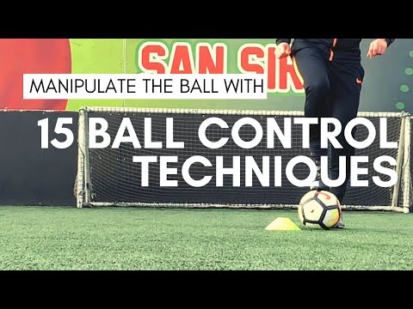
Integrate U13-U14
Workout: Toe Taps and more
How: Ball is in front of you, touching the ball with the bottom toe portion of foot . Video is a reference and pick and chose the various ball control techniques
Where: Preferably outside on grass or driveway, inside garage, or inside the house
When: Do the exercise for 1 minute and rest for 1 minute. Repeat 10x
Why: Increase mastery of ball handling skills using the foundation of toe taps to manipulate the ball through multiple directions and patterns

Slide 7
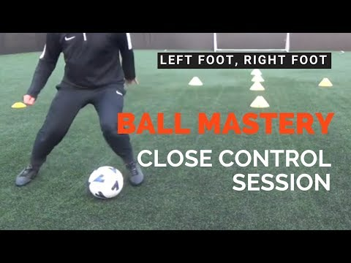
Perform U15-U16
Workout: Ball Mastery
How: Video is a reference and pick and choose the various ball control techniques
Where: Preferably outside on grass or driveway, inside garage, or inside the house
When: Do the exercise for 1 minute and rest for 1 minute. Repeat 10x
Why: Increase mastery of ball handling skills using different technical moves with the ball through multiple directions and patterns
What: If you have cones, great use them, but if don't have cones then visualize cones and opponents while doing the moves

Slide 8
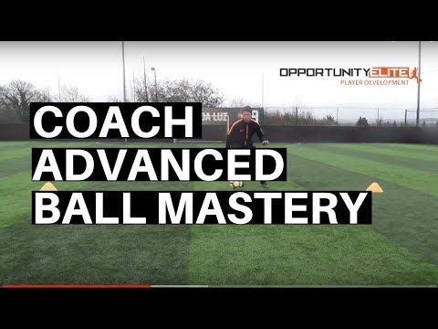
Elite U17-U19
Workout: Advanced Ball Mastery
How: Video is a reference and pick and choose the various ball control techniques
Where: Preferably outside on grass or driveway, inside garage, or inside the house
When: Do the exercise for 1 minute and rest for 1 minute. Repeat 10x
Why: Increase mastery of ball handling skills using different technical moves with the ball through multiple directions and patterns
What: If you have cones, great use them, but if don't have cones then visualize cones and opponents while doing the moves

