Slide 1

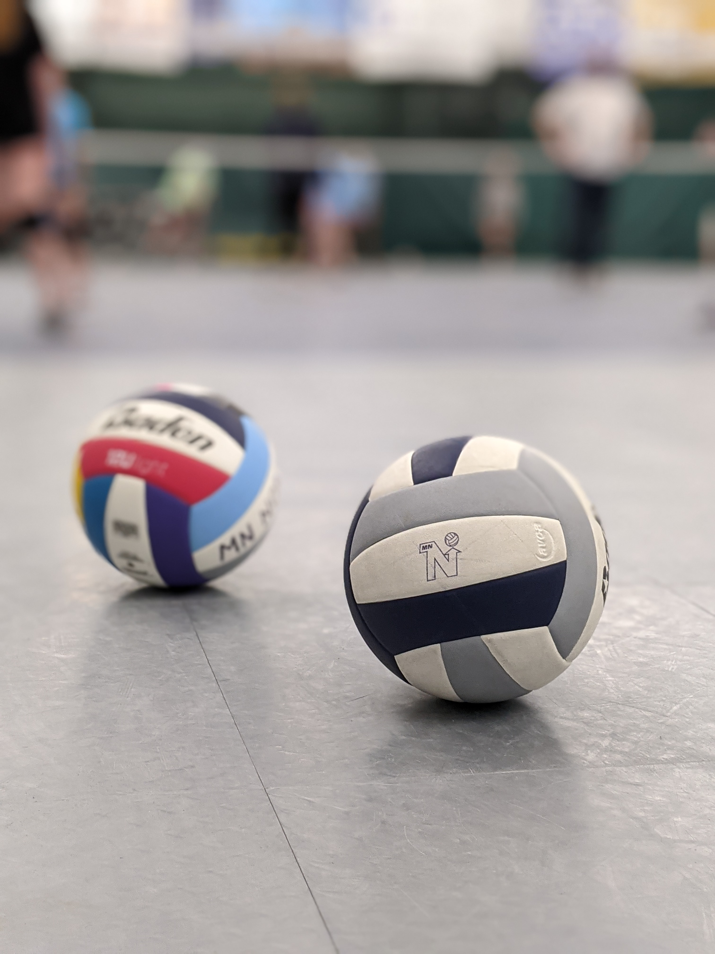
Minnesota north volleyball
Parent meeting and information
2025-2026 Season

Slide 2
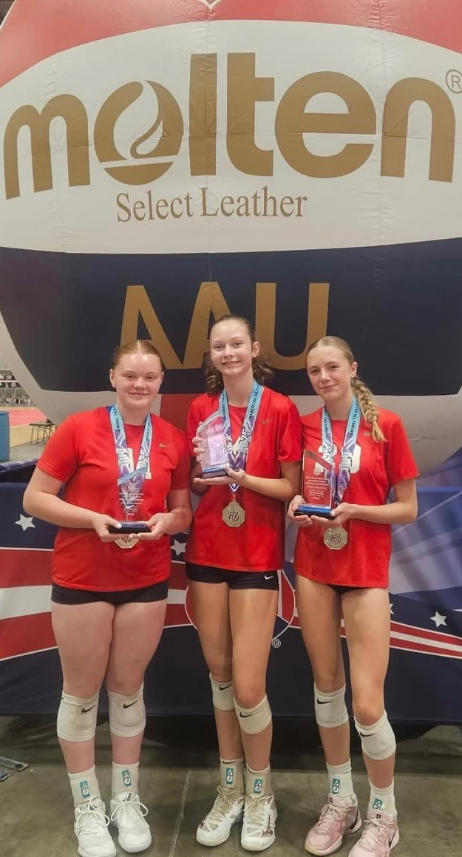
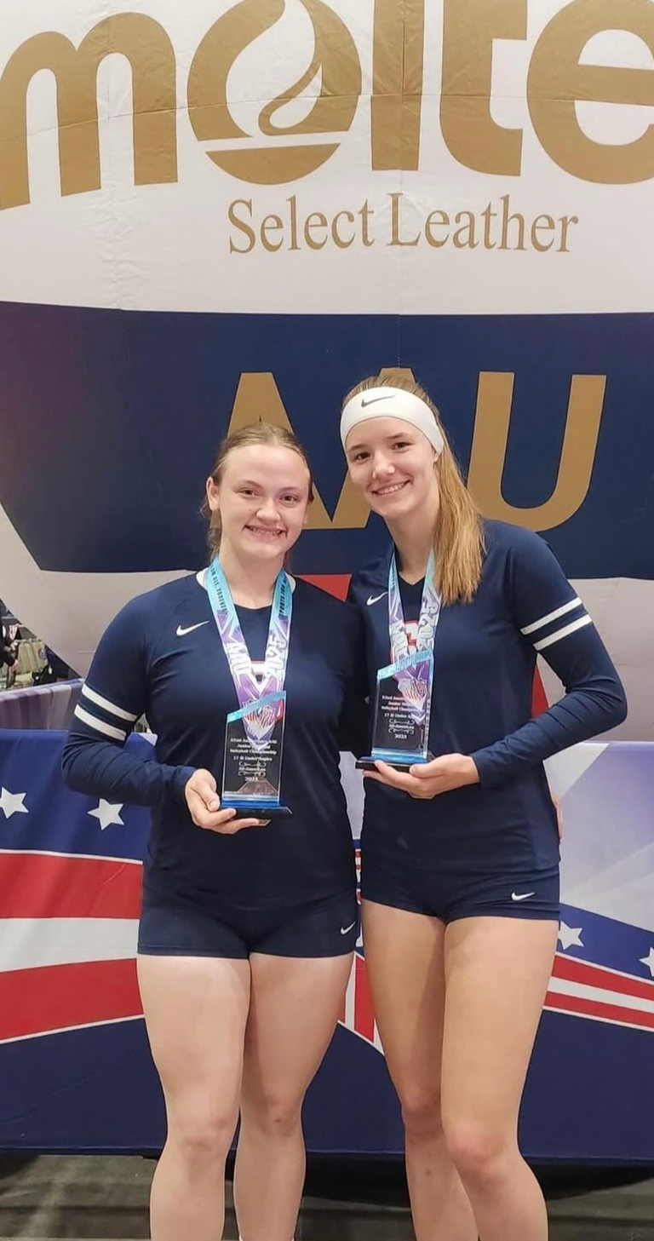
About Us
Minnesota North Volleyball is a 501c3 non-profit volleyball club based out of Duluth, Minnesota.
We were established in 2006 as an evolution of East End Volleyball to serve the greater area.
Since then, we have grown to as large as 27 teams in a single season, with almost 4150 athletes having gone through the Minnesota North Volleyball program.

Slide 3
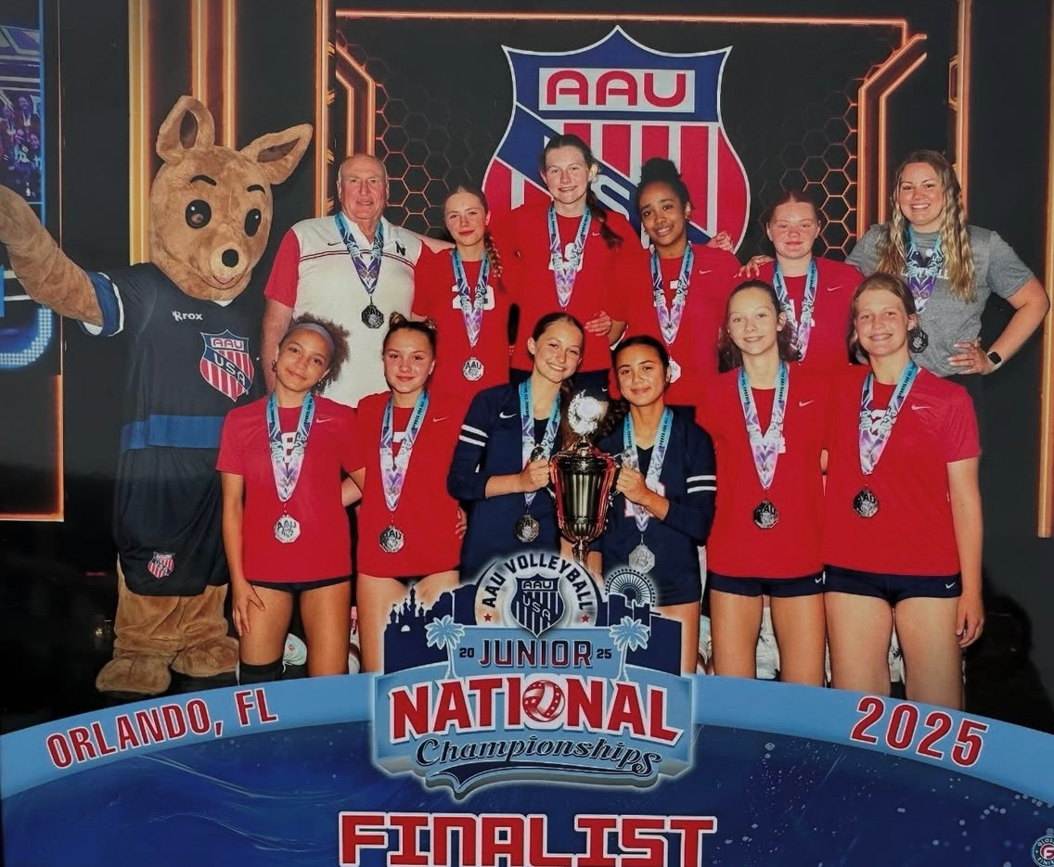
MINNESOTA NORTH VOLLEYBALL
MISSION AND GOALS
To promote the growth of youth volleyball in Northeastern Minnesota and Northwestern Wisconsin by providing instruction and opportunities to play in organized youth leagues.
MN North National, Select and Club teams provide athletes of all skill levels with an environment to accomplish their volleyball goals, make lifelong friendships and learn life lessons.

Slide 4
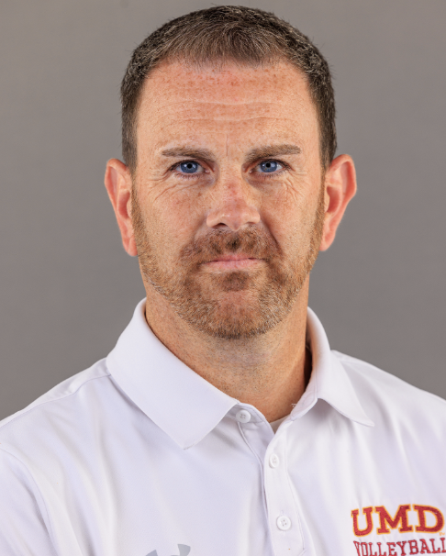

Athlete Training and Development
Jim Boos
Director of Player Development
Minnesota North Volleyball is proud to be working with ETS Performance for the 2025-2026 Season.
ETS Performance is an elite athlete training program that helps athletes develop strength, speed, and performance through individual training sessions.
All MN North athletes can receive a Free Sports Performance Evaluation, and a 15% discount on all training services.
Minnesota North is excited to announce Jim Boos, is continuing as our Director of Player Development
Jim has been the Head coach of the University of Minnesota Duluth volleyball program for the last 22 years. Jim has proven success at the NCAA Division II level, and a strong history of athlete development.
Jim and his athletes will be assisting in helping develop our athletes through skills sessions and coaching development within our program.
ETS Performance Training

Slide 5


Minnesota North Alumni
Success on the court
I
11+ Division One level Athletes
Minnesota North Volleyball has proudly helped athletes have success during and after their high school careers.
Over 150 of our athletes have gone on to play college volleyball after high school.
Our full alumni list is available to view on our website
II
35+ Division Two level Athletes
III
70+ Division Three level Athletes

Slide 6


Teams and Levels – How we Operate
N
S
C
National Teams
Select Teams
Club Teams
Our National teams are our most competitive. They travel all over Midwest to play in competitive tournaments and face the toughest competition. National teams typically practice 55-65 times in a season. All our national teams plan on competing in a national tournament at the end of season (Either AAU nationals or USAV Nationals)
Our select teams are competitive teams that play a more local schedule with the addition of two multi-day tournaments in the Twin Cities. Select teams typically practice 40-50 times in a season.
Our club teams are focused on athlete development and play a local schedule. These are primarily our 12-14s levels team. Club teams typically practice 35-40 times a season.

Slide 7
GIRLS Sample Tournament schedule
 | 12's Select | 12's Club | 13's Navy | 13's Select | 14-1 Navy | 14-1 Red | 14's Select
Local MN North Tournaments
Freeze | x | x | x | x | x | x | x
Spring Classic | x | x | x | x |  | x | x
Duluth Cup | x | x | x | x | x | x | x
Snownami | x | x | x | x | x | x | x
Showcase | x | x | x | X | X | x | x
Head of the Lakes | x | x | x | x | x | x | x
Away Tournaments
Smashin' in Superior Cupid's Cup | x | x |  | x |  |  | x
January Thaw (Cities) |  |  |  |  | x | x
Big City Luau (Cities) | X |  |  | X |  |  | x
President's Day (St. Louis) |  |  |  |  | x
Presidents Day (Omaha) |  |  | x |  |  | x
Northern Lights Qualifier (Cities) |  |  | x |  | x | x
Pentagon (Sioux Falls) |  |  | x |  | x | x
Midwest Fiesta (Cities) | x |  | x | x | x | x | x
Molten Cup (Cities) |  |  | x |  | x | x
AAU Nationals/ GJNC |  |  | x |  | x | x
Prep Dig |  |  |  |  | x
Please Note that these are samples
Individual team schedules will be released in early December 2025

Slide 8
GIRLS Sample Tournament schedule
GIRLS Sample Tournament schedule
 | 15-1 Navy | 15-1 Red | 15 Select | 16-1 Navy | 16-1 Red | 16 Select | 17-1 Navy | 17-1 Red | 17 Select | 18-1 Navy | 18 Select
Local MN North Tournaments
Freeze | x | x | x | x | x | x | x | x | x | x | x
Spring Classic |  | x | x |  | x | x |  | x | x |  | x
Duluth Cup | x | x | x | x | x | x | x | x | x | x | x
Snownami | x | x | x | x | x | x | x | x | x | x | x
Showcase |  |  | x |  |  | x | x | x | x |  | x
Head of the Lakes | x | x | x | x | x | x | x | x | x |  | x
Away Tournaments
Smashin' in Superior Cupid's Cup |  |  | x |  |  | x |  |  | x |  | x
Big City Luau (Cities) |  |  | x |  |  | x |  |  | x |  | x
JVA Showcase (WI Dells) | x |  |  | x |  |  | x |  |  | x
January Thaw (Cities) | x | x |  | x | x
Presidents Day (St. Louis) | x |  |  | x |  |  | x |  |  | x
Presidents Day (Omaha) |  | x |  |  | x |  |  | x
Northern Lights Qualifier (Cities) | x | x |  | x | x |  | x | x |  | x
Elite Division (Cities) |  |  |  |  |  |  | x | x |  | x
Pentagon (Sioux Falls) | x | x |  | x | x |  | x | x |  | x
Midwest Fiesta (Cities) | x | x | x | x | x | x | x | x | x | x | x
Molten Cup (Cities) | x | x |  | x | x |  | x | x
AAU Nationals/ GJNC | x | x |  | x | x |  | x | x |  | x
Windy City Qualifier (Chicago) |  |  |  |  |  |  | x
Please Note that these are samples​
Individual team schedules will be released in early December 2025​

Slide 9
Stay and play events
For the following tournaments you MUST stay at the hotels provided by the club:
    January Thaw
    President's Day Omaha
    President's Day St. Louis
    Northern Lights Qualifier
    Windy City Qualifier
    *If you do not stay at the stay and play hotels provided you will be assessed an additional fee to cover the cost of a hotel room*

Slide 10
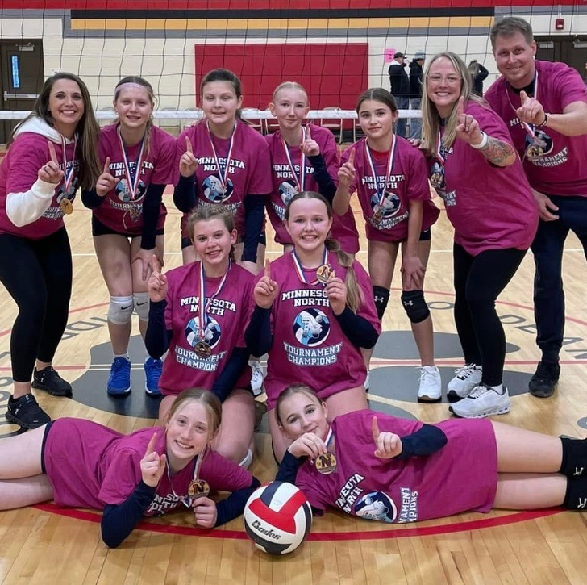
Team Practices
Our teams practice out of the Duluth Indoor Sports Center, and other local schools around the Duluth and Superior area.
Each practice session is designed to develop player's individual skills and apply them to game like scenarios
National teams average 2 practices per week.
Select and Club teams have 1-2 practices per week.
Teams will usually be practicing with at least 1 other team in similar age/skill range

Slide 11
Team Prices – Costs and Fees 2025-2026 Season
Team Level | Number of Tournaments | Cost Per Athlete
12s Club | 6-7 | $650
12s Select | 8-9 | $850
13-14s Select | 8-9 | $1,200
13 National | 13-14 | $2,700
14 Navy | 12-14 | $2,850
14 Red | 12-14 | $2,700

Slide 12
Team Prices – Costs and Fees 2025-2026 Season
Team Level | Number of Tournaments | Cost Per Athlete
15-18s Select | 8-9 | $1,200
15, 16 & 18 Navy | 12-13 | $3,200
15-18 Red | 12-13 | $3,000
17 Navy | 13-14 | $3,400
Boys | Pending | Pending

Slide 13
Price comparisons to other clubs around the state
Junior Program | Location | Team Fee (16 National) | Deposit
Mizuno Northern Lights | Burnsville | $7,750 | $1,000
Minnesota Select | Maple Grove | $6,780 | $835
Vital VBC | Eden Prairie | $6,110 | $1000
Club 43 Volleyball | Hopkins | $4,700 | $800
Mizuno M1 | Bloomington | $5,823 | $1,000
Crossfire Volleyball | Champlin | $5,700 | $750
Kokoro VBC- Twin Cities | North St. Paul | $5,665 | $800
Minnesota North | Duluth | $3,200 | $300
Southern MN VBC | Rochester | $3,900 | $600
Minnesota Select (Boys) | Maple Grove | $2,050 | $200
Minnesota North (Boys) | Duluth | Pending | $300
  *While some club's fees may include travel expenses, MN North price does not.

Slide 14
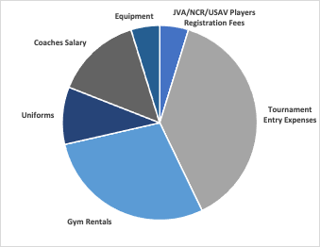
Costs and Fee Breakdown

Slide 15
Age Definitions for athletes
A
T
Tryout Dates
Age Requirements
Age Group | Date of Birth (on or after date below)
12s | July 1st , 2013
13s | July 1st , 2012
14s | July 1st , 2011
15s | July 1st , 2010
16s | July 1st , 2009
17s | July 1st , 2008
18s | July 1st , 2007
Ages 14 and Under: Sunday November 2nd
  Grades 7-8 (13-14s): Check In: 7:00 am- 8:00 am
  Tryouts: 8:00 am- 12:00 pm
  Grades 3-6 (12s): Check In: 12:00 pm- 1:00 pm
    Tryouts: 1:00 pm- 4:00 pm
  Boys All Ages: Check In: 12:00 pm – 1:00 pm
    Tryouts: 1:00 pm- 4:00 pm
Ages 18 and Under: Sunday November 9th
  Grades 9-10 (15s-16s): Check In: 7:00 am- 8:00 am
  Tryouts: 8:00 am- 1:00 pm
  Grades 11-12 (17s-18s): Check In: 1:00 pm- 2:00 pm
  Tryouts: 2:00 pm- 5:00 pm
IF YOU HAVE ANY QUESTIONS ABOUT YOUR CHILD'S AGE GROUP PLEASE REACH OUT

Slide 16
Registration information
Sunday November 2nd Grades 3-6 (12s) Boys all ages | Tryout Day Registration: 12:00 pm- 1:00 pm
Sunday November 2nd Grades 7-8 (13s-14s) | Tryout Day Registration: 7:00 am- 8:00 am
Sunday November 9th Grades 9-10 (15s-16s) | Tryout Day Registration: 7:00 am- 8:00 am
Sunday November 9th Grades 11-12 (17-18s) | Tryout Day Registration: 1:00 pm- 2:00 pm
Step 1 | Pre-register online **Please pre-register so we can setup for tryouts effectively**
Step 2 | Fill Out 4 Forms JVA Release and Reliability 2025-2026 JVA Medical Release and Waiver Form 2025-2026 USAV Medical Form 2025-2026 Birth Certificate for National Teams
Step 3 | Team Deposit: $300 for all ages (paid at online registration) Tryout Fee: $20.00 per player (non-refundable) (paid at online registration) Concessions Deposit Fee: $600 (per player) (Paid at registration).

Slide 17
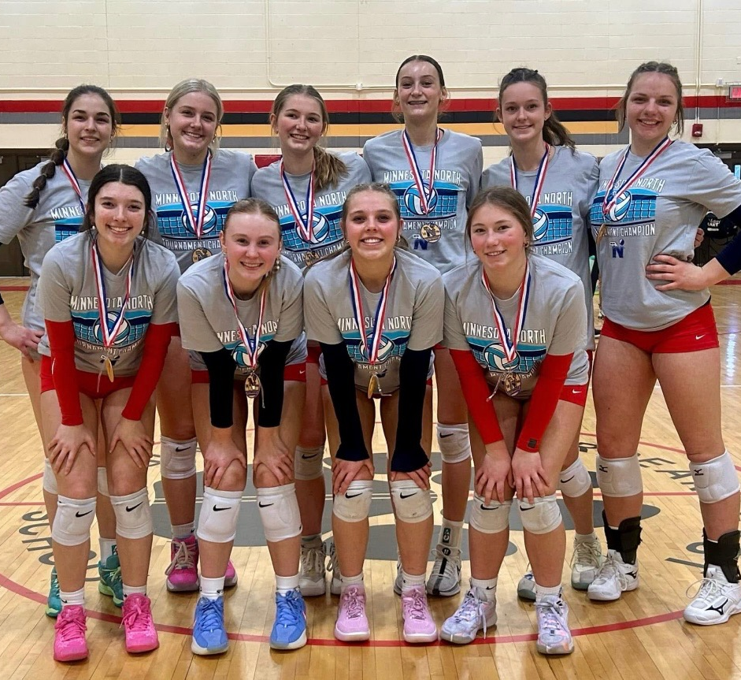
Team Deposit
Team Deposits are needed at tryouts and are in the following amount:
12s-18s - $300
These checks are cashed after tryouts and are used to cover the cost of jersey and apparel orders in the beginning of the season.

Slide 18
Refund policy
MN North Board Notified: Deadline Date | Team Level | Amount Retained by Club
November 6th by 5:00 pm | All boys, 12 club, 12 select 13-14 Select and 14 National | $0.00
November 13th by 5:00 pm | 15-18 select and 15-18 National | $0.00
December 10th by 5:00 pm | All club, select and boys teams | $200
December 10th by 5:00 pm | All National Level Teams | $300

Slide 19
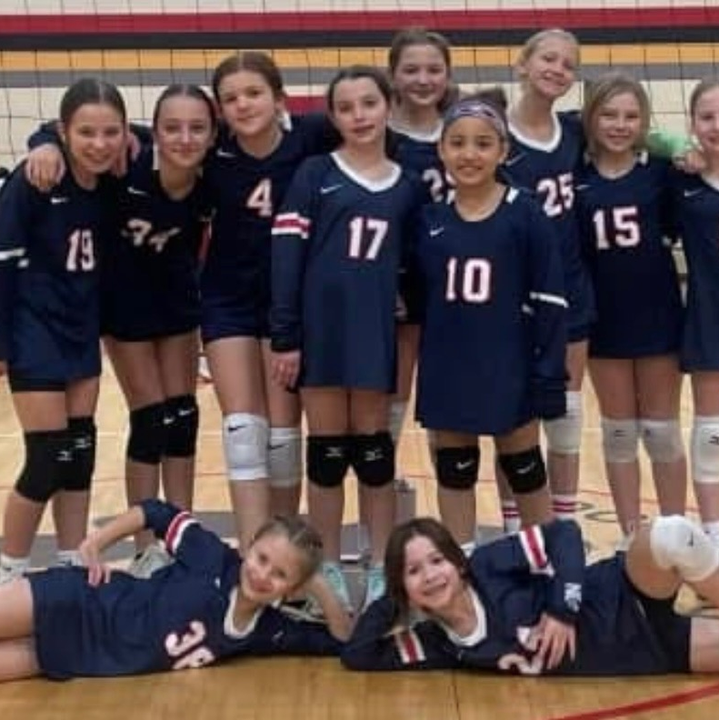
Concession deposit
Each player is required to have a concessions deposit check of $600 at tryouts.
All parents and/or players (16 and older) are required to work multiple concession shifts at home tournaments during the season.
For a player to work concessions alone they must be at least 16 years old.
This check is cashed if concession shifts are not worked during the season.
The concession check will also be cashed for a no call/ no show to signed up concession shifts.
The specified number of concessions shifts will be released after tryouts.

Slide 20
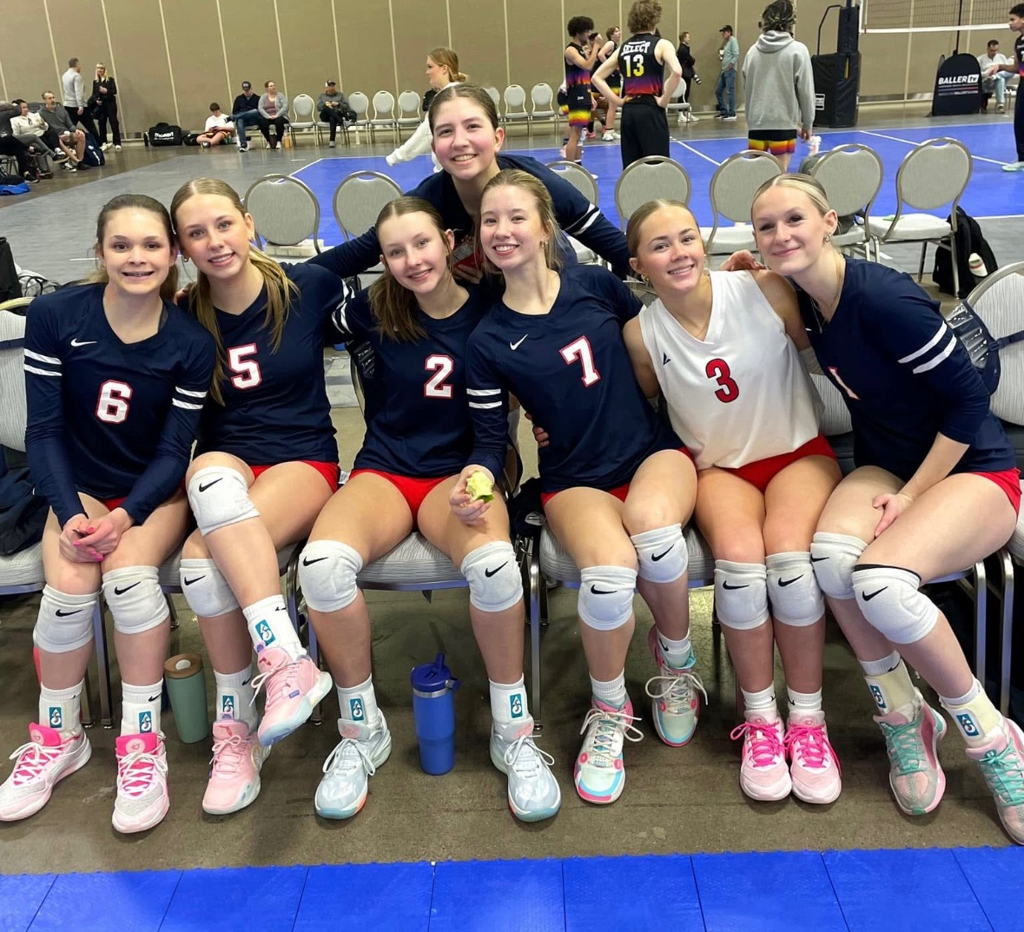
Concession Structure
Teams will be responsible for setting up and taking down concessions at home tournament locations
More information to come after tryouts

Slide 21
Expected payment schedule
Team | Deposit | Dec. 10 | Jan. 10 | Feb. 10 | Mar. 10 | Apr. 10 | May 10 | June 10th | Total
12s Club | $300 | $75 | $76 | $75 | $75 | $50 | - | - | $650
12s Select | $300 | $100 | $100 | $100 | $100 | $100 | $50 | - | $850
13-18s Select | $300 | $150 | $150 | $150 | $150 | $150 | $150 | - | $1200
13 National | $300 | $350 | $350 | $350 | $350 | $350 | $350 | $300 | $2700
14 Navy | $300 | $375 | $375 | $375 | $375 | $375 | $375 | $300 | $2850
14 Red | $300 | $350 | $350 | $350 | $350 | $350 | $350 | $300 | $2700
15, 16 & 18 Navy | $300 | $425 | $425 | $425 | $425 | $425 | $425 | $350 | $3200
15-18s Red | $300 | $400 | $400 | $400 | $400 | $400 | $400 | $300 | $3000
17 Navy | $300 | $450 | $450 | $450 | $450 | $450 | $450 | $400 | $3400

Slide 22
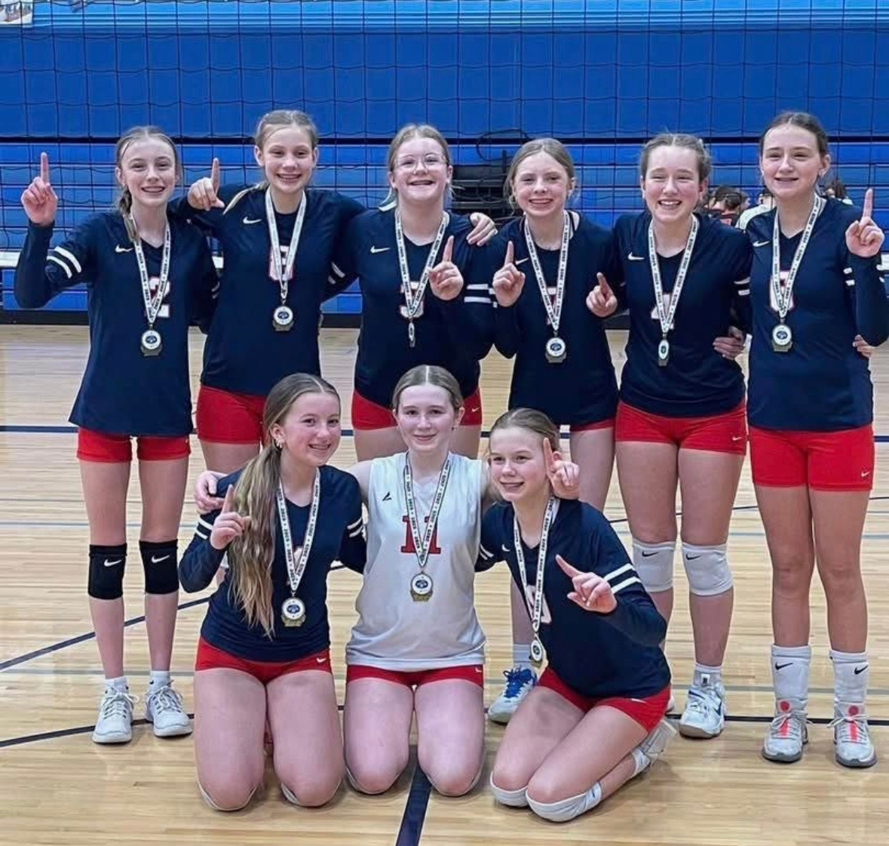
Fundraising
Fundraising is a great way to reduce your child's player fees.
Our current fundraising opportunities are listed on the Minnesota North Website.
**Fundraising credits can only be applied towards player fees. No refunds will be offered, if you have credit it will carry forward to your fees next year.

Slide 23
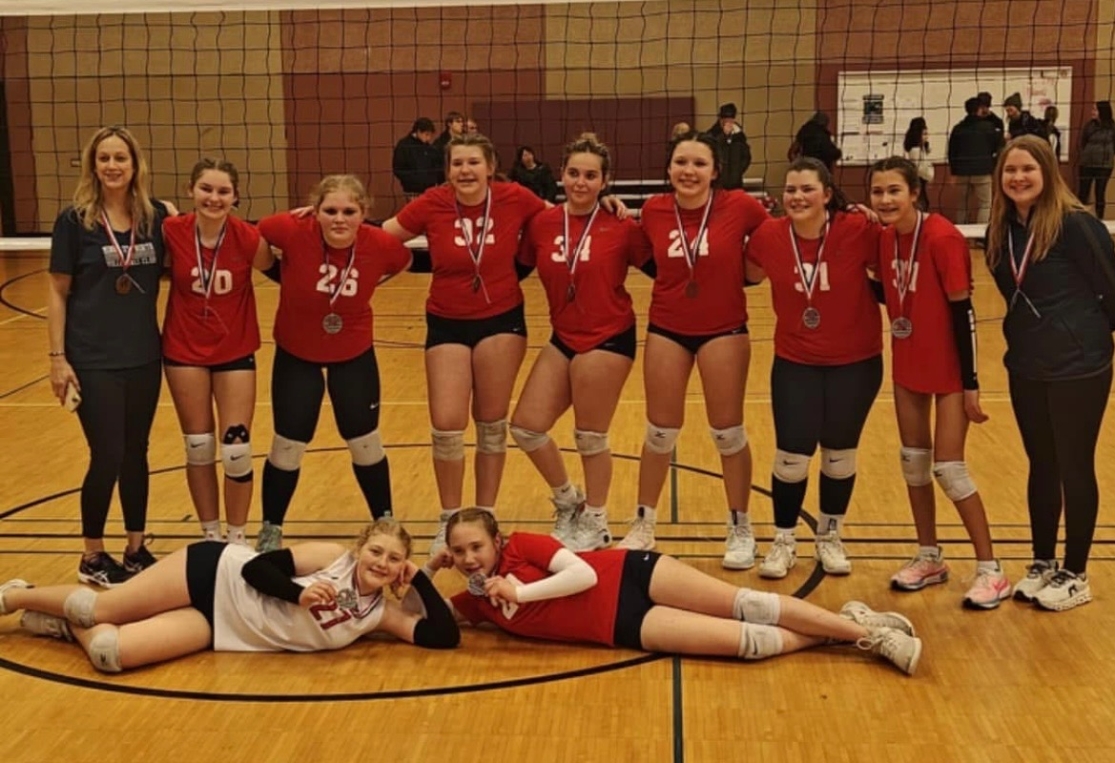
Banners
North is looking to fill the DISC with banners.
If you sell a banner to a business you receive a credit towards your account!
  4 x 8 Banner:
    Cost- $500 & Credit- $100
  7 x 10 Banner:
    Cost- $1000 & Credit- $200
  14 x 20 Banner:
    Cost- $3000 & Credit- $400

Slide 24
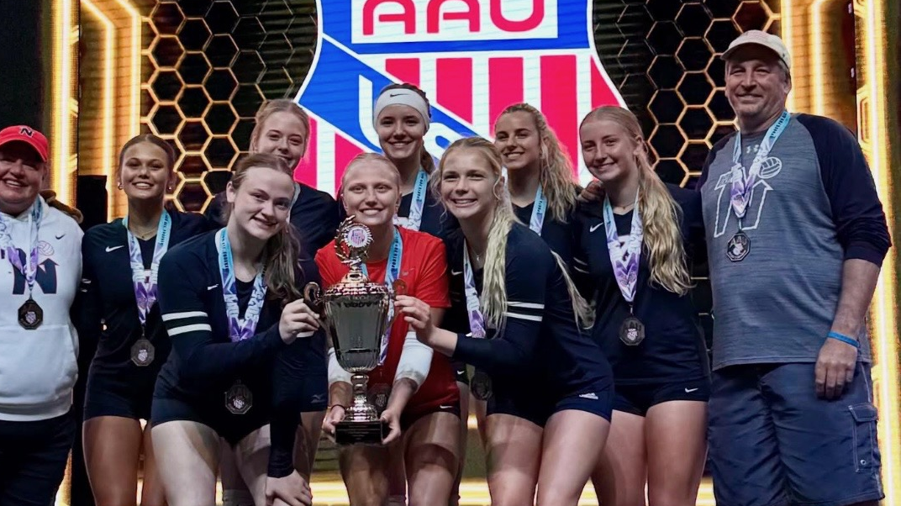
Thank you!

