Slide 1


The Science of the 400-Meter Dash
Derek Leininger, Ph.D.
Wisconsin Clinic • February 2025

Slide 2
Parallel Lines – Not a Spectrum
Speed
Endurance
Speed
Endurance

Slide 3
Physiology
ATP
Aerobic/anaerobic systems
Lactate buildup
Types A, B, C

Slide 4
40 Second Wall
What happens from 0-50 seconds
The glycolytic system
Aerobic to anaerobic switch
Anaerobic energy taps out
Lactate buildup

Slide 5
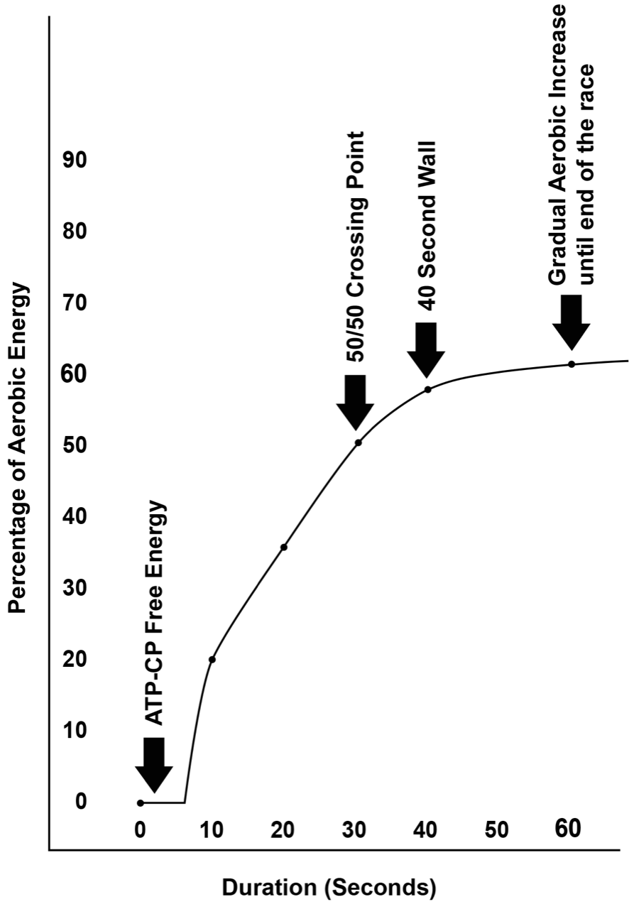

Slide 6
The 60/40 Ratio
60% anaerobic, 40% aerobic
50 years ago – 90/10 anaerobic
Michael Johnson’s injuries
Research in the 90s
Two Labs

Slide 7
Quantity to Quality
Year long approach
Fall base training
Short rest time between intervals
All sprints are endurance sprints

Slide 8
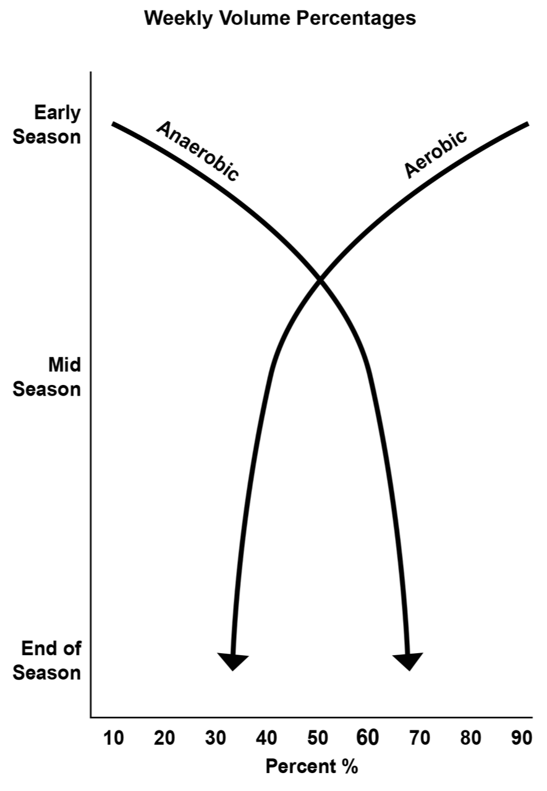

Slide 9
Reloading / Peaking is a Myth
Peaking on a specific date is elusive
Why tapering doesn’t work
Reloading leads to higher fitness levels
High school approach to reloading

Slide 10
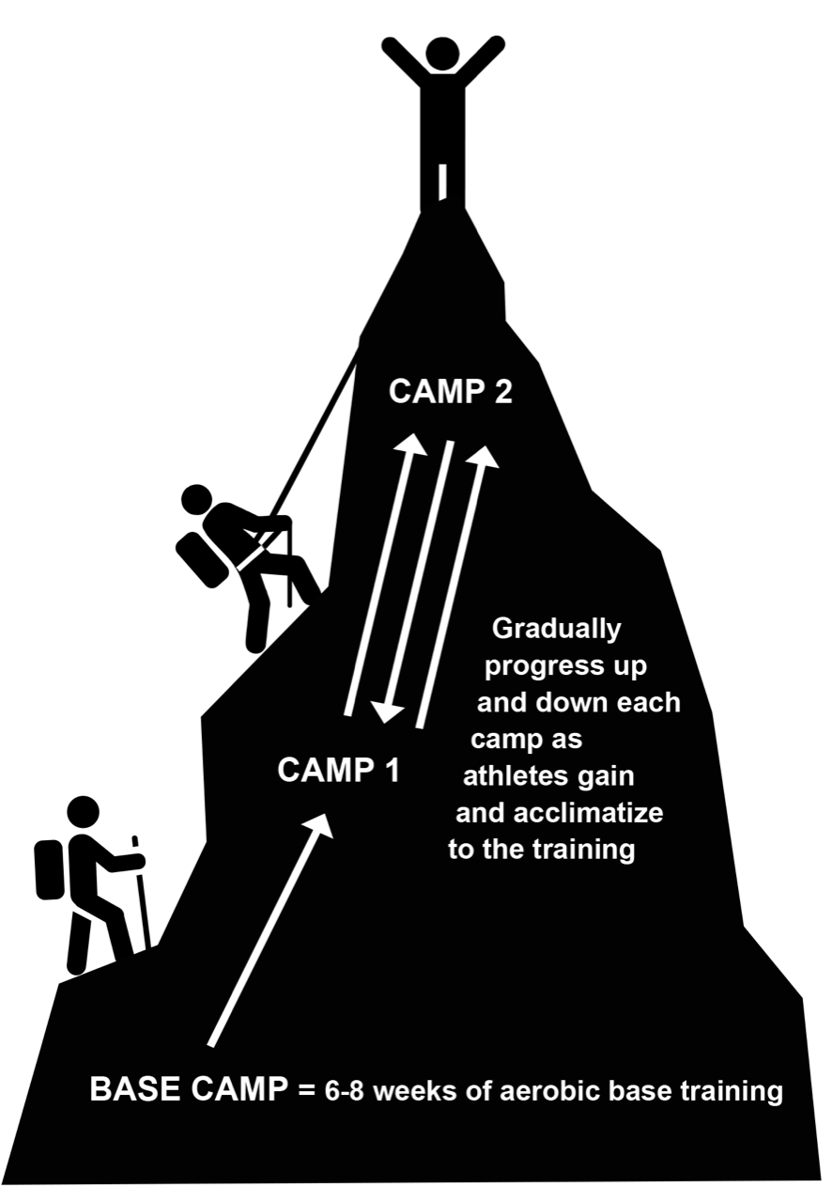
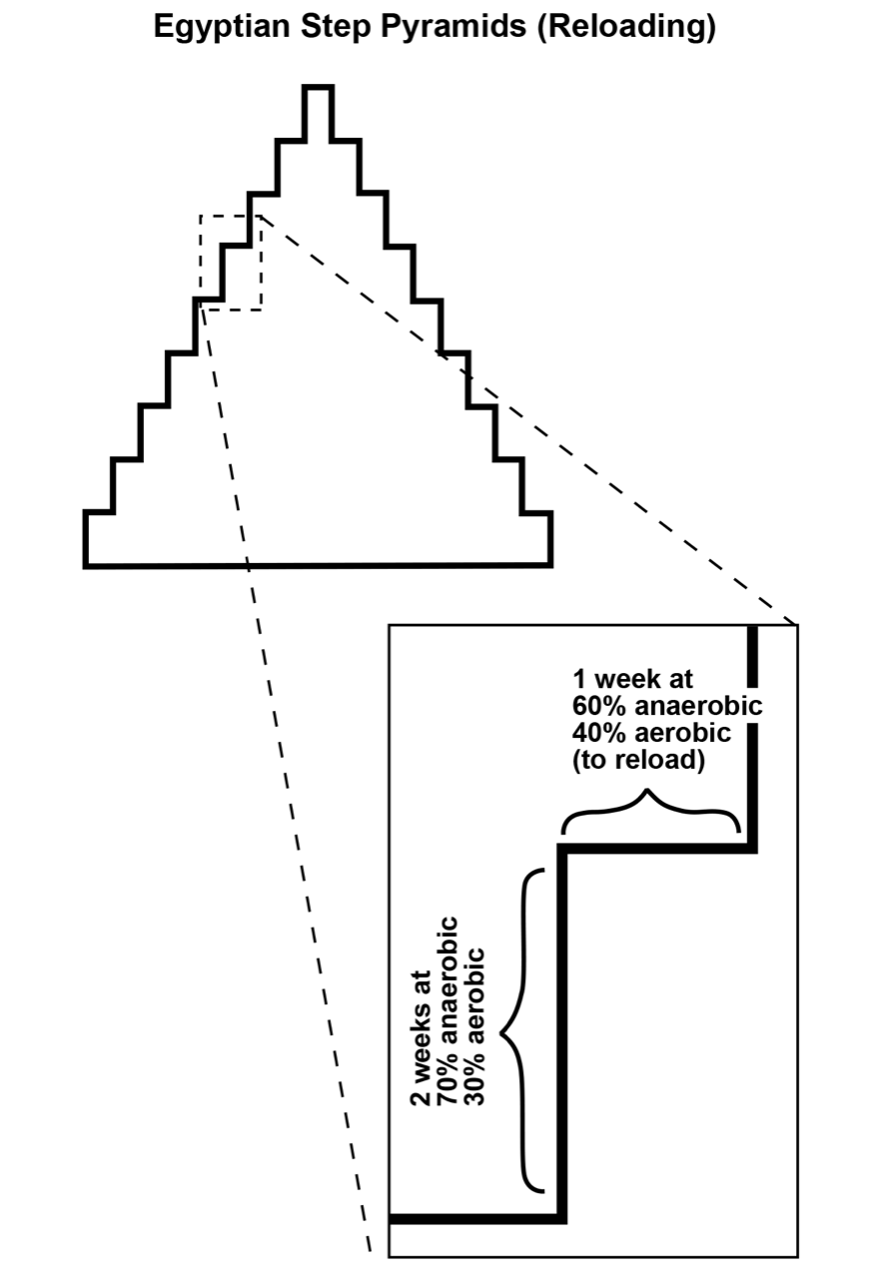

Slide 11
Six Seconds of Free Energy
ATP-CP system
Mark out 50 meters in your lane
Go hard for 6 seconds, then find pace

Slide 12
Gender and Age
Almost all research conducted with adults
Females – about 5% more aerobic than males
Children – at least 10% more aerobic than adults
Anaerobic system not developed in children/adolescents

Slide 13
Racing the 400s: The Four Ps
Push
Pace
Position
Poise

Slide 14
4x400 Meter Relay Lineup
Lead off runner
Legs 2 and 3
Anchor leg
Baton exchanges

Slide 15
Why use a balanced approach?
How many running events in track?
200/400/800 options -- almost half
4x400 and 4x800 relays
Endurance is the shortest path
Ability to double and triple

