Slide 1




19-20 Neenah High School Wrestling
“Meet the Team”
Tuesday November 26th 2019

Slide 2
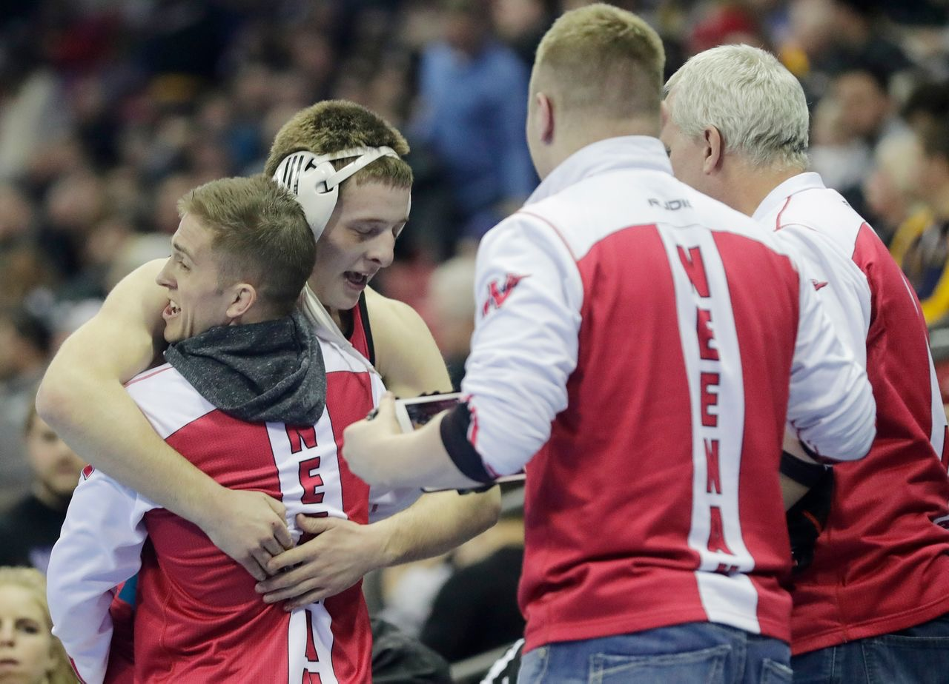
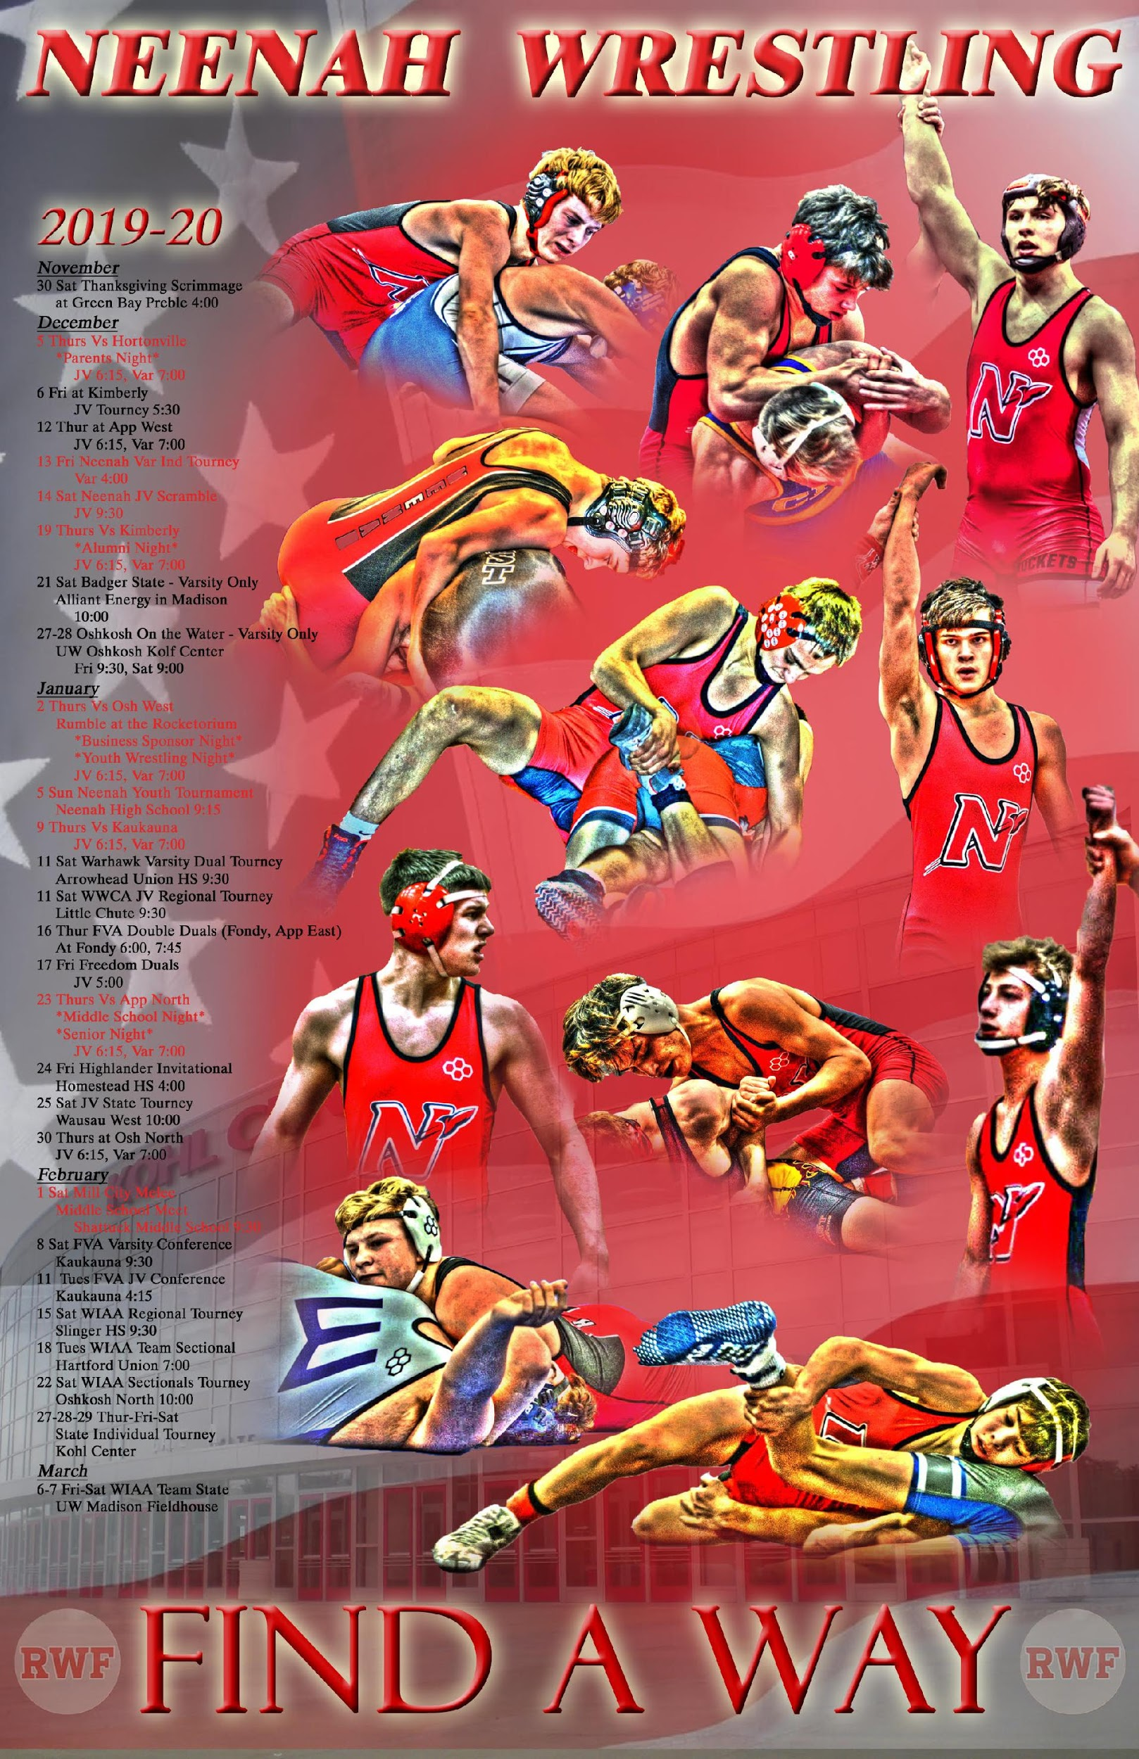
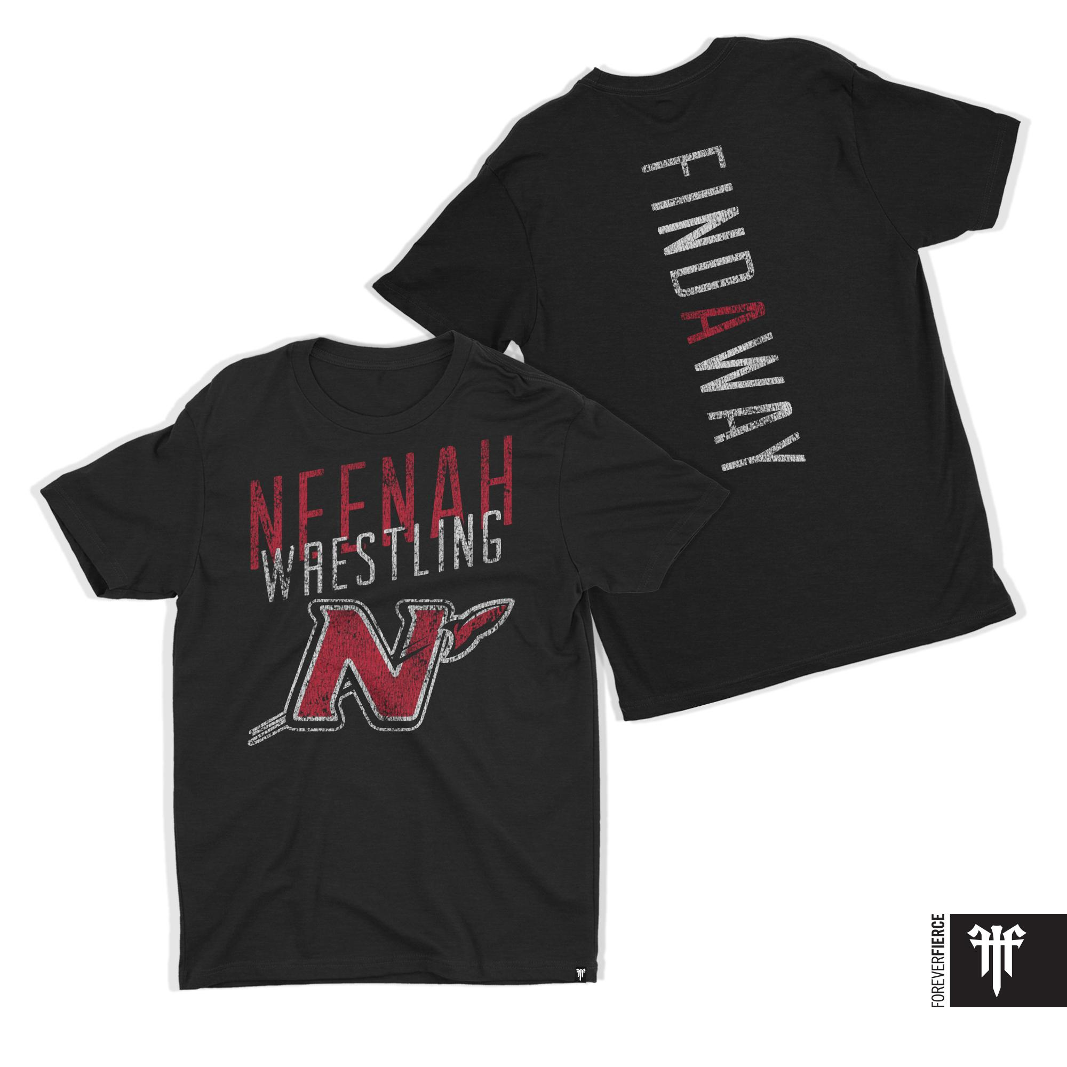
RWF “Meet the Team”
19-20 Season Slogan
“FIND A WAY”

Slide 3

Mission of
Neenah High School Wrestling 2019-2020
“Building Students of Wrestling; Creating Champions in Life”
  #1 Championship People
  Taking risks to accomplish goals/missions
  Academic, Social, Athletic Champions

Slide 4
Academic Goals/Mission of
Neenah High School Wrestling 2019-2020
Academic Goals/Mission
Over 70% of Neenah High School Team with 3.0 GPA or Higher. *59% in 18-19
6 or more wiwrestling.com All State Scholar Athletes. *5 in 18-19
2 plus Neenah High School Wrestling Team members on SALT (Student Athlete Leadership Team)
100% Senior Graduation Rate
_________________________________
To Qualify For All-State Scholar Athlete
3.0 or Higher GPA, 10 or More Varsity Wins, .600 winning percentage on varsity, sectional and state results increase odds of making the team.

Slide 5
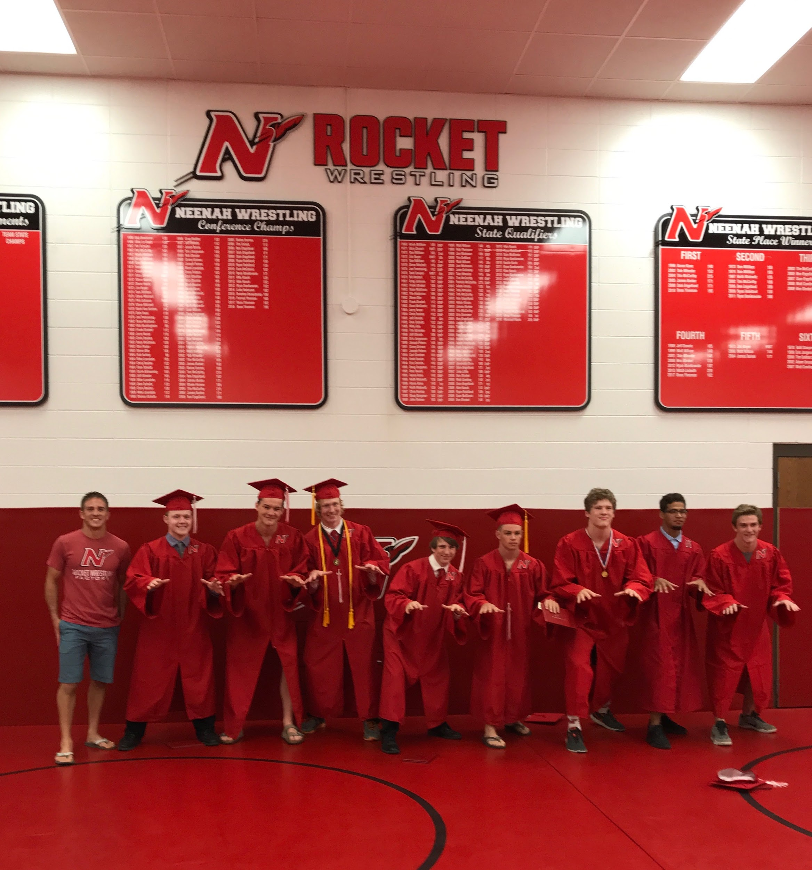
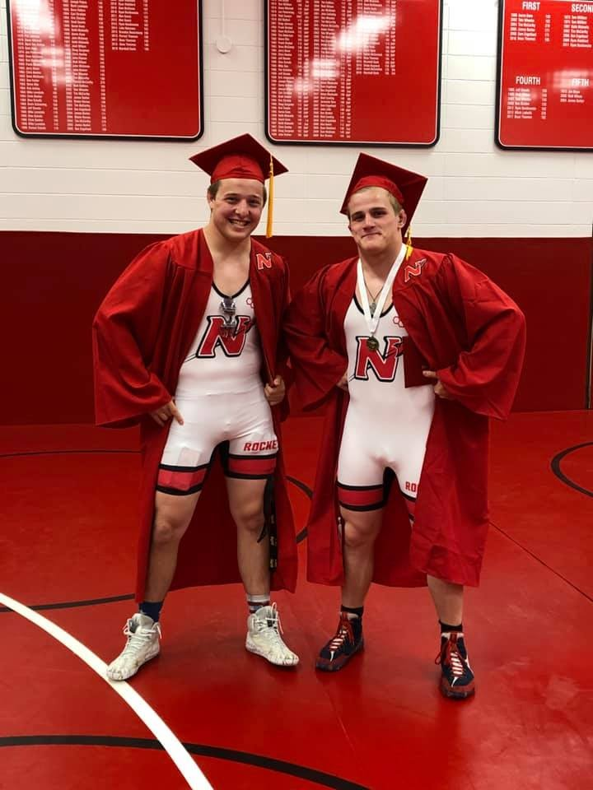
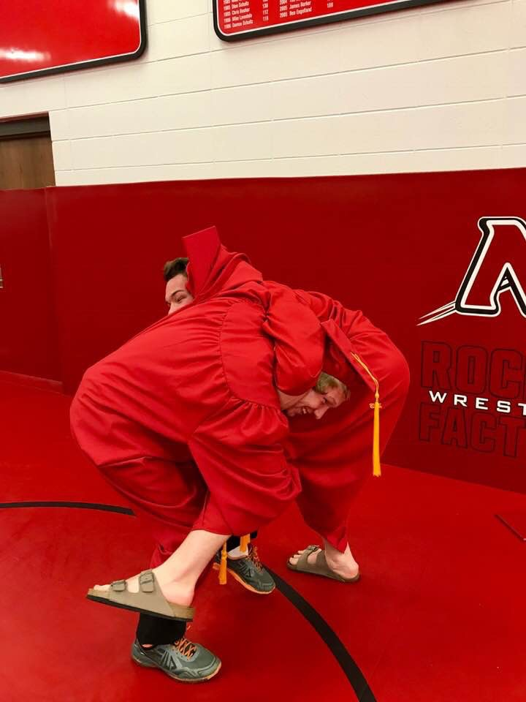
Academic Goals/Mission of
Neenah High School Wrestling 2019-2020

Slide 6
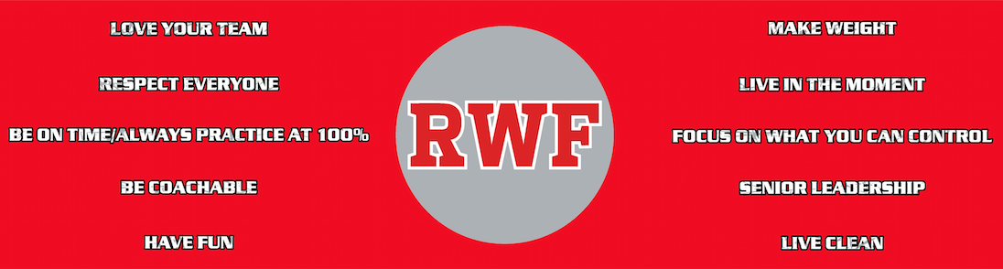
Social Goals/Mission of
Neenah High School Wrestling 2019-2020
      Social Goals/Mission
      No NJSD or Neenah Wrestling Code Violations
      Live by the Team Core Values
      Neenah High School Wrestling Core Values (established 2017-2018)

Slide 7
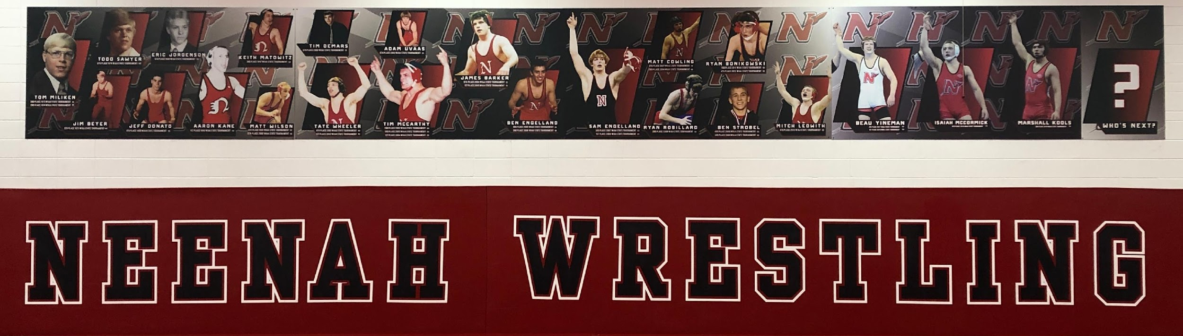
Athletic Goals/Mission of
Neenah High School Wrestling 2019-2020
Goals/Mission of Neenah Wrestling:
“Building Students of Wrestling Creating Champions in Life”
#2 Championship Results 19-20 Season Goals/Mission
  Top 2 in the FVA Conference (Duals and Tournament)
  3 WWCA JV State Place-Winners (5 or more qualifiers)
  Win WIAA Regional Tournament and WIAA Sectional Tournament
  Top 10 in Overall Team Standings at the WIAA Individual State Tournament
  Qualify for the WIAA Team State Tournament (first time since 2003-2004)

Slide 8
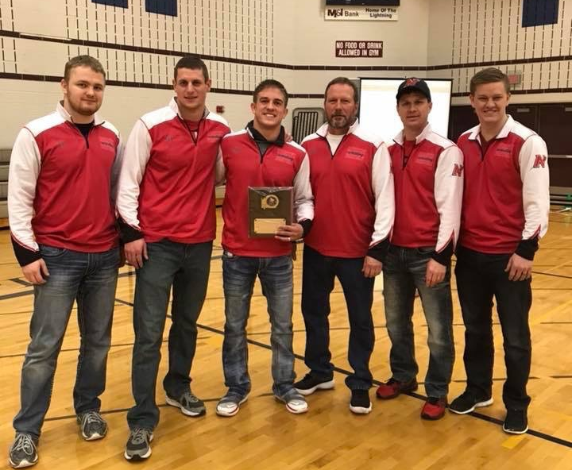
Neenah High School Wrestling
2019-2020 Coaching Staff
Kyle Kleuskens: Head Varsity Coach
Mark Cowling: Assistant Varsity Coach
Chris Rundquist: Head JV Coach
Mason Bohm: Volunteer Coach
Corey Zuberbier: Volunteer Coach
Kevin Beauchamp: Volunteer Coach
Brian Piechocki: Volunteer Coach
Ryan Robillard: Volunteer Coach
Corey Knudsen: Volunteer Coach
Ben Strobel: Volunteer Coach
Jason Kurszewski: Volunteer Coach
Beau Yineman: Volunteer Alumni
Isaiah McCormick: Volunteer Alumni

Slide 9
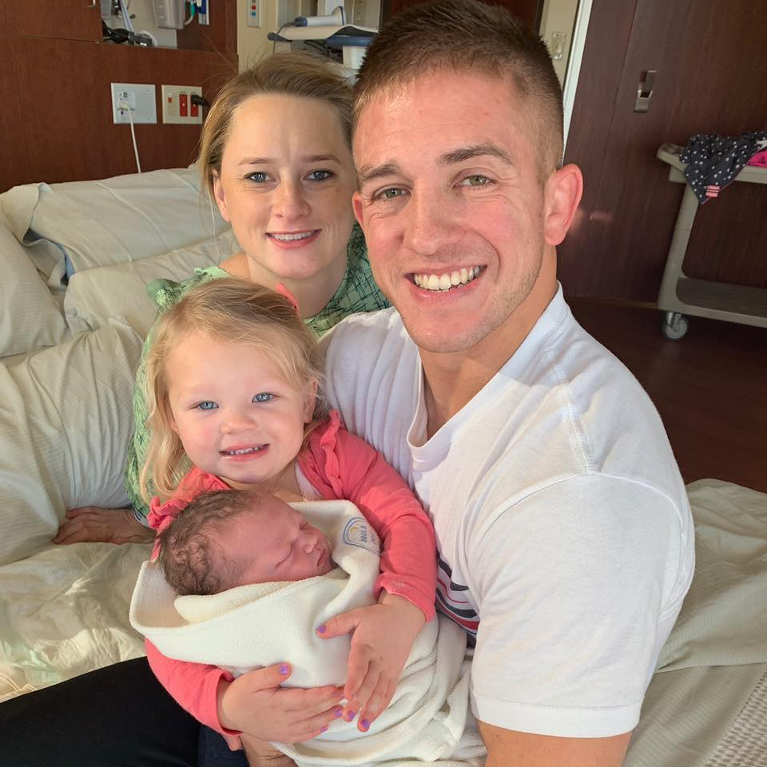
Neenah High School Wrestling
2019-2020 Coaching Staff
Head Varsity Coach
Kyle Kleuskens
5th Season as Neenah Wrestling Head Coach
2017-2018 FVA Coach of the Year
NCAA Academic All-American 2011 for UW Oshkosh
2X Team Captain @ UW Oshkosh 2010, 2011
Wisconsin National Team Coach 2011-2014
Elementary Physical Education Teacher @ Lakeview in Neenah
Wife: Sarah
Daughters (2): Ellison and Macklyn

Slide 10
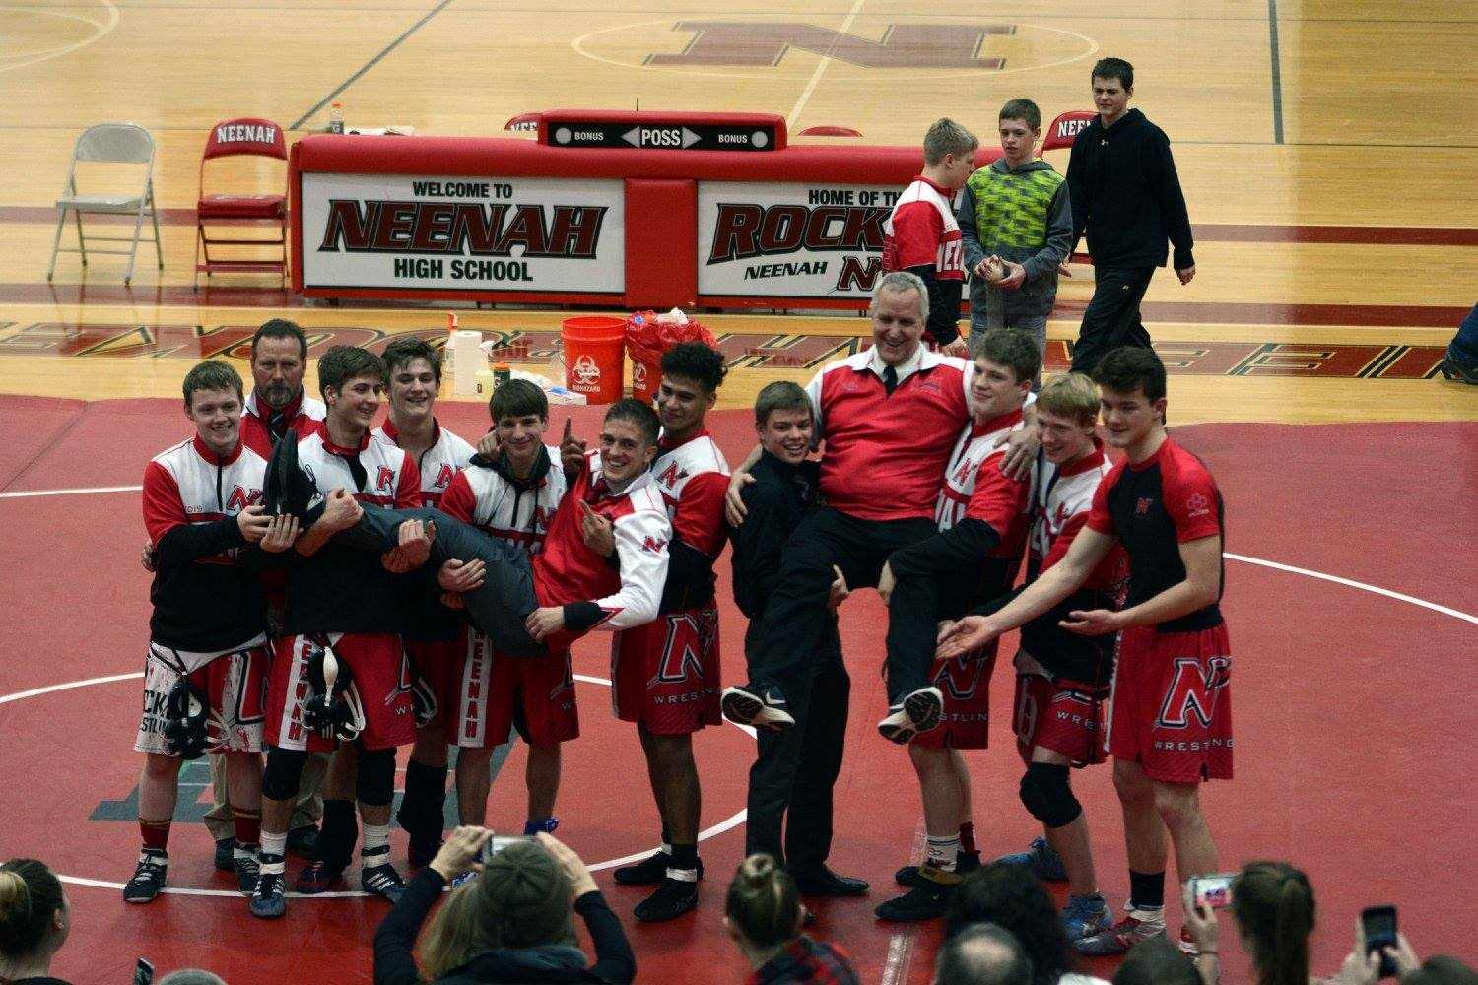
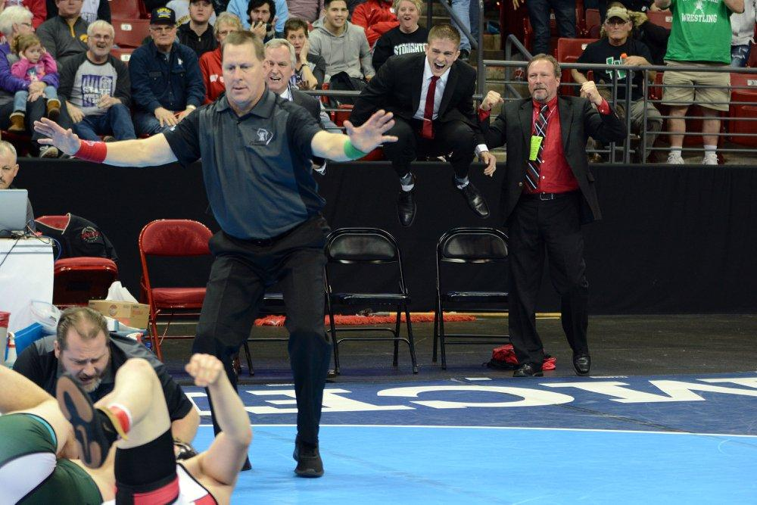
Coach Kleuskens Affirmations
I cherish the relationships and lifelong friendships I have gained through my experiences as a competitive student/athlete and coach.
I truly love the sport of wrestling and having the opportunity for my ongoing experiences in wrestling to continue to shape me into the man I am today.
I am 100% committed to the present and future of Neenah Wrestling and enjoy the process of working hard to achieve our program goals of Championship People and Championship Results.

Slide 11
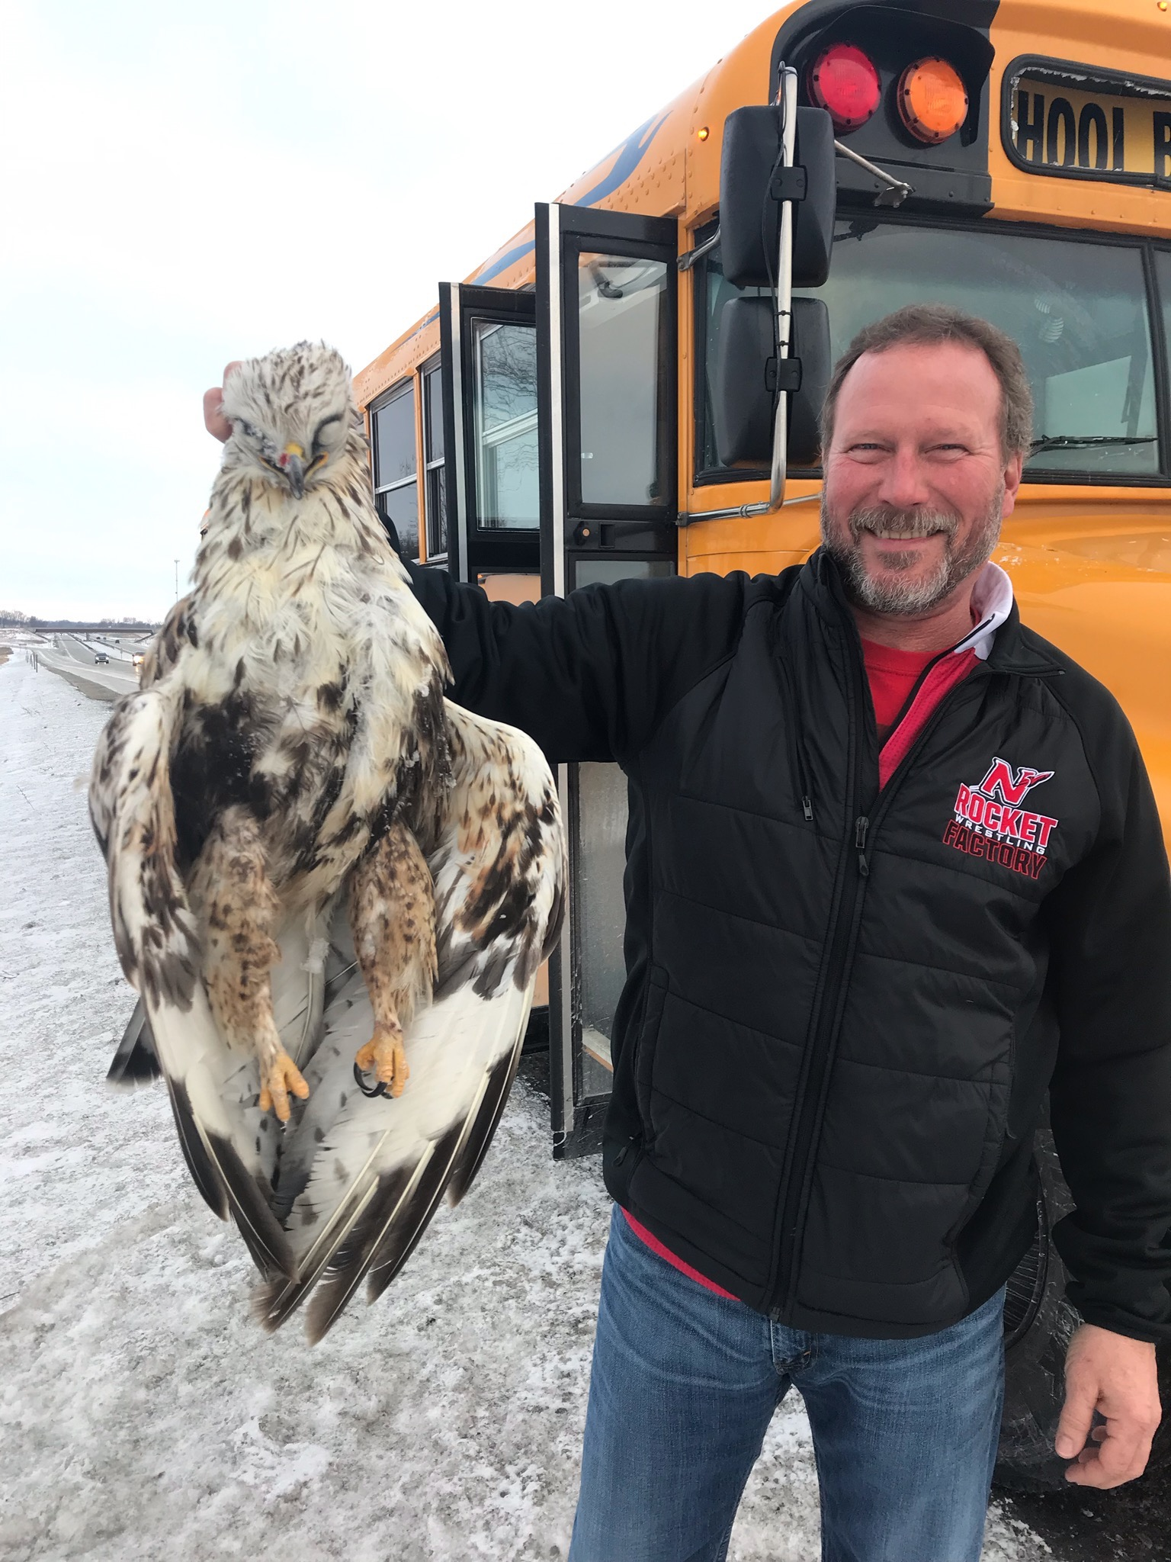
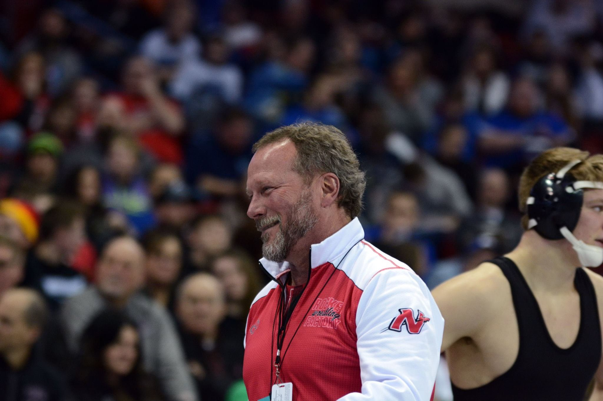
Neenah High School Wrestling
2019-2020 Coaching Staff
Varsity Assistant Coach
Mark Cowling
”Grandfather” of Neenah Wrestling
Neenah Wrestling Alumni
Coached at various levels in
the program since the 1980’s.
Founder and Owner of PAVCO
Wife: Mary
Sons (2): Jake and Josh

Slide 12
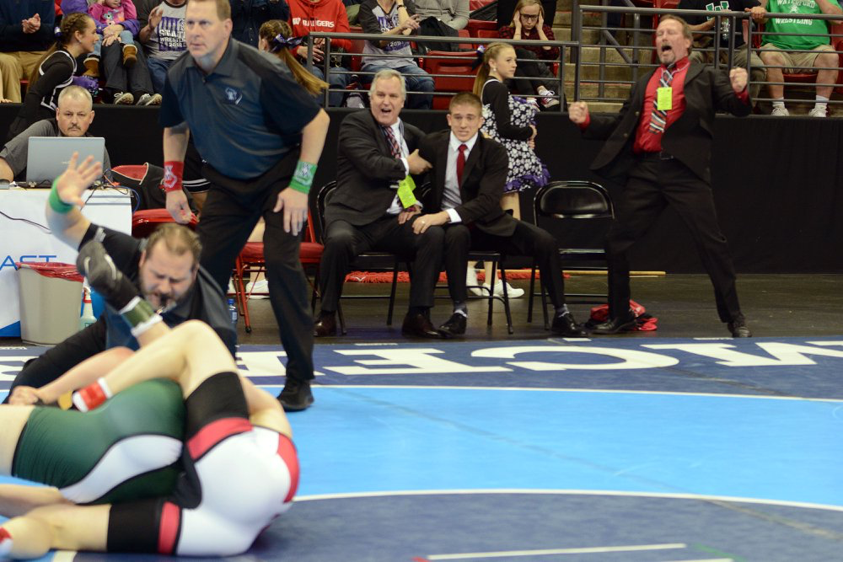
Coach Cowlings Affirmations
I am very fortunate to have the friendships and relationships I have gained through the sport of wrestling.
I am grateful for the opportunity to work with coaches, kids and their families to change their lives for the better.
I appreciate what wrestling has done for me and my family.

Slide 13
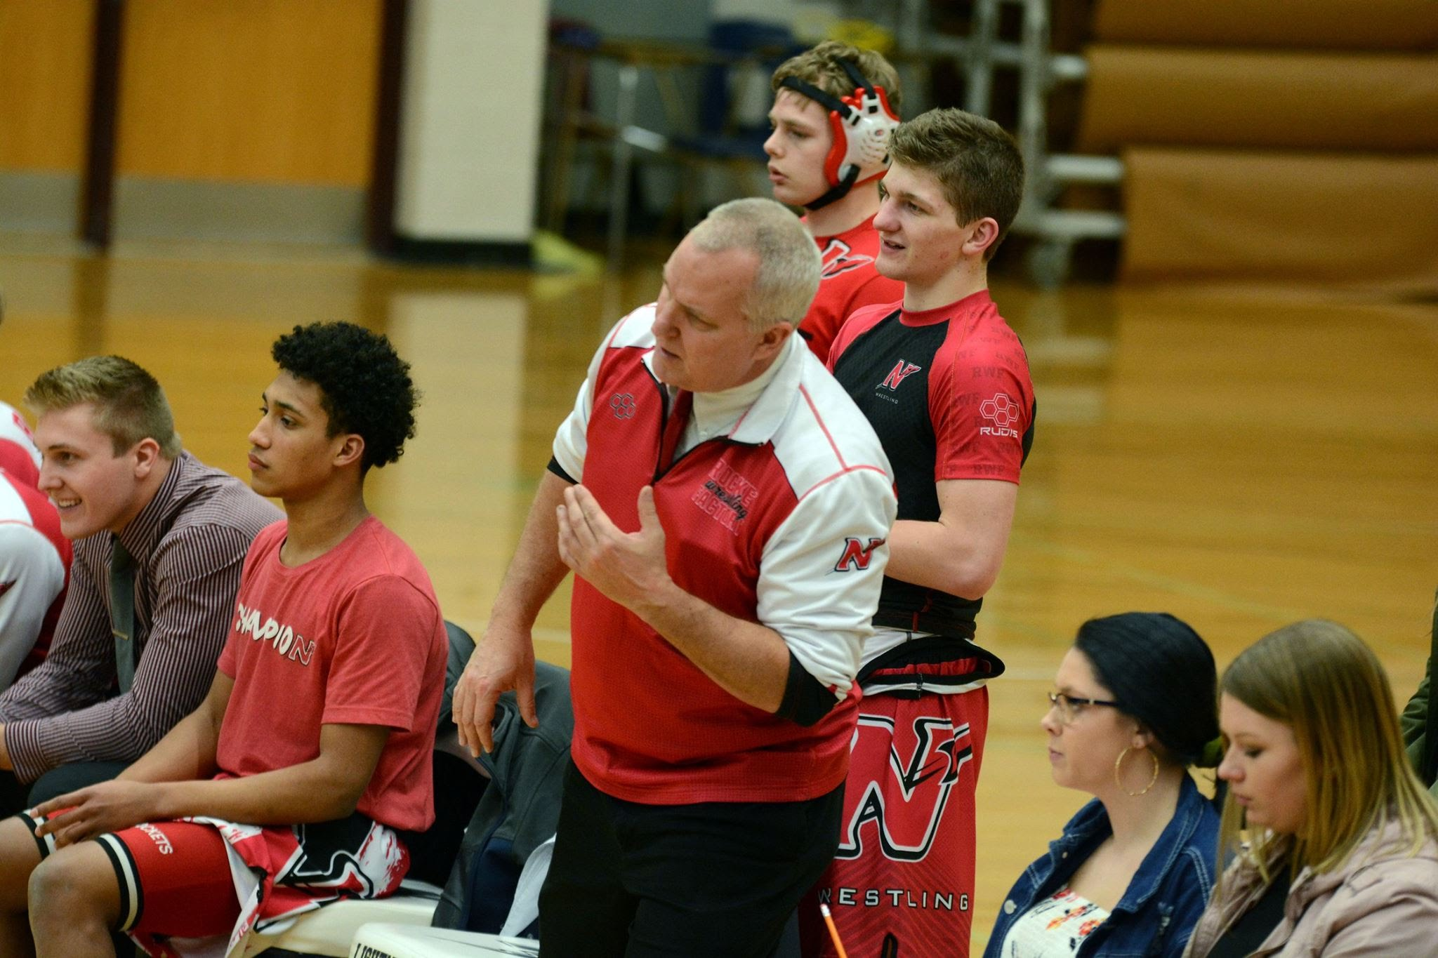
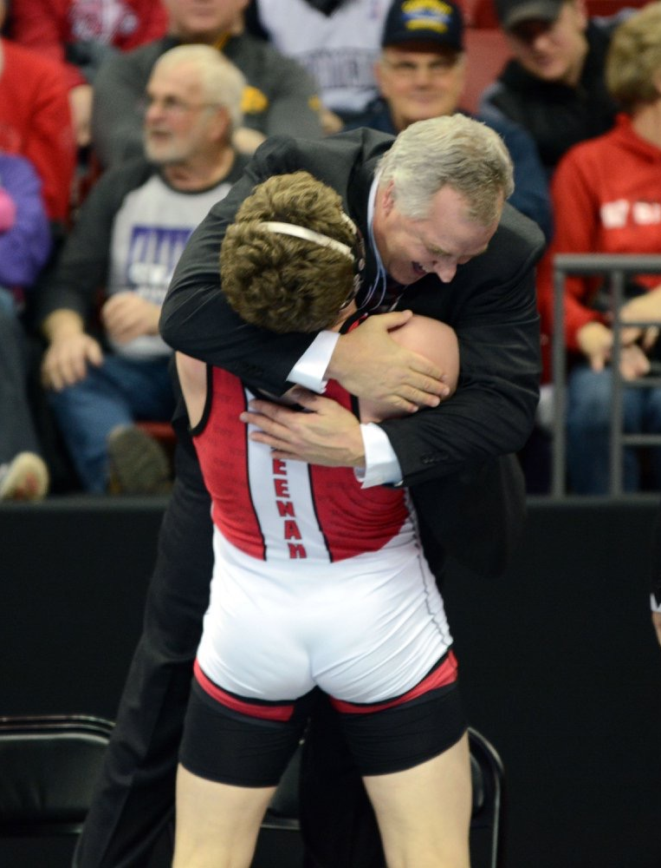
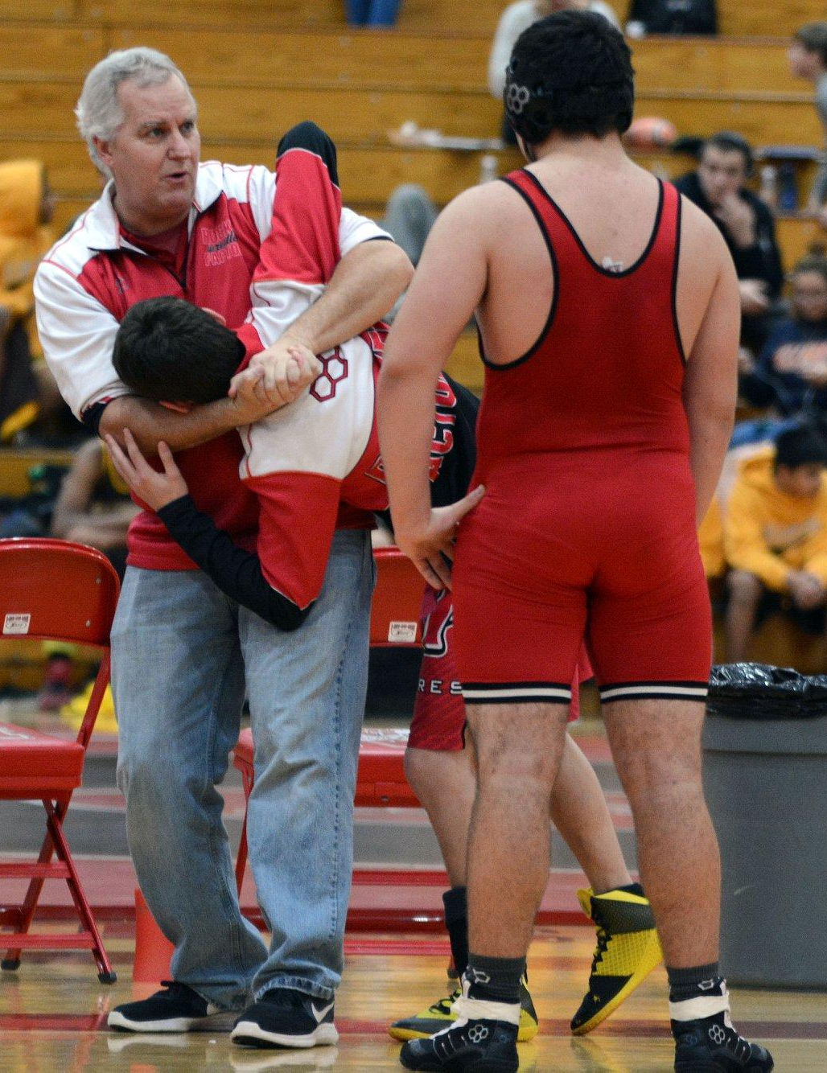
Neenah High School Wrestling
2019-2020 Coaching Staff
Head JV Coach
Chris Rundquist
8th Season as Neenah Wrestling Head JV Coach.
2018-2019 Neenah Joint School District
High School Teacher of the Year
Former Head Wrestling Coach at
Kimberly High School.
Wife: Heather
Daughters (3): Sophie, Emma, Grace

Slide 14
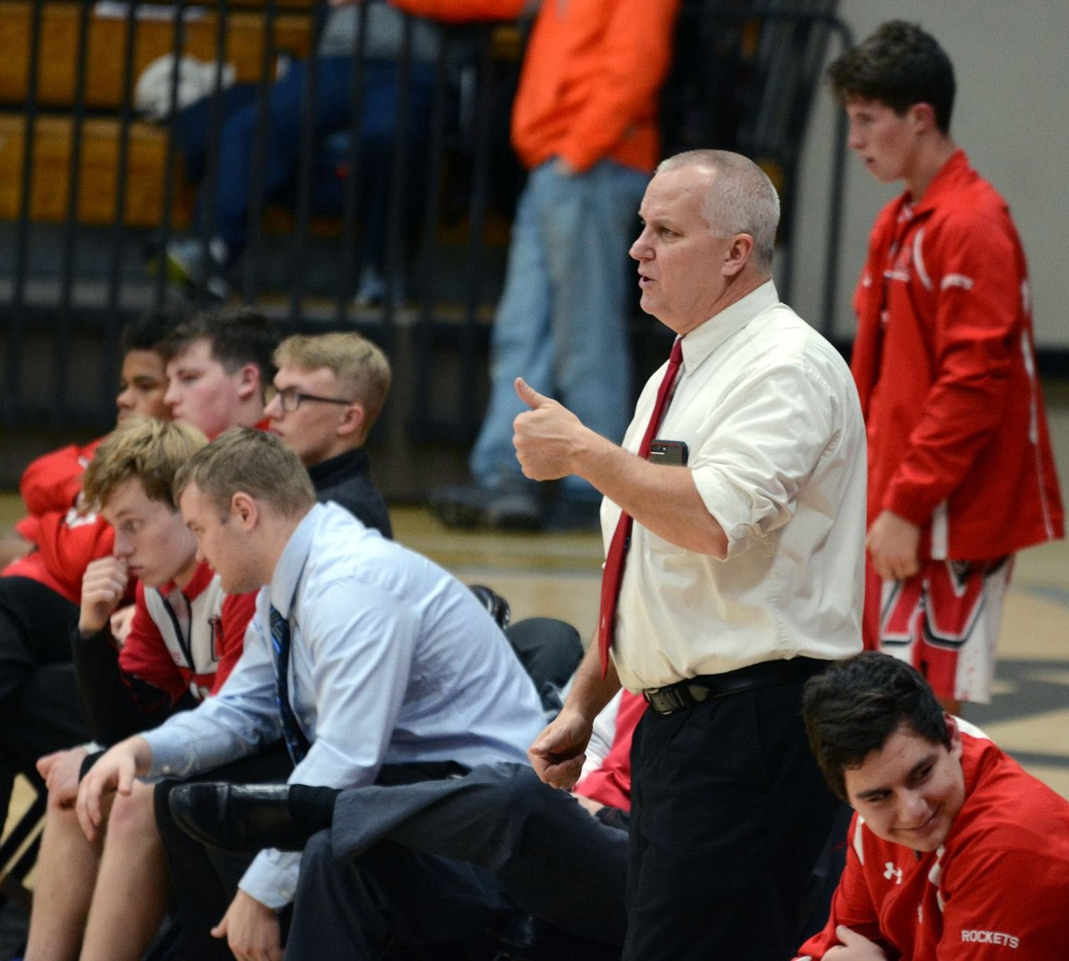
Coach Rundquist’s Affirmations
I am determined to treat every individual who joins the team as a valued individual regardless of talent or ability.
I will be a role model in regards to caring unconditionally.
I will remind myself daily that I am blessed to be a part of a great organization, filled with amazing people who love the sport of wrestling.

Slide 15
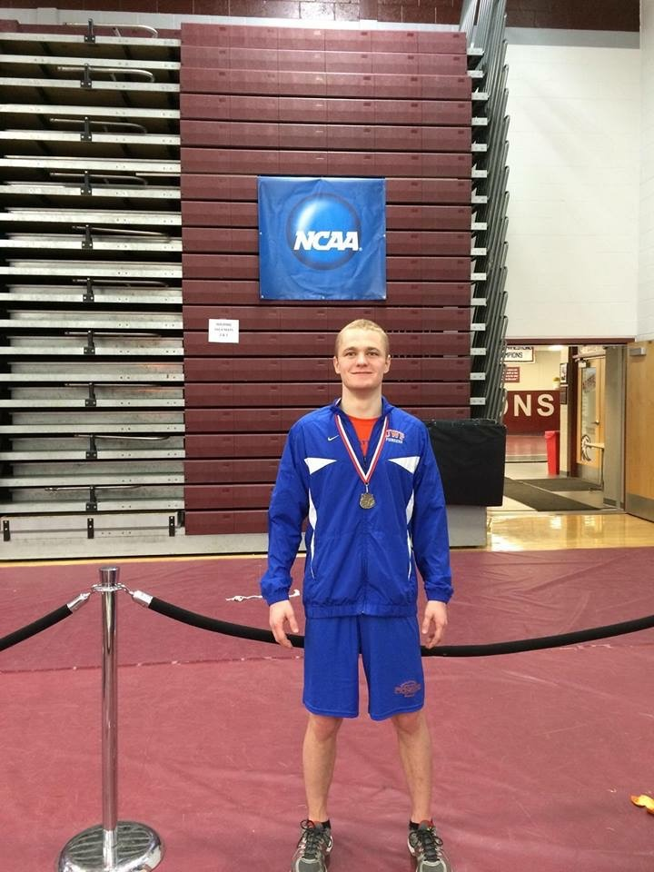
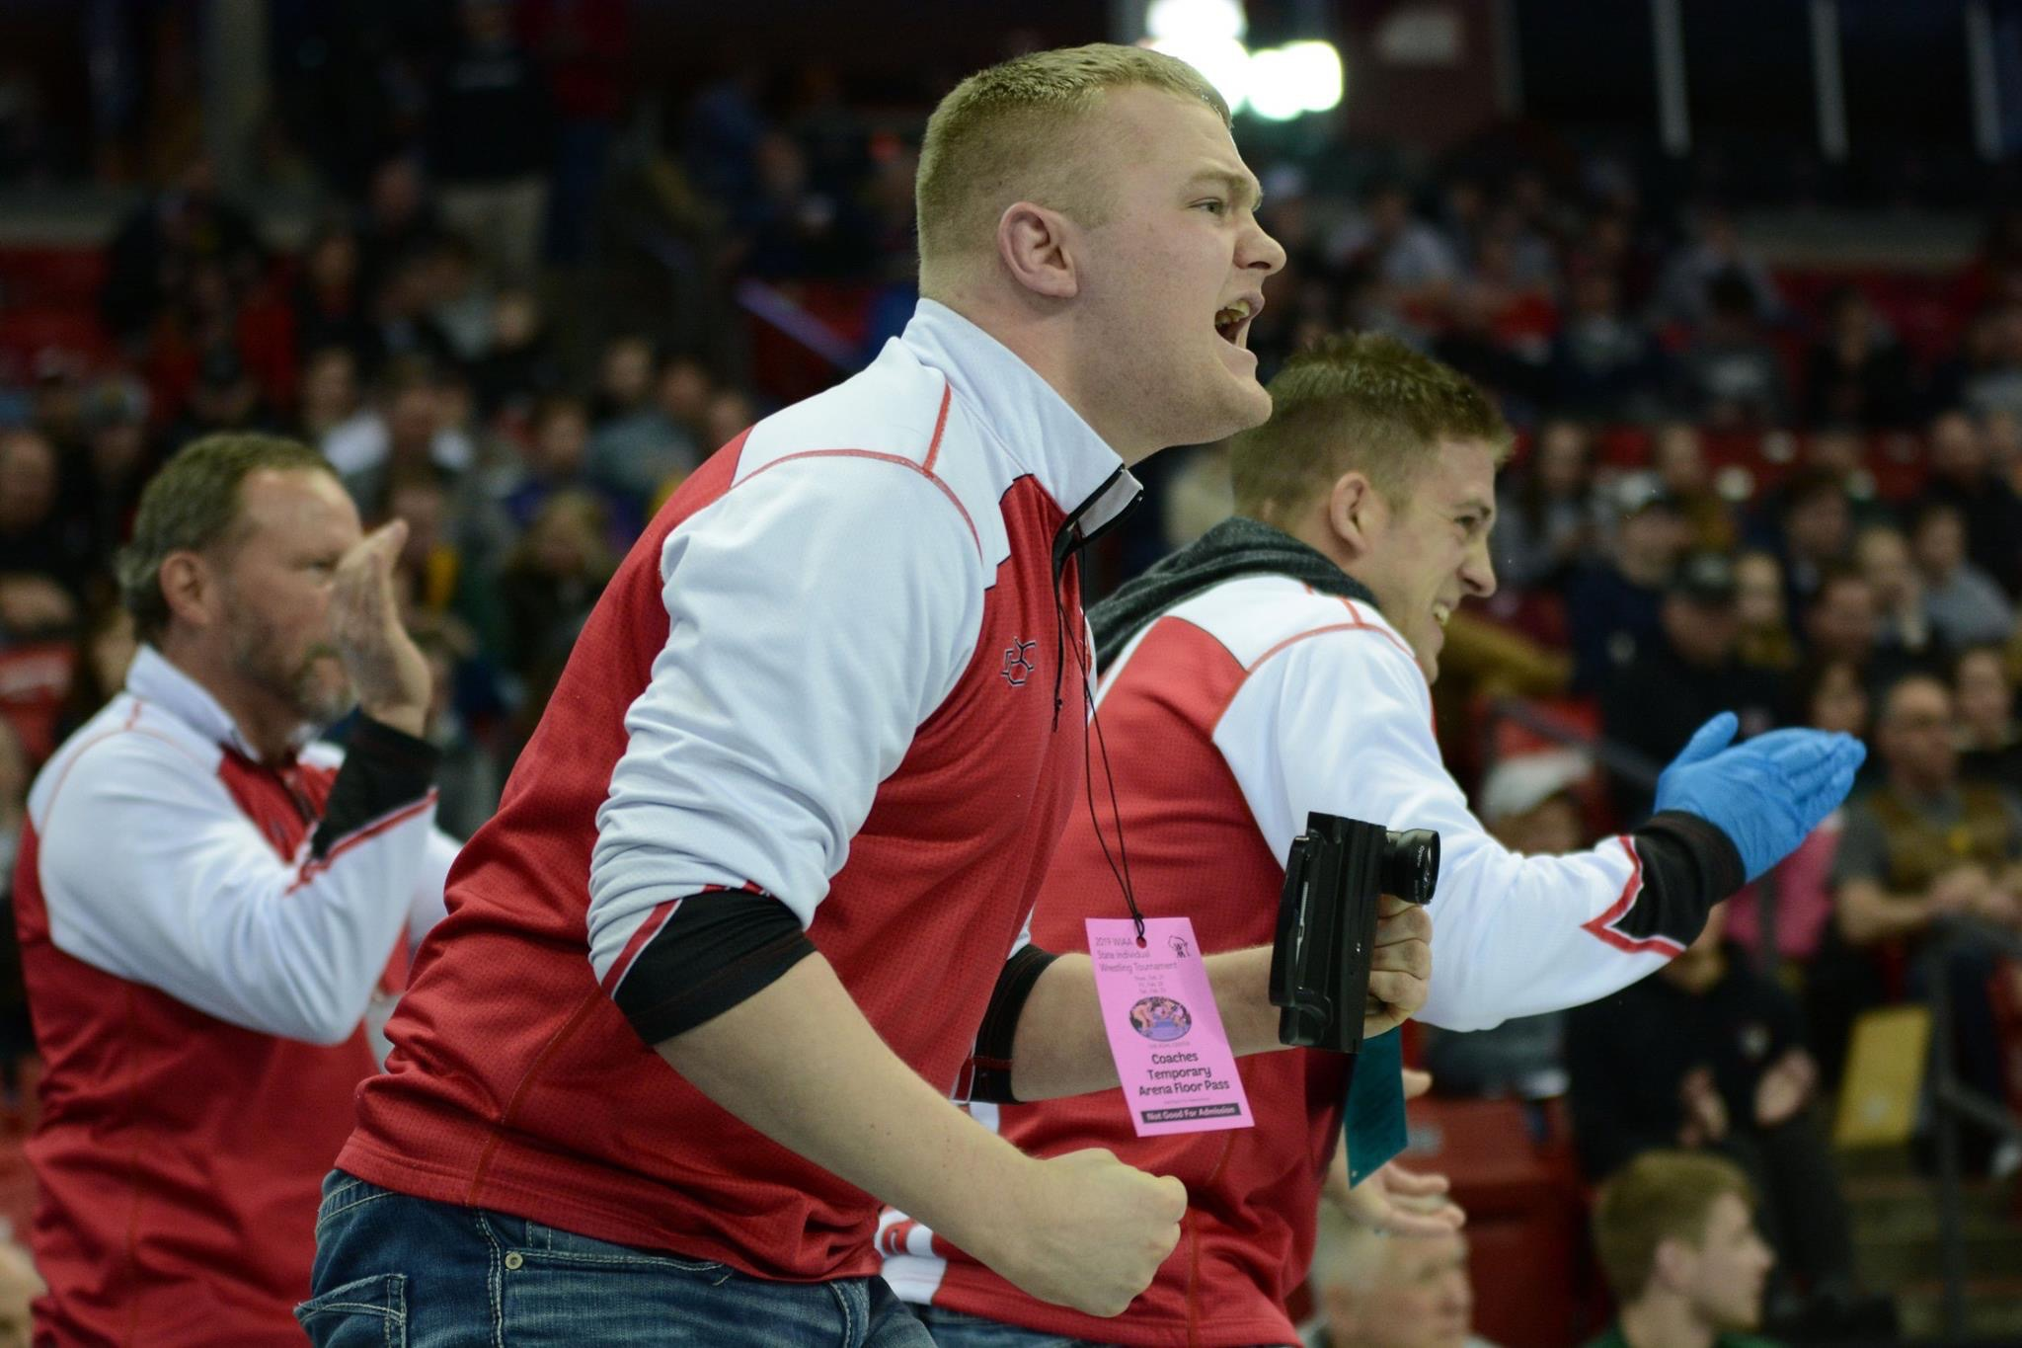
Neenah High School Wrestling
2019-2020 Coaching Staff
Volunteer Assistant
Mason Bohm
4th Season Coaching @ Neenah
2X WIAA State Runner-Up @ Shawano High School
2X NCAA National Qualifier @ UW Platteville
Engineer @ Neenah Paper

Slide 16
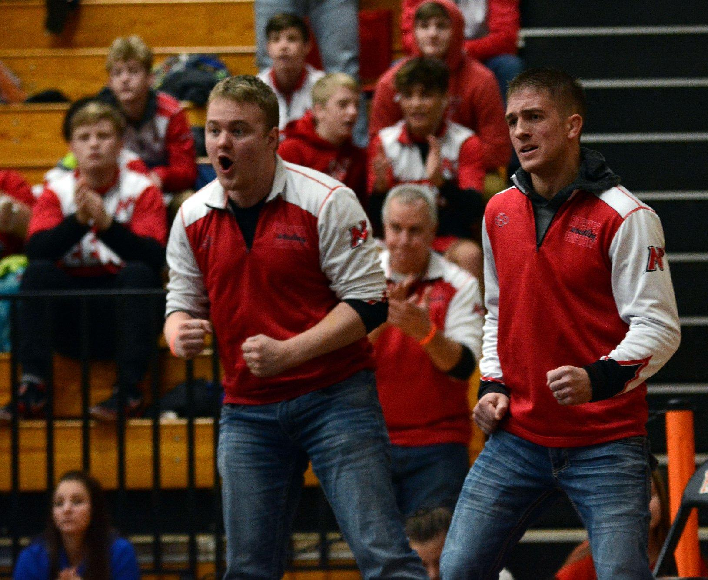
Coach Bohm’s Affirmations
I’m grateful to watch and try helping our young adults become respectful people going forward in life. To see them grow and mature is something I always love seeing.
I cherish the opportunities to help them accomplish their goals on the mat. I’m grateful to have had any impact at all in their ability to achieve their goals and dreams.
I’m grateful for all the friendships coaching at Neenah has brought me. I consider everyone to be like a second family to me and appreciate all the things everyone has done for me.

Slide 17
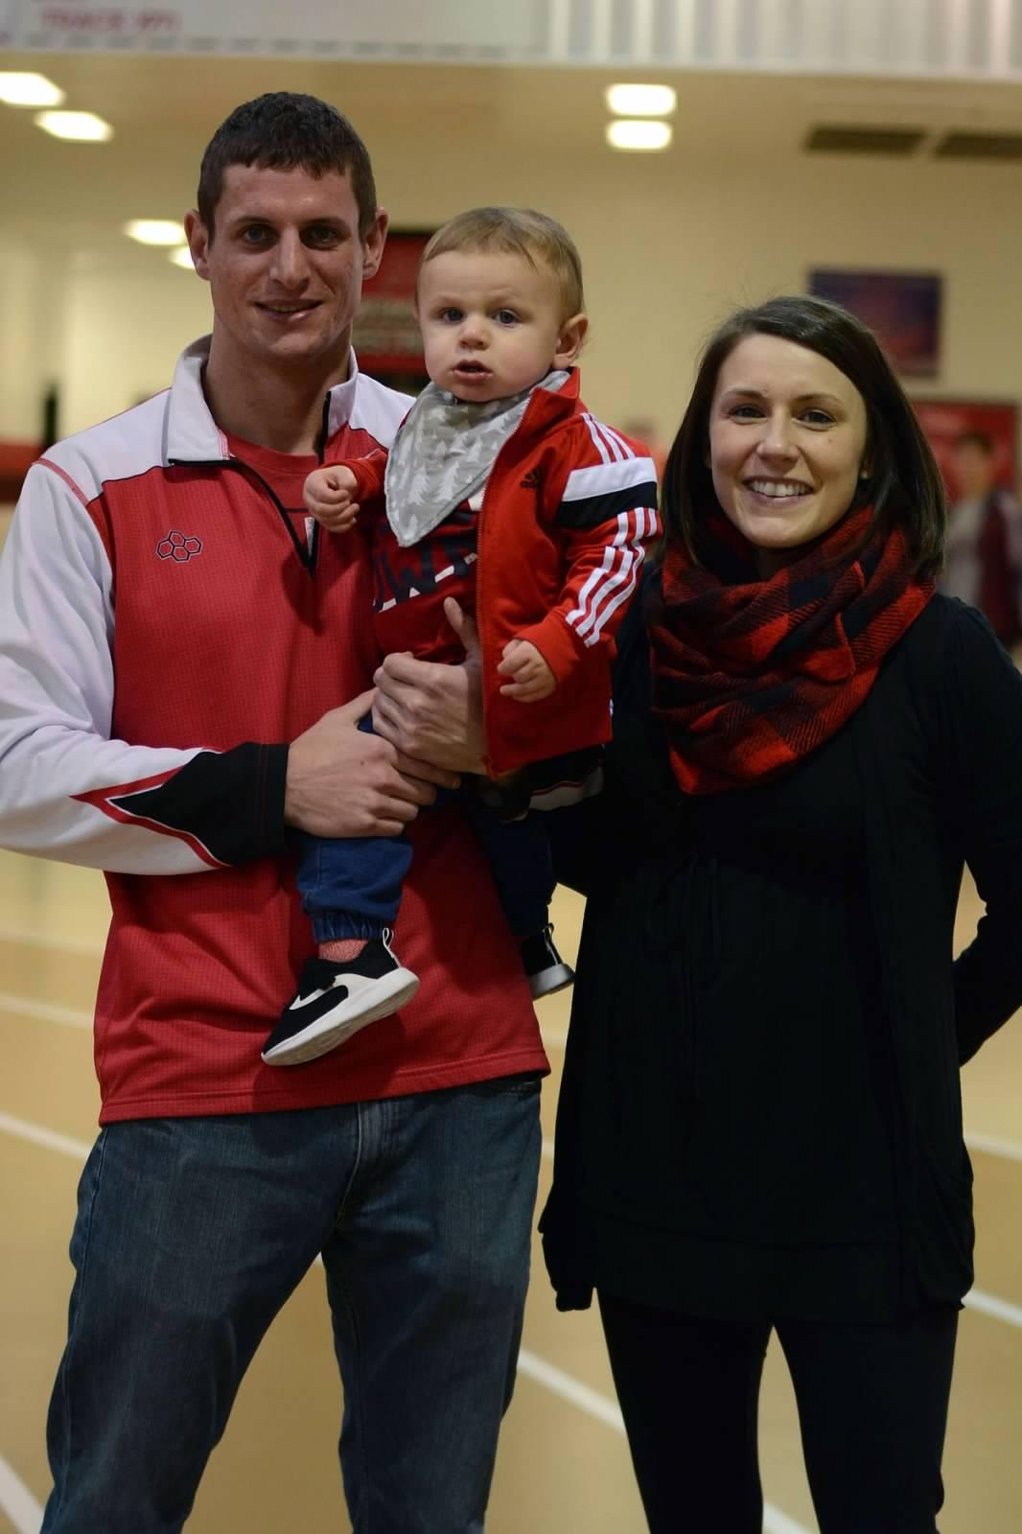
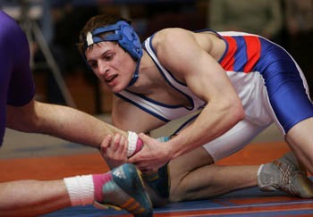
Neenah High School Wrestling
2019-2020 Coaching Staff
Volunteer Assistant
Cory Zuberbier
5th Season Coaching @ Neenah; 7th with Coach K overall.
Wrestled at UW Platteville for 4 Seasons.
Engineer @ AMCOR
Wife: Kristin
Sons (2): Levi and Micah

Slide 18
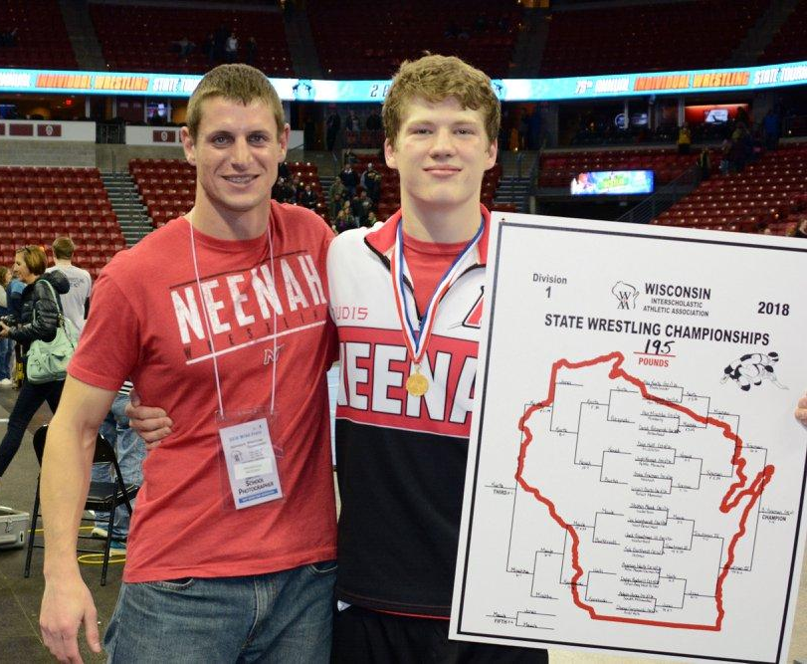
Coach Zuberbier’s Affirmations
It's a big part of who I am today and because of that I love the opportunity to give back to the sport.
I am blessed and appreciate all the relationships I have developed through the sport.
I enjoy wrestling, the lessons it teaches and the challenges it has to offer for any talent or skill level.

Slide 19
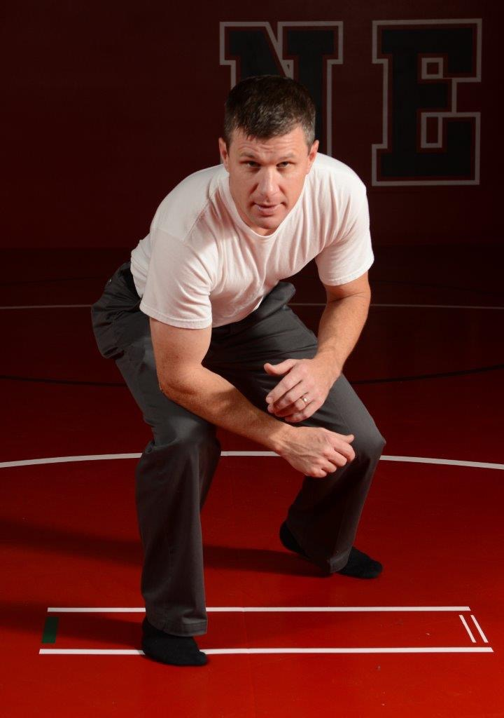
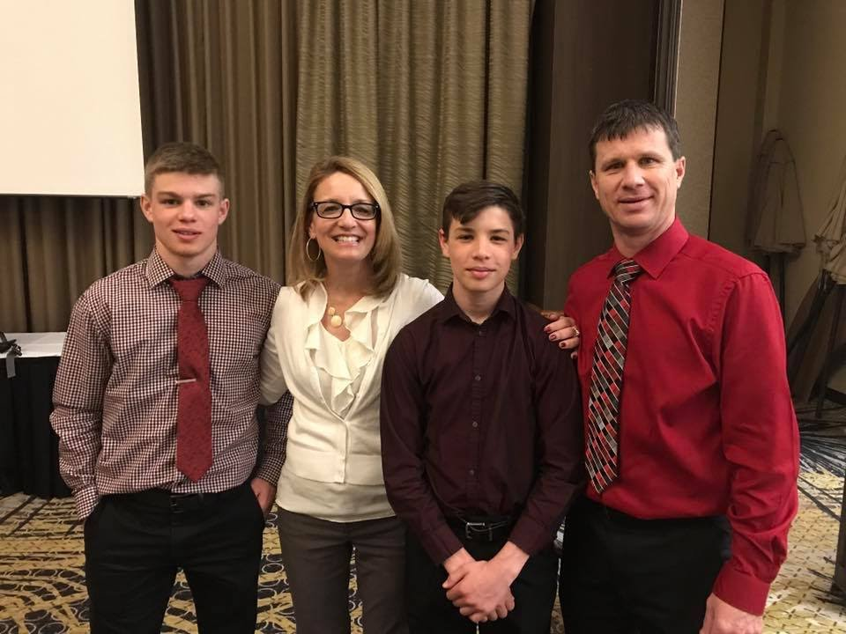
Neenah High School Wrestling
2019-2020 Coaching Staff
Volunteer Assistant
Kevin Beauchamp
5th Season Coaching
@ Neenah
State Champion in HS at Gladstone MI.
Chief @ Galloway Company in Neenah
Responsible for team posters.
Wife: Bridget
Sons: Brandon and Tyler

Slide 20
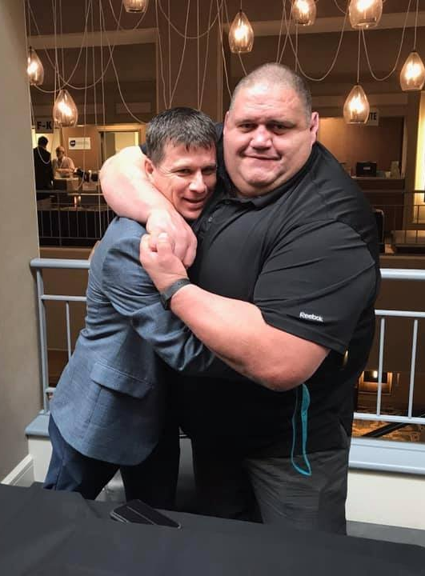
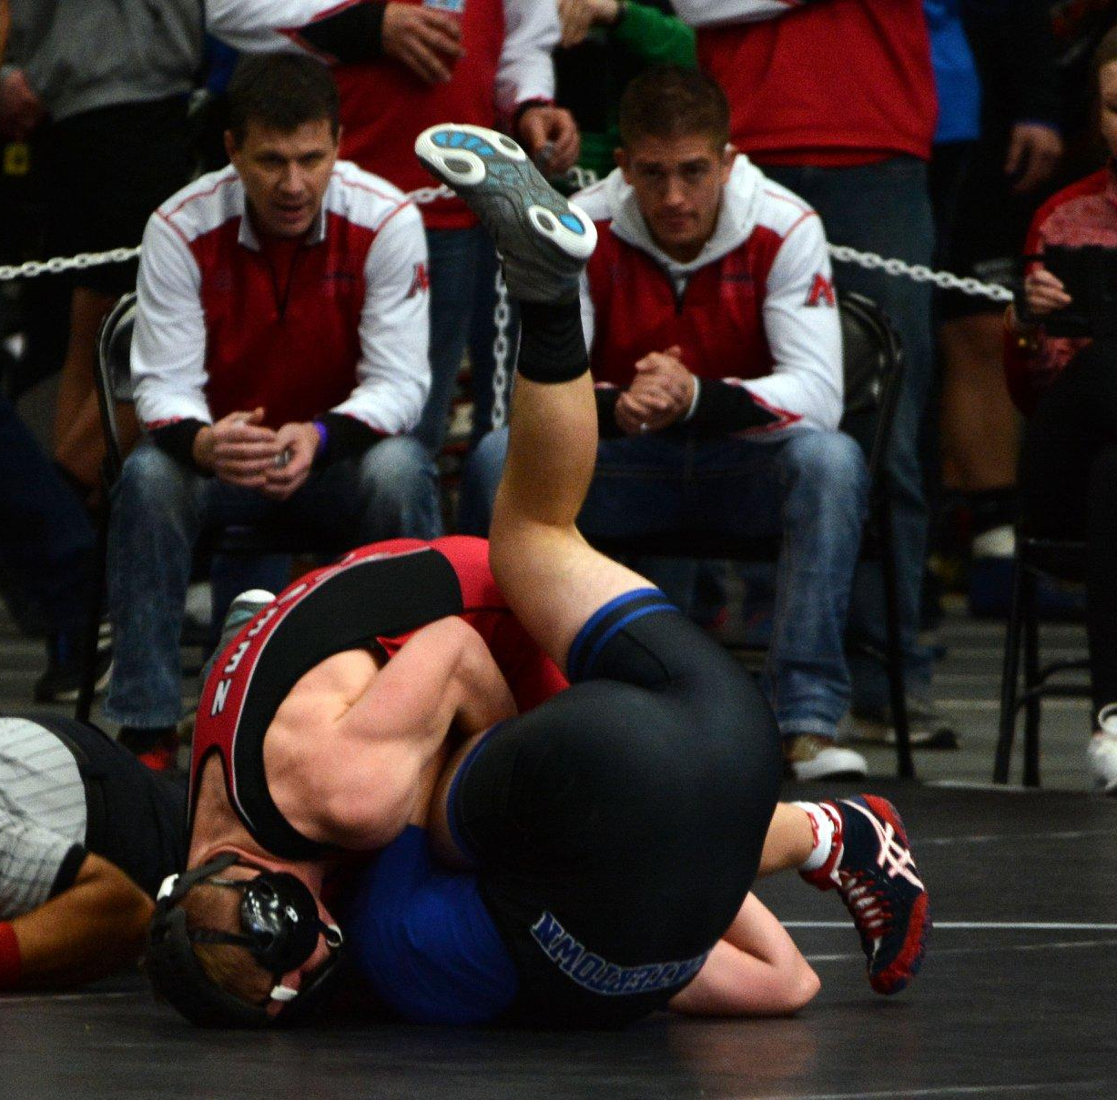
Coach Beauchamps Affirmations
I coach wrestling because I want to help student athletes compete in a sport that has given me so much. Wrestling was a huge part of my life growing up and I believe that wrestling was influential in making me into the person I am today.
The core values instilled in wrestlers help them in their daily life as well as their future business and family life. I coach wrestling because I want to help young athletes build their own set of core values that will enable their success on the wrestling mat, but more importantly, make them “Champions in Life”.

Slide 21
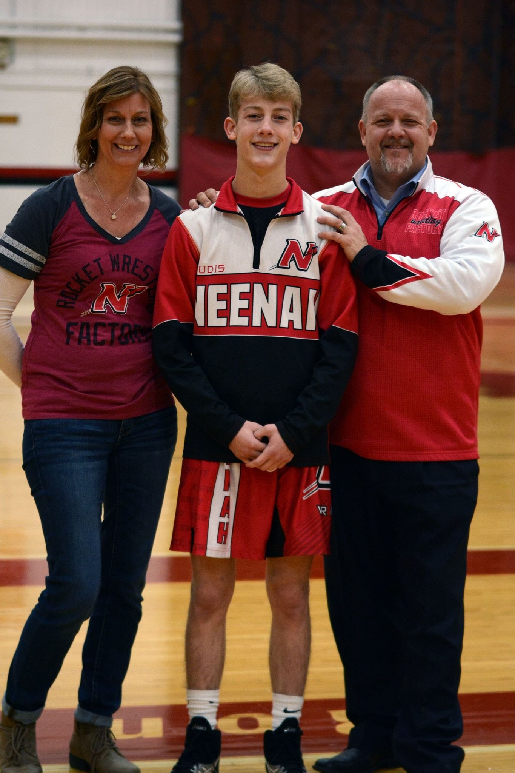
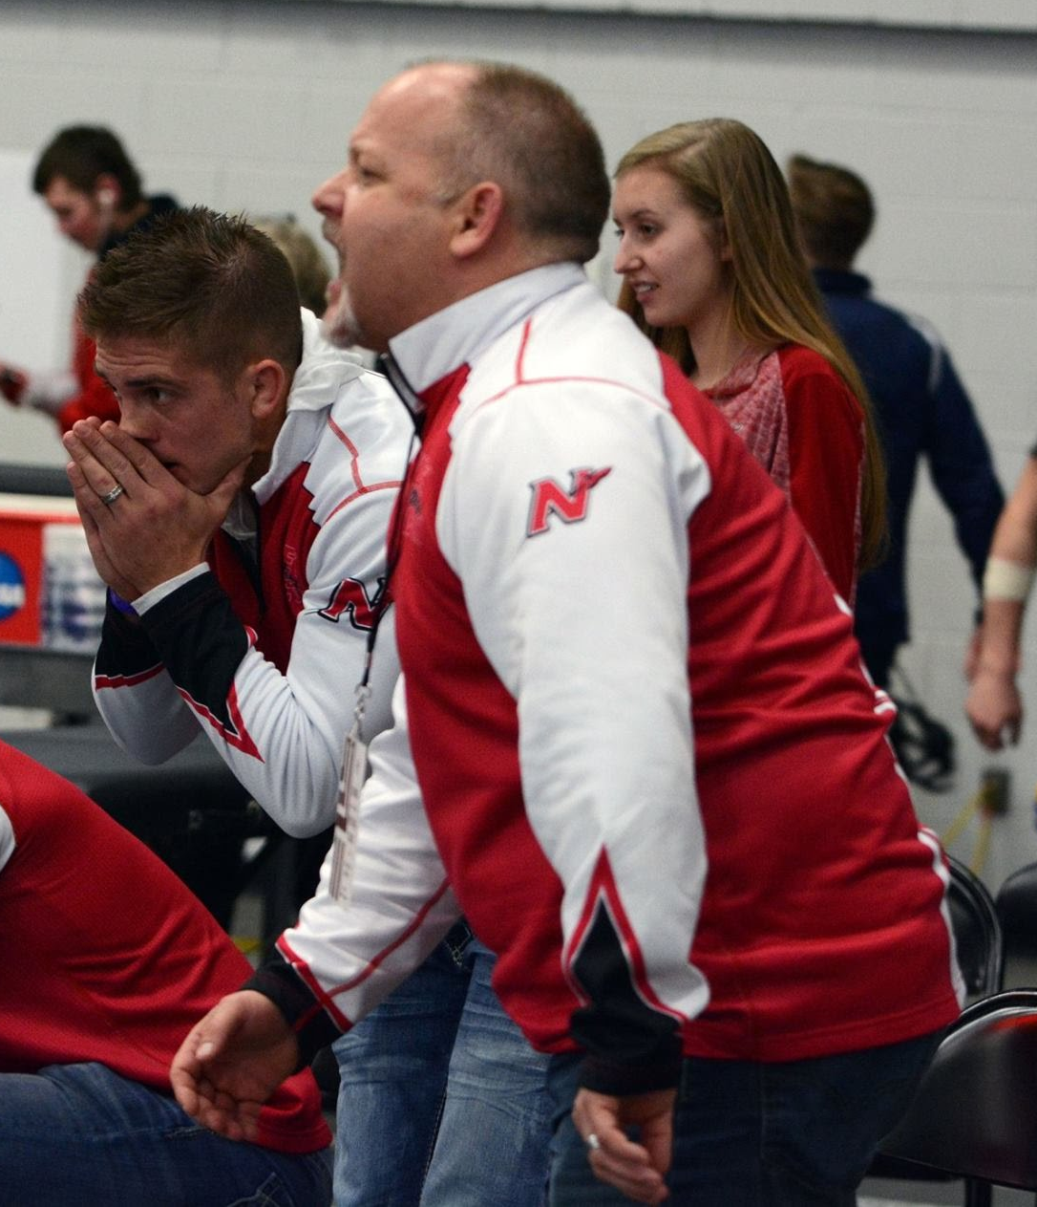
Neenah High School Wrestling
2019-2020 Coaching Staff
Volunteer Assistant
Brian Piechocki
Coached at Various Levels in
the program since the 1990’s.
Works @ GrayBar
Wife: Pam
Children (3): Madelyn, Gabriella, Evan

Slide 22
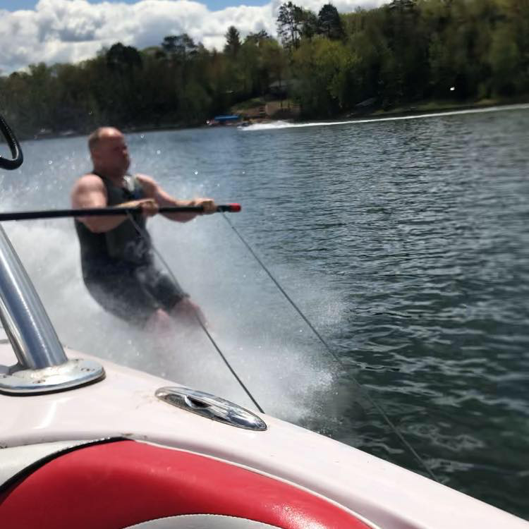
Coach Piechocki’s Affirmations
Wrestling has blessed me with many life-long relationships both as an athlete and coach. Wrestling has become a way for me to “pay it forward”
The ups and downs of wrestling has helped me to excel in daily life. It has taught me to appreciate the struggle and take on adversity and or challenges.
I am absolutely committed to building a top tier program. Athletically, Socially and Academically. I believe we are shaping the kids in our program to better our school and community.

Slide 23
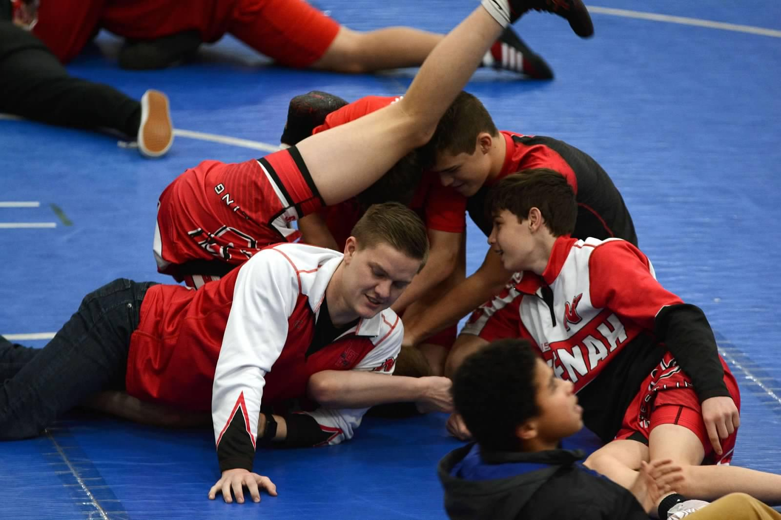
Neenah High School Wrestling
2019-2020 Coaching Staff
Volunteer Assistant
Ryan Robillard
3rd Season Coaching @ Neenah
State Runner-Up in 2009
Chiropractor at Clover
Chiropractic in Neenah.
Wife: Amanda

Slide 24
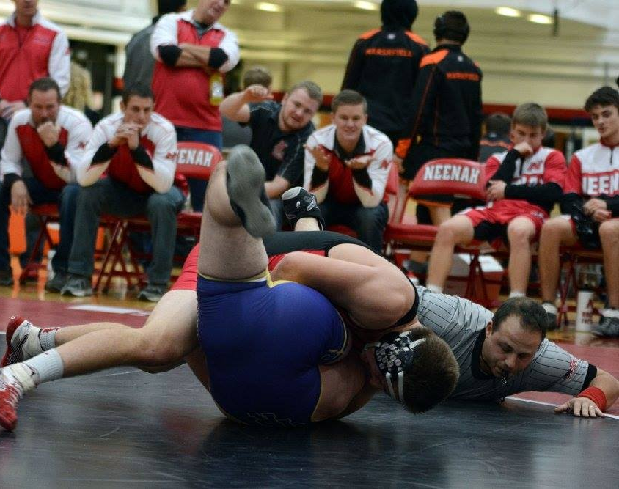
Coach Robillard’s Affirmations
I am excited to continue working with a sport that has helped me grow throughout my life.
I am grateful for the relationships that i build through the sport with coaches and athletes.
I am excited for another year with a great team and staff.

Slide 25
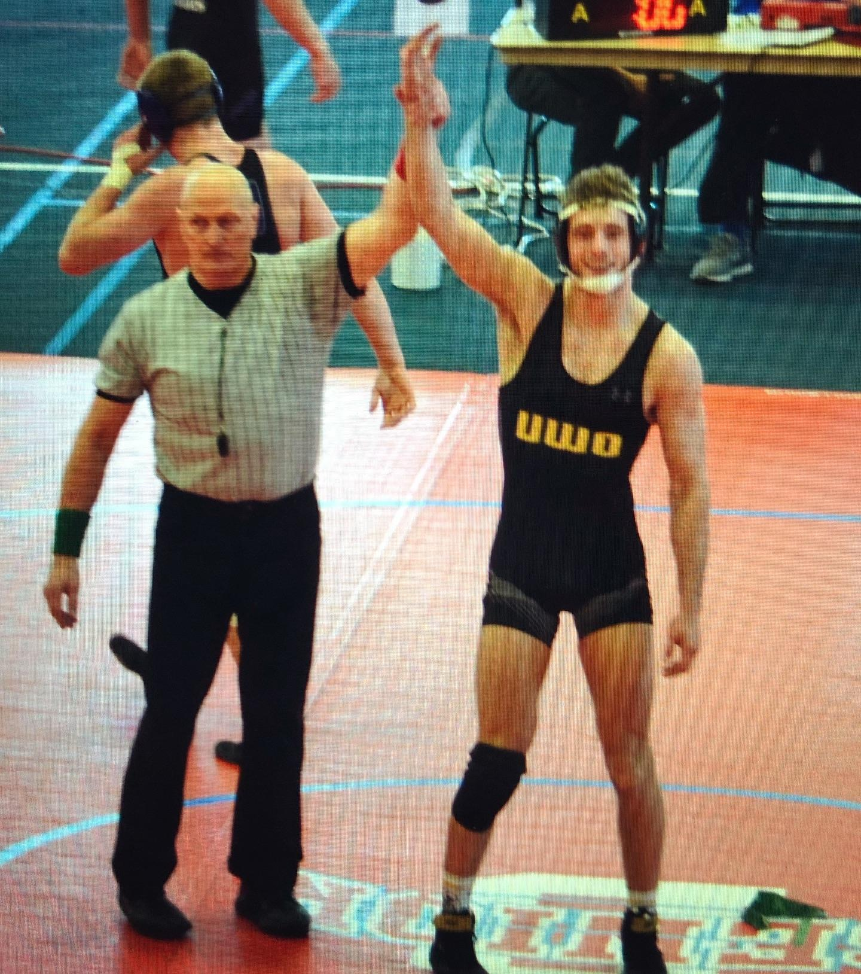
Neenah High School Wrestling
2019-2020 Coaching Staff
Volunteer Assistant
Corey Knudsen
1st Season Coaching Neenah HS Wrestling
Helped Neenah Youth Wrestling in 2018-2019
Wrestled 4 Seasons @ UW Oshkosh Team Captain 18-19
Student Teaching with Coach Kleuskens @ Lakeview Elementary in Neenah.
Girlfriend: Lauren

Slide 26
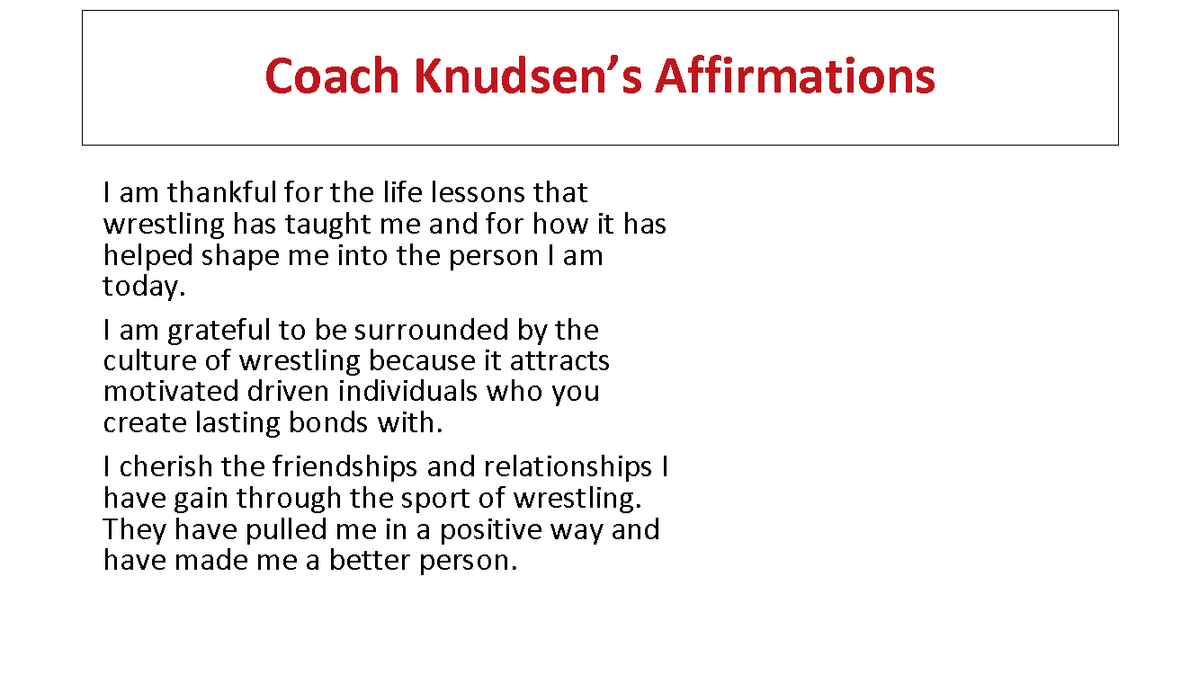
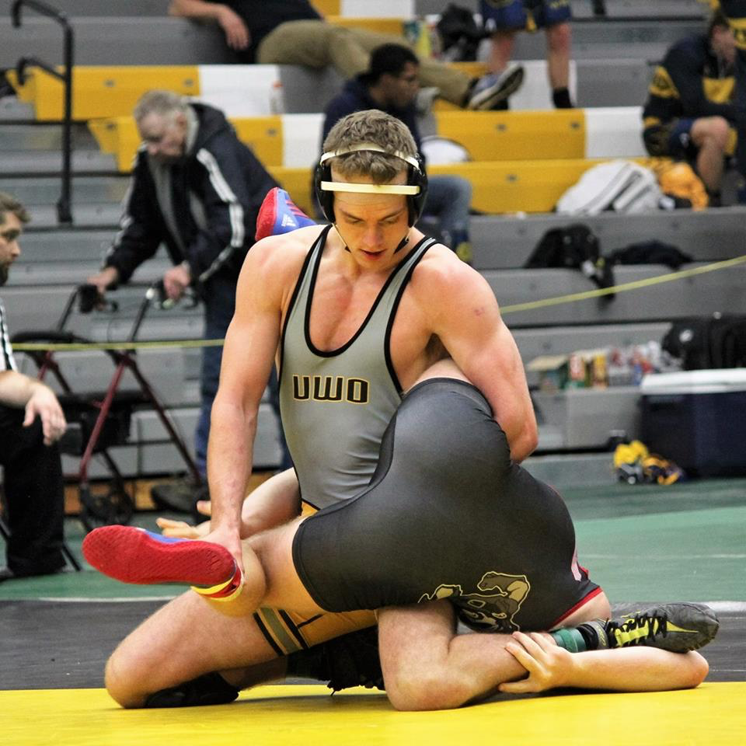
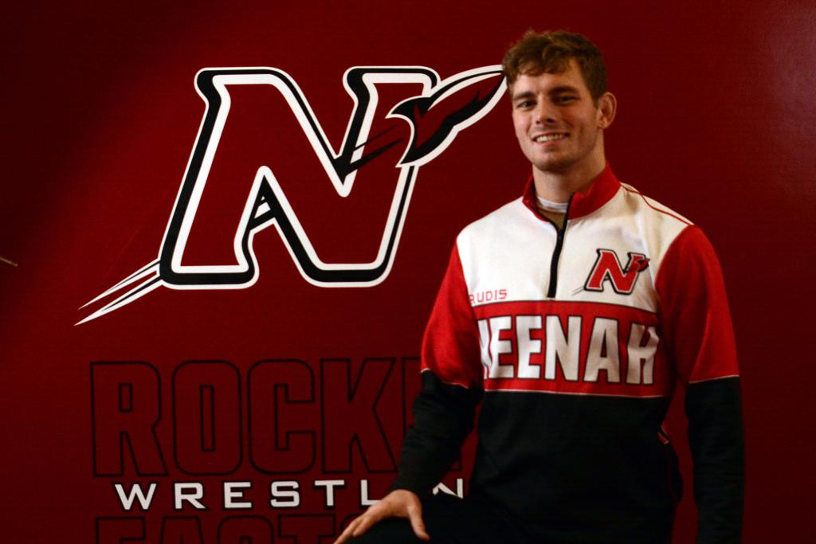
Coach Knudsen’s Affirmations
I am thankful for the life lessons that wrestling has taught me and for how it has helped shape me into the person I am today.
I am grateful to be surrounded by the culture of wrestling because it attracts motivated driven individuals who you create lasting bonds with.
I cherish the friendships and relationships I have gain through the sport of wrestling. They have pulled me in a positive way and have made me a better person.

Slide 27
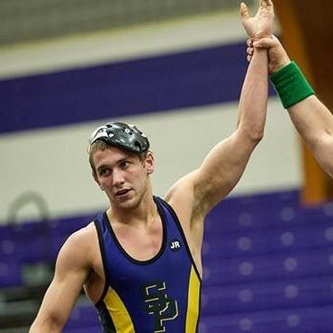
Neenah High School Wrestling
2019-2020 Coaching Staff
Volunteer Assistant
Ben Strobel
2nd Season Volunteer Coaching Neenah HS Wrestling.
2X WIAA State Placewinner 4th (2008), 3rd (2009) for Neenah HS.
Wrestled 4 Seasons @ UW Stevens Point where Ben was a 2X National Qualifier.
Dentist @ Curless Dental
Wife Lori

Slide 28
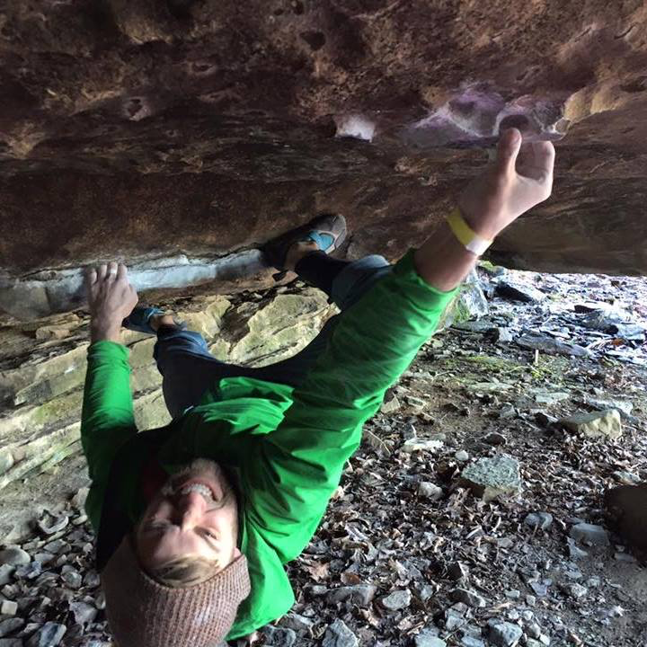
Coach Strobel’s Affirmations
I want to give back to a sport that made me the type of person I wanted to be.
Showing young men how to be resilient in the face of adversity gives me great satisfaction as I get to watch them mature and grow mentally.
Helping young people set and achieve their goals sets them up for success in life and I value my time helping them develop this.

Slide 29
Neenah High School
Activities Contacts
Activities Office – Room 323 Door 3 Entrance
  Michael Elkin - Activities Director
  Lisa Dohr – Activities Director Assistant
    All Paperwork – Physicals…..
  Heidi Neustifter – Trainer
Neenah High School Wrestling Activities Information
  District Website – NJSD
  Neenah High School
  Neenah High School Wrestling on Facebook
  Neenah High School Wrestling Website: www.neenahwrestling.com
  Neenah High School Wrestling Sports Engine

Slide 30
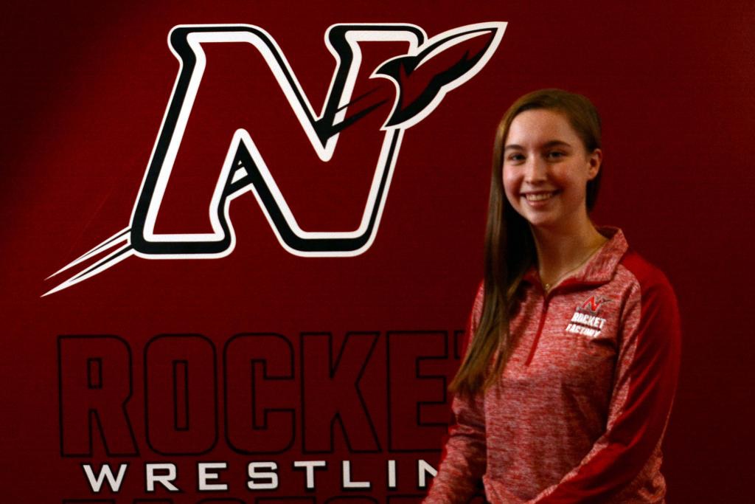
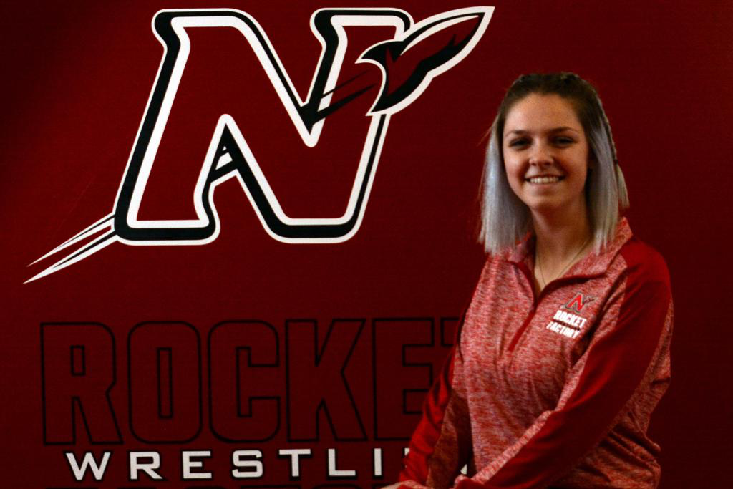
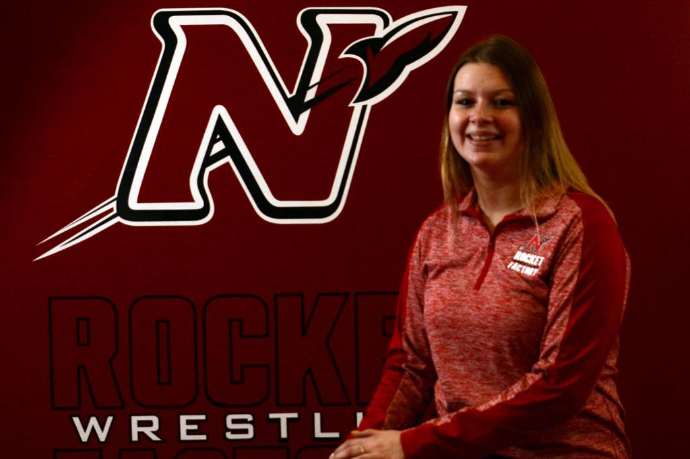
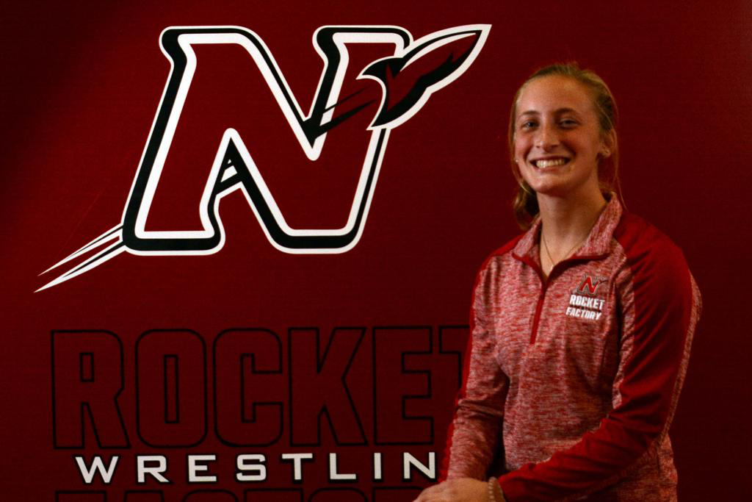
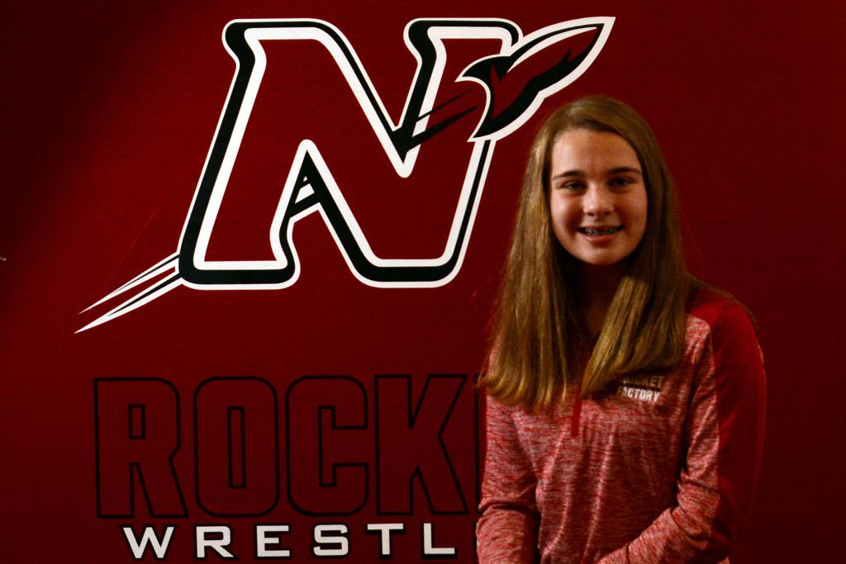
Neenah High School Wrestling
2019-2020 Manager Staff
McKenna Herm: Freshman 1X
Jordan Fitzgerald: Junior 3X
Natalie Flom: Junior 2X
Brianna Fochs: Senior 2X
Lexi Novak: Senior 4X

Slide 31
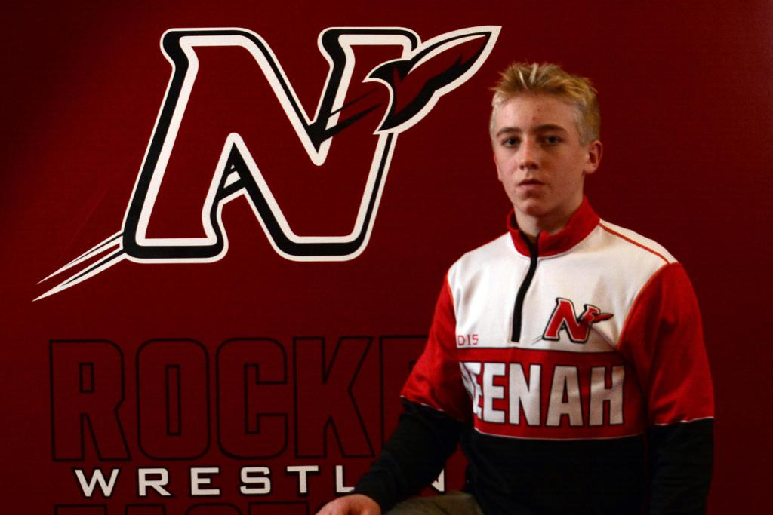
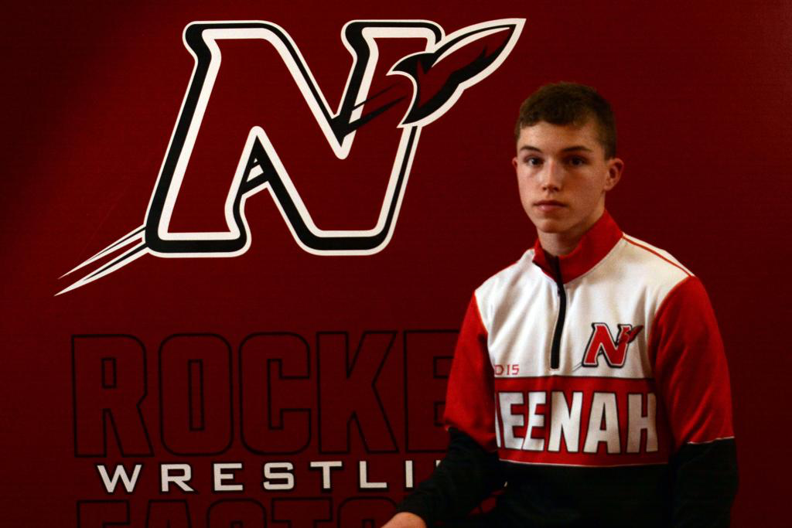
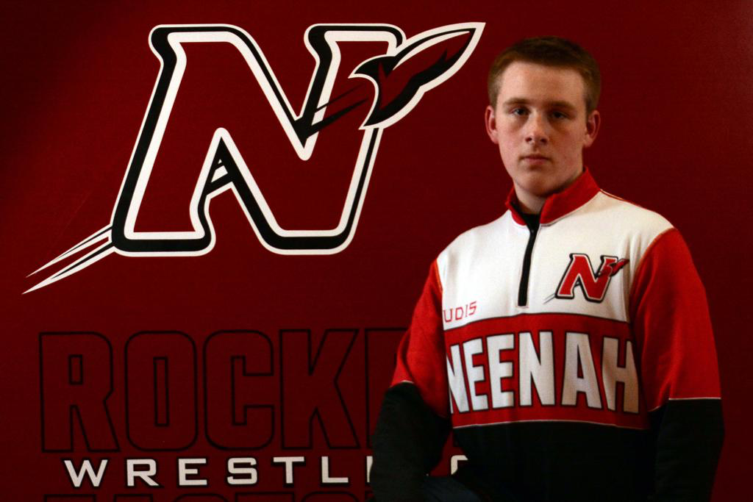
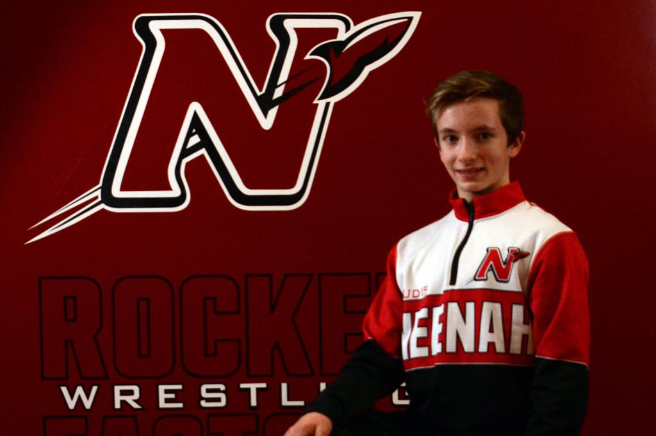
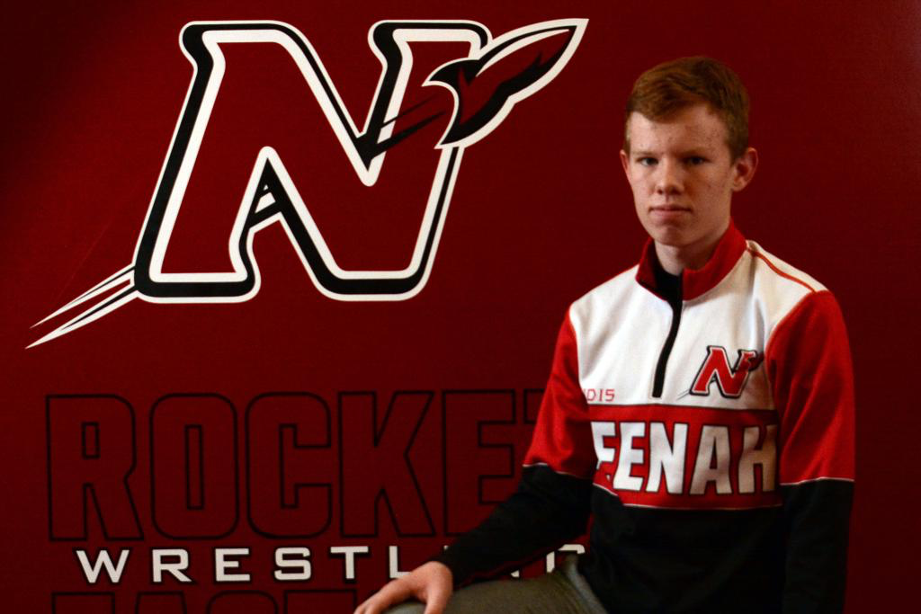



Neenah High School Wrestling
2019-2020 Freshman
Eli Gast
Ben Hansen
Preston Hella
Zach Kramp
Kaiden Lambert
Nick Novak
Roger Seelow
Jayden Sheppard

Slide 32






Neenah High School Wrestling
2019-2020 Sophomores
Charles Alft
Bryce Fochs
Caleb Letson
Austin Lewis, Davin Munoz, Caleb Letson, Bryce Fochs, William Rambert, Charlie Alft

Slide 33









Neenah High School Wrestling
2019-2020 Juniors
Tyler Beauchamp
Bryce Crook
Jacob Hamilton (NP)
Drake Hayward
Hannah McCormick
Evan Piechocki
Ethan Quella
Izaiah Reed (NP)
Kenny Schaufelberger
Myles Steward
Josh Xiong

Slide 34




Neenah High School Wrestling
2019-2020 Seniors
Marshall Kools: 4 years
Dante Caiani: 4 Years
Jenssey Fermin: 2 Years
Ramon Manka-Wigfall: 2 Years

Slide 35




Neenah High School Wrestling
  Website - www.neenahwrestling.com
  Access registration, calendars, news, photos, apparel, volunteer sign-ups (Dibs), club meetings info.
  **Primary mode of communications**
  Mobile App - SportsEngine
  App allows for quick and easy view of some
  website info and can push notifications to your
  device

Slide 36


Neenah Wrestling Club
2019-2020 Board and Volunteer Roles
Sara Sheppard: President 2nd Year; 3rd Year on Board
Craig Fochs: Vice President 3rd Year
Bridget Beauchamp: Treasurer 5th Year
Paige Lambert: Secretary 2nd Year
Angela Farrell: Youth Wrestling Coordinator
Kari Jo Butzke: Assistant Youth Wrestling Coordinator
Kyle Kleuskens: Director
Heidi Leverance: Middle School Concessions Co-Chair,
Volunteer Sign-Up (DIBS)
LynnAnn Gast: Concessions
Missy Hayward: Concessions
Melissa Novak: Concessions
Kelly Kramp: Middle School Concessions Co-Chair
Lisa Fochs: Fundraising & Apparel
Tessa Rasmussen: Technology Coordinator

Slide 37

Neenah High School Wrestling
Volunteer Needs: Sara Sheppard
  Our program is funded 100% by sponsors and volunteers!!
  Please help us continue a successful program by volunteering for a minimum of one task.
  Sign-up on the Dibs section of our website neenahwrestling.com.

Slide 38
Neenah High School Wrestling
Regional Bus: Sara Sheppard
  CALLING ALL NEENAH WRESTLING FANS TO PACK THE BUS FEB 15TH 2020!!!
  Neenah Wrestling fans are taking a coach bus to the regional tournament in Slinger to cheer our wrestlers on to the sectional tournament.
  Reserve your seat by emailing neenahrocketwrestling@gmail.com. Seats are $10.00 each. The bus will depart by 8:00 am so we will arrive in plenty of time before wrestling and the team will save seats in the bleachers for those riding the bus.

Slide 39


Neenah High School Wrestling
State Tickets: Sara Sheppard
WIAA Individual State Tournament February 27^{th-}29th @ Kohl Center in Madison.
To Purchase State Tickets please contact Bridget Beauchamp.
  $50 per set…5 sessions.
Room Blocks available through Sun Feb 23rd @ The Madison Concourse 1-800-356-8293 under Neenah HS Wrestling 2020 Parent Block
  $50 per set…5 sessions.
State Tickets are distributed the week of Monday February 24th

Slide 40


Neenah High School Wrestling
Senior Write Ups: Sara Sheppard
Seniors:
Dante Caiani, Jenssey Fermin, Marshall Kools, Ramon Manka-Wigfall, Lexi Novak, Brianna Fochs
Please send your write-up using the guidelines (we will email you) and a picture to neenahrocketwrestling@gmail.com by January 3rd.

Slide 41


Neenah High School Wrestling
Senior Night Festivities: Sara Sheppard
Senior Night:
Thursday January 23rd 2020
Neenah vs Appleton North
Celebrating: Dante Caiani, Jenssey Fermin, Marshall Kools, Ramon Manka-Wigfall, Lexi Novak, Brianna Fochs

Slide 42



Neenah High School Wrestling
Senior Scholarships: Sara Sheppard
Academic Scholarship: Senior Wrestlers and Managers Minimum of 3 Years in NHS Wrestling
$500
Requirements: GPA 3.0 or higher or IEP with 2 teacher letter of recommendation and no code violations while attending NHS.
Due Date: Send completed form to neenahrocketwrestling@gmail.com by February 1st
Collegiate Wrestling Scholarship: After Freshman Year of Collegiate Wrestling
$500
Requirements: Complete freshman year of collegiate wrestling on good standing with the Head Coach of the program.
Due Date: April of Freshman Year of Wrestling

Slide 43
Neenah High School Wrestling
Winterfest Decorations: Sara Sheppard
Opportunity to highlight our wrestlers and managers amongst the student body at NHS!!
Parents and guardians of the high school wrestlers and managers will get creative and decorate the hallway outside of the wrestling room to be on display for Winterfest week.
Decorations go up Sun February 1st and to be taken down by the 15th

Slide 44

Neenah High School Wrestling
2019-2020 HS Home Events
  Thursday December 5^{th:} FVA Home Dual vs Hortonville
  *** Parents Night
  Friday December 13th: Neenah Varsity Invitational
  Saturday December 14th: Neenah JV Scramble
  Thursday December 19th: FVA Home Dual vs Kimberly
  ***Alumni Night
  Thursday January 2nd: FVA Home Dual vs Oshkosh West in Pickard
  ***Rumble at the Rocketorium V4 *Youth Night *Business Sponsorship Night
  Sunday January 5th: Neenah Youth Tournament
  Thursday January 9th: FVA Home Dual vs Kaukauna
  Thursday January 23rd: FVA Home Dual vs Appleton North
  ***Middle School Night; Senior Night
  Saturday February 1st: Mill City Melee Middle School Duals @ Shattuck MS

Slide 45
Neenah High School Wrestling
Thanksgiving Break Schedule
  Wednesday November 27th: NO SCHOOL; Practice 8:00-10:30 AM
  Thursday November 28th: Thanksgiving NO PRACTICE
  Friday November 29th: Practice 2:00-4:30 PM
  Saturday November 30th: Scrimmage @ Green Bay Preble
  Arrive: 2:00
  Bus: 2:15
  Start Time: 4:00
  End Time: 6:00
  Return Home 7:15-7:30
  Sunday December 1st No Practice

Slide 46
Neenah High School Wrestling
Christmas Break Schedule
  Friday December 20th: Varsity Departs for Badger State Invite; NO Practice for JV
  Saturday December 21st: Badger State Invite @ Alliant Energy in Madison
  10:00 AM Start Time
  Sunday December 22nd: No Practice
  Monday December 23rd: Practice 8:00-10:30 AM
  Tuesday December 24th: No Practice Christmas Eve
  Wednesday December 25th: No Practice Christmas Day
  Thursday December 26th:
  Set-Up Rumble @ Rocketorium: 2:30-3:15
  Practice 3:30-6:00
  Friday December 27th: Varsity @ Oshkosh on the Water: JV Practice 8:00-9:30 AM
  OTW Starts 9:30 AM
  Saturday December 28^{th:} Varsity @ Oshkosh on the Water: JV Practice 8:00-9:30 AM
  OTW Starts 9:00 AM

Slide 47
Neenah High School Wrestling
Christmas Break Schedule
  Sunday December 29th: OFF
  Monday December 30^{th:} Practice 8:00-10:30 AM
  Tuesday December 31st: Practice 8:00-9:30 AM
  Wednesday January 1st: Practice: 6:00-8:00 PM
  Thursday January 2nd: FVA Home Dual vs Oshkosh West
  Rumble at the Rocketorium V4
    *Youth Wrestling Night
    Business Sponsorship Night

Slide 48


NHS Parent Involvement
It Takes a Community to Raise a Child
BE A TEAM FAN not a MY KID FAN

Slide 49


NHS Parent Involvement
It Takes a Community to Raise a Child
BE A TEAM FAN not a MY KID FAN

Slide 50

NHS Parent Involvement
Chain of Communication if Discussion is Needed
  Student talks with Coach/Advisor
  Student/Parents Meeting with Coach/Advisor
  Student/Parent/Coach/Advisor meeting with Activities Director
Be a positive Role Model all the time
Respectful of the officials! Referee = Uncontrollable
Show respect for the opposing players, coaches, spectators and support groups
Being a “Team” fan, not a “My kid” fan

Slide 51
NHS Parent Involvement
If you are a parent attending a high school athletic event this fall, you can help by following these six guidelines:
Act Your Age. You are, after all, an adult. Act in a way that makes your family and school proud.
Don’t Live Your Life Vicariously Through Your Children. High school sports are for them, not you. Your family’s reputation is not determined by how well your children perform on the field of play.
Let Your Children Talk to the Coach Instead of You Doing It for Them. High school athletes learn how to become more confident, independent and capable—but only when their parents don’t jump in and solve their problems for them.
Stay in Your Own Lane. No coaching or officiating from the sidelines. Your role is to be a responsible, supportive parent—not a coach or official.
Remember, Participating in a High School Sport Is Not About Getting a College Scholarship. According to the NCAA, only about 2 percent of all high school athletes are awarded a sports scholarship, and the total value of the scholarship is only about $18,000.
Make Sure Your Children Know You Love Watching Them Play. Do not critique your child’s performance on the car ride home. Participating in high school sports is about character development, learning and having fun—not winning and losing.
Purchasing a ticket to a high school athletic event does not give you the right to be rude, disrespectful or verbally abusive. Cheer loud and be proud, but be responsible and respectful. The future of high school sports in Wisconsin is dependent on you.

Slide 52
Academic Review STUDENT - Grades
Time Management
Target Based Grading
Must be enrolled as a full-time student
A student must pass 5 courses
One or fewer failing grades
Academically ineligible restricted from competition for 15 days

Slide 53
Academic Review STUDENT - Attendance
Must be in school all day to participate in an event
Work with the activities office on
  Medical appointments
  Family emergencies etc.
  Note from the doctor
Getting a hair cut or going to the mall is not a viable excused absence

Slide 54
Team Rules and Guidelines
Team Handbook
2019-2020 Season Guide
Includes:
Coaches Contact Information
Practice Schedules (Monthly Calendars)
Holiday Schedules
Competition Schedules
Bus Schedules
Team Honor Code
Team Wrestle-Off Policy
Un-Excused Absence from Practice

Slide 55
Team Rules and Guidelines
Varsity Wrestle-Off Policy
Dual Meets (9 FVA Duals) and Dual Tournaments (Hartland Aarowhead)
Line-Up will 100% be under the discretion of Coach Kleuskens and the NHS Coaching Staff to do what is best for the TEAM.
Wrestlers must always be prepared to wrestle their weight class and the weight class above.
Line-Up decisions ultimately are not made until the weight class begins pending on the coin flip, opponent who presents to the mat from opposing team, score of the dual meet etc.
At times we will hold more than 14 wrestlers for varsity to give our team options in dual meets for line-up changes when needed to help the TEAM.
Individual Tournaments: Neenah, Badger State, Oshkosh on the Water, Homestead, Conference
Starting Line-Up will be determined by winner of 2 X 2 X 2 wrestle off matches.
Matches will be officiated by NHS assistant coaches.
Wrestle Off’s will take place the week of major tournaments to determine line-up.
WIAA Tournaments: WIAA Regionals, Sectionals, State
Challenger (Non-STARTER) must win best 2 of 3 vs incumbent starter.
The Challenger must win Match #1 to move to the best of 3 series…if not there is no match #2.

Slide 56

Team Rules and Guidelines
Team Uniforms
Team Uniforms
Includes:
RUDIS Singlet
RUDIS Sublimated ¼ Zip
RUDIS Fight Shorts
RUDIS Compression Shirt
***Value of $225
All items property of Neenah High School.
Failure to return items at end of season will result in a fine.
Wash Wrestling Gear…
Cold Water
Wash Singlets Inside Out
Hang Dry Singlets

Slide 57
Team Rules and Guidelines
Shower Policy
Shower/Policy and Skin Infection Prevention
Wrestling Mats are washed before and after every practice.
Wrestlers must shower at Neenah…no exceptions:
  Defense Anti-Bacterial Soap provided
Disenfect Shoes/Head Gear before and after practice
Laundry after every practice/meet.
Inform Coaching Immediately if symptoms occur…
  Itching, Pimple, Abraision

Slide 58



End of Season Honors/Awards
Wall of Champions: WIAA State Place-winner
Additional Record Boards in NHS Wrestling Room :
JV State Placewinner, Conference Champion, State Qualifier, State Placewinner, Team Accolades
Varsity Letter Requirements: 35 Overall Points
1 Point for Wrestling in Varsity Match; 2 Points for Winning Varsity Match, 3 Points for a Pin in a varsity match.
Neenah Wrestling Room Hallway Quote Boards:
Meet 2 of 3 criteria
  wiwrestling.com All-State Scholar Athlete
  Team Captain
  State Qualfier
End of Season Banquet Awards:
Team MVP, Most Improved Season to Season, Most Pins, Team Captains, Most Dedicated, JV MVP, MVP Most Wins

Slide 59

End of Season Highlight Video
Matboss App
Go to the Matboss Website www.matbossapp.com
Click the Login Link on the Top Right
Enter Username and Password
Username: HSNeenWI
Password: rocketwrestlingfactory1920
Click Video
Sort Through Options to Find Your Match (Year, Event, Wrestler)
Select the Match you want to watch.
If you have a Highlight you want in the Highlight Video at the end of the year please use the Highlight Data Tool on the right to enter data and submit. Need to Enter Description, Move, Start/Stop Points

Slide 60


Thank You for Attending
Together lets make it a great Season

