Slide 1




Coaches Corner
Developing the 5 C’s
Confidence
Commitment
Communication
Concentration
Control

Slide 2
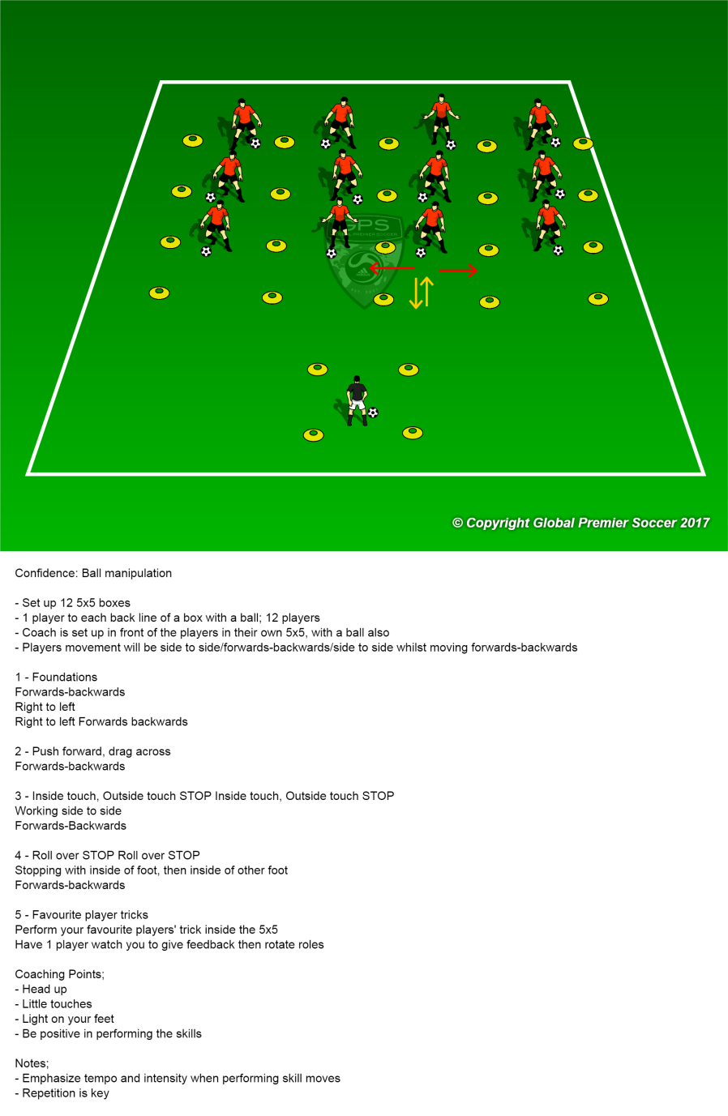
Confidence
1. Use first names when giving encouragement/praise & specific feedback on individual accomplishments .
2. Work with players to apply individual goals where possible. Gradually build success using ‘personal bests’ and self-set targets that all players respect, value and strive to achieve.
3. Challenge players to innovative & be brave within their decision making and show positive physical presence.
4. Offer players to practice their ‘go-to’ drills at home and improve their strengths.

Slide 3
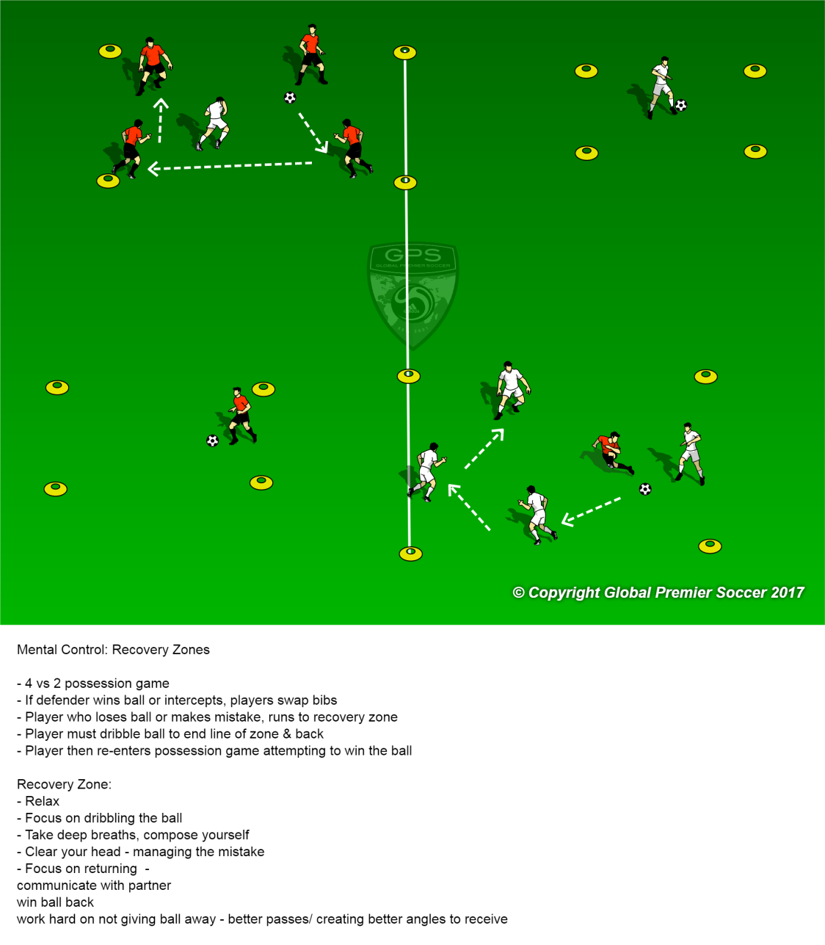
Control
Show players the difference between negative & positive emotional reactions – Illustrate the effects of anger, self-criticism, poor body language & negative thinking on the field.
Encourage players to detach themselves from mistakes/negativity by using immediate refocusing triggers- Deep breaths/Back on it/Next chance. Challenge players to recover quickest.
Use stimulated pressure games/drills to train positive responses to adversity – Use bad officiating/play them 1-0 down/time pressure.
Reinforce the use of mental routines for pre-game, breaks in play, at set pieces. Ask how many are breathing/visualising/ using positive affirmations .

Slide 4
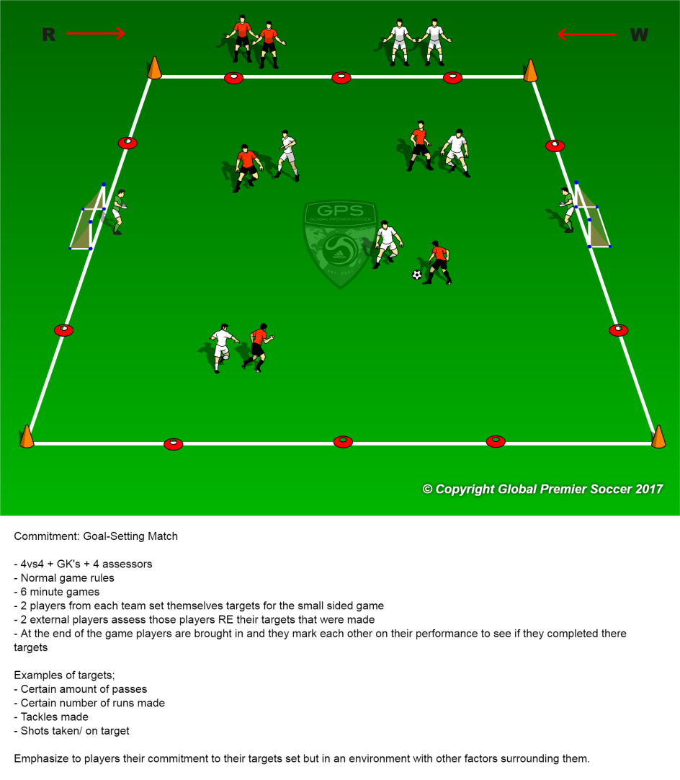
Commitment
Reward a player’s efforts, attitude & intentions beyond merely just the execution of outcome.
Give skill-specific feedback and personalised recognition when earned. Encourage the use of individually chosen goals.
Encourage a persistence after mistakes and create a ‘no limits’ environment.
Offer positive reinforcement and recognition when extra effort led to a positive outcome.
Ask players to review and rate their commitment levels – (Out of 10). ‘Can the team raise the level 5% in the next 5 minutes?’

Slide 5
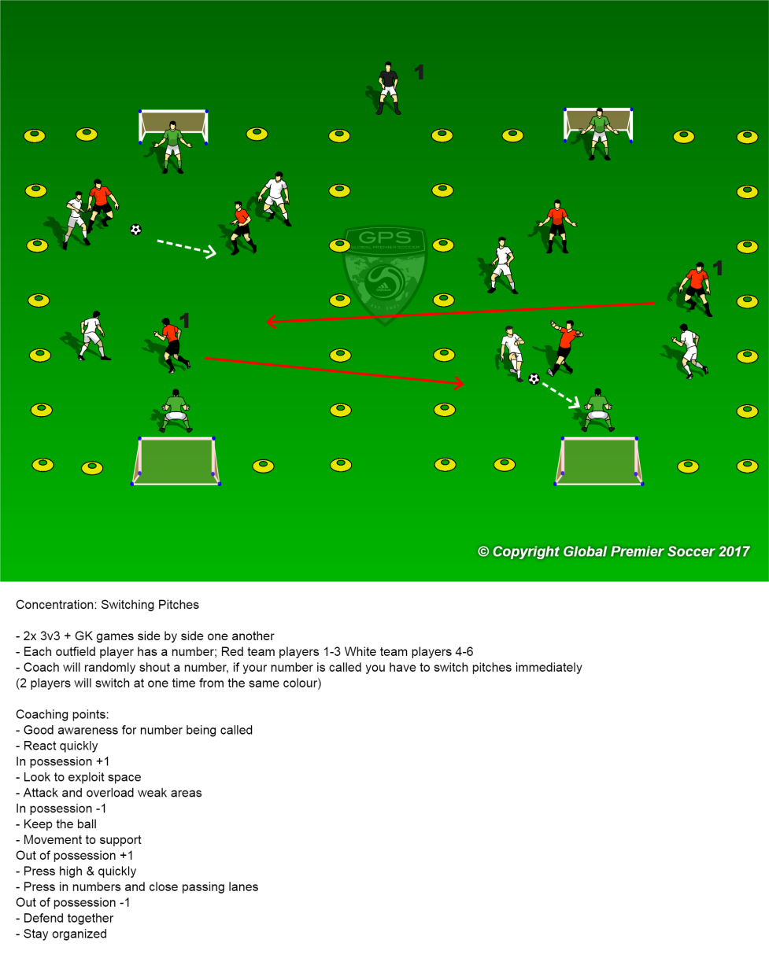
Concentration
Highlight the correct cues that a player should focusing on (When on and off the ball.
2. Use trigger words to reinforce relevant concentration cues for a task or move. (Press, squeeze, contain, shift, drop).

Slide 6
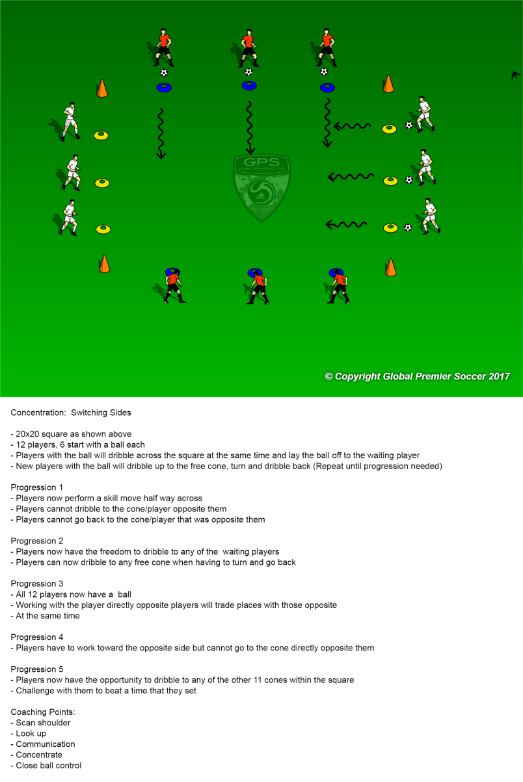
Concentration Pt.2
3. Adopt practices that challenge the players to scan and switch their focus effectively – between ball, space, key player (Check shoulder; control ball with peripheral vision, close eyes – where are your team mates?).
4. Overload and stretch players’ concentration spans and attention capacity to tasks by adding irrelevant distractions or extending drills when fatigued/bored.

Slide 7
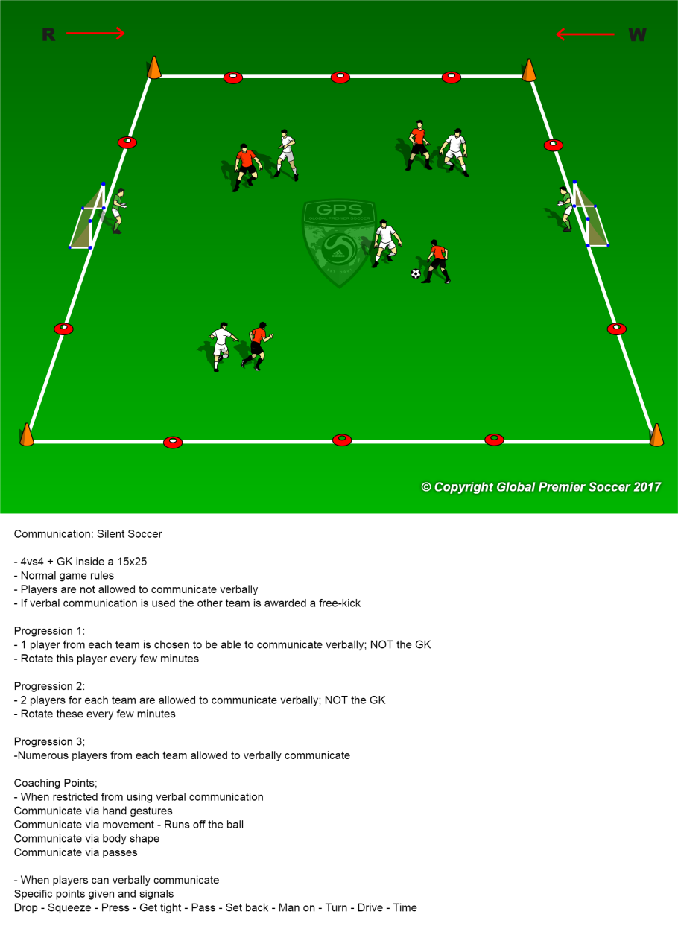
Communication
Develop a specific drill that highlights the role of communication (Only 2 players can talk; swap every 1-2 minutes; silent soccer – non-verbal communication only)
Include conditions in drills that develop communication (Name on a pass; use of trigger words; encourage teammates; silent soccer)
Recognise and reinforce when a player gives appropriate praise, acknowledgment, feedback, information or instruction to a teammate.

Slide 8



