Slide 1

Girls Lax Stats
INGLA 2026

Slide 2
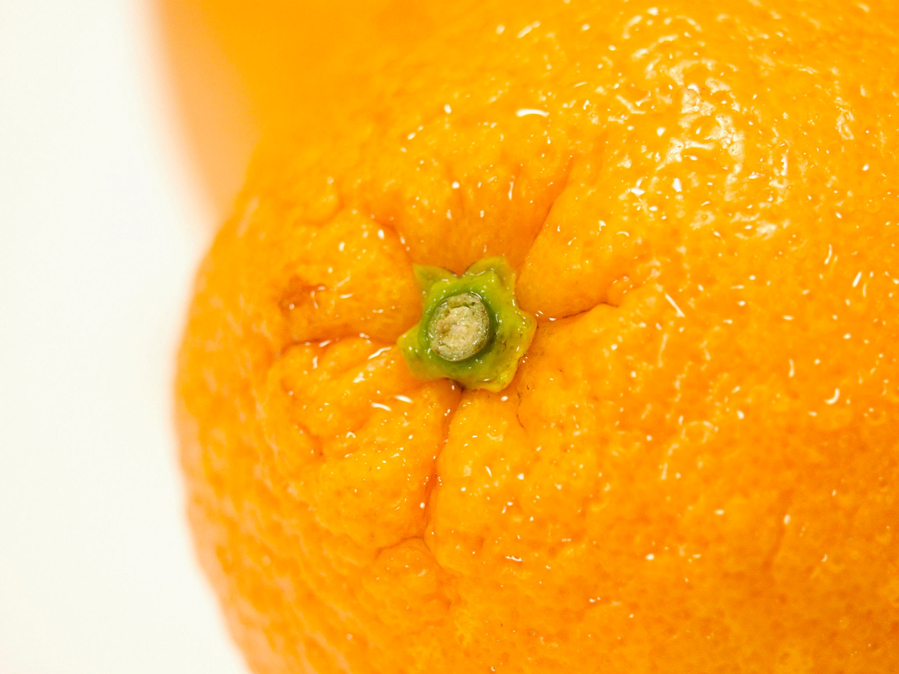

Welcome & Thank you!

Slide 3

Speakers
Abby Ferrettie, Carmel HS Girls Lacrosse Stats
M.E. Mildenberg- referee, INGLA Secretary

Slide 4
Agenda
Basics before the game starts
Field Players Stats
Goalie Stats

Slide 5
Basics before the game starts
Physical items you need
Pen/paper
Helpful items
A “spotter” to assist
What your coach should provide
Roster
What the other coach should provide
Roster
What can the referee provide
Q&A
Notes:
Best way to prepare is to first look at the rule book and familiarize yourself with the game - shadowing is encouraged.

Slide 6
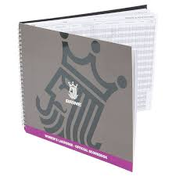
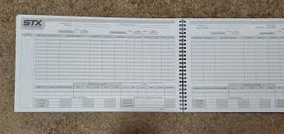
“The Book”
Different teams use different books
Different books have different stats listed/order
The sport has changed faster than the books
halves/quarters

Slide 7
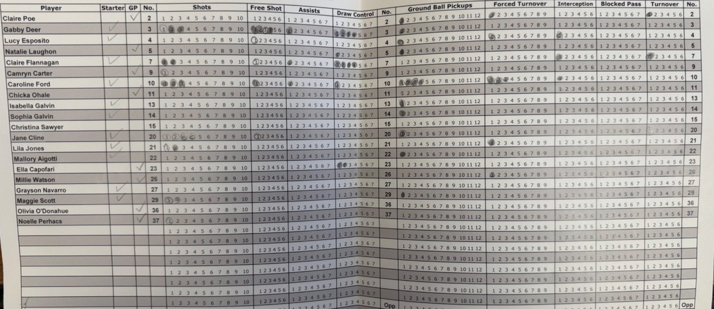
Guerin Catholic STATS SHEET
Notes:
Whats great about this one is that it has the number of the player in three different places
Starter column, then check
Simple circles
You can’t see it here but there is section below with cards
You can create your own on excel and then have it printed at fedex kinkos
Comfortable with your system or create your own
We had one of the stats takers from heritage on this last year and she mentioned their sheet is very similar but they also keep track of a few different things that are important to them like opponent ground balls
Speaking for INGLA, we are doing this so that we can align stats across the league for awards as well as for players wanting to go on to the next level

Slide 8
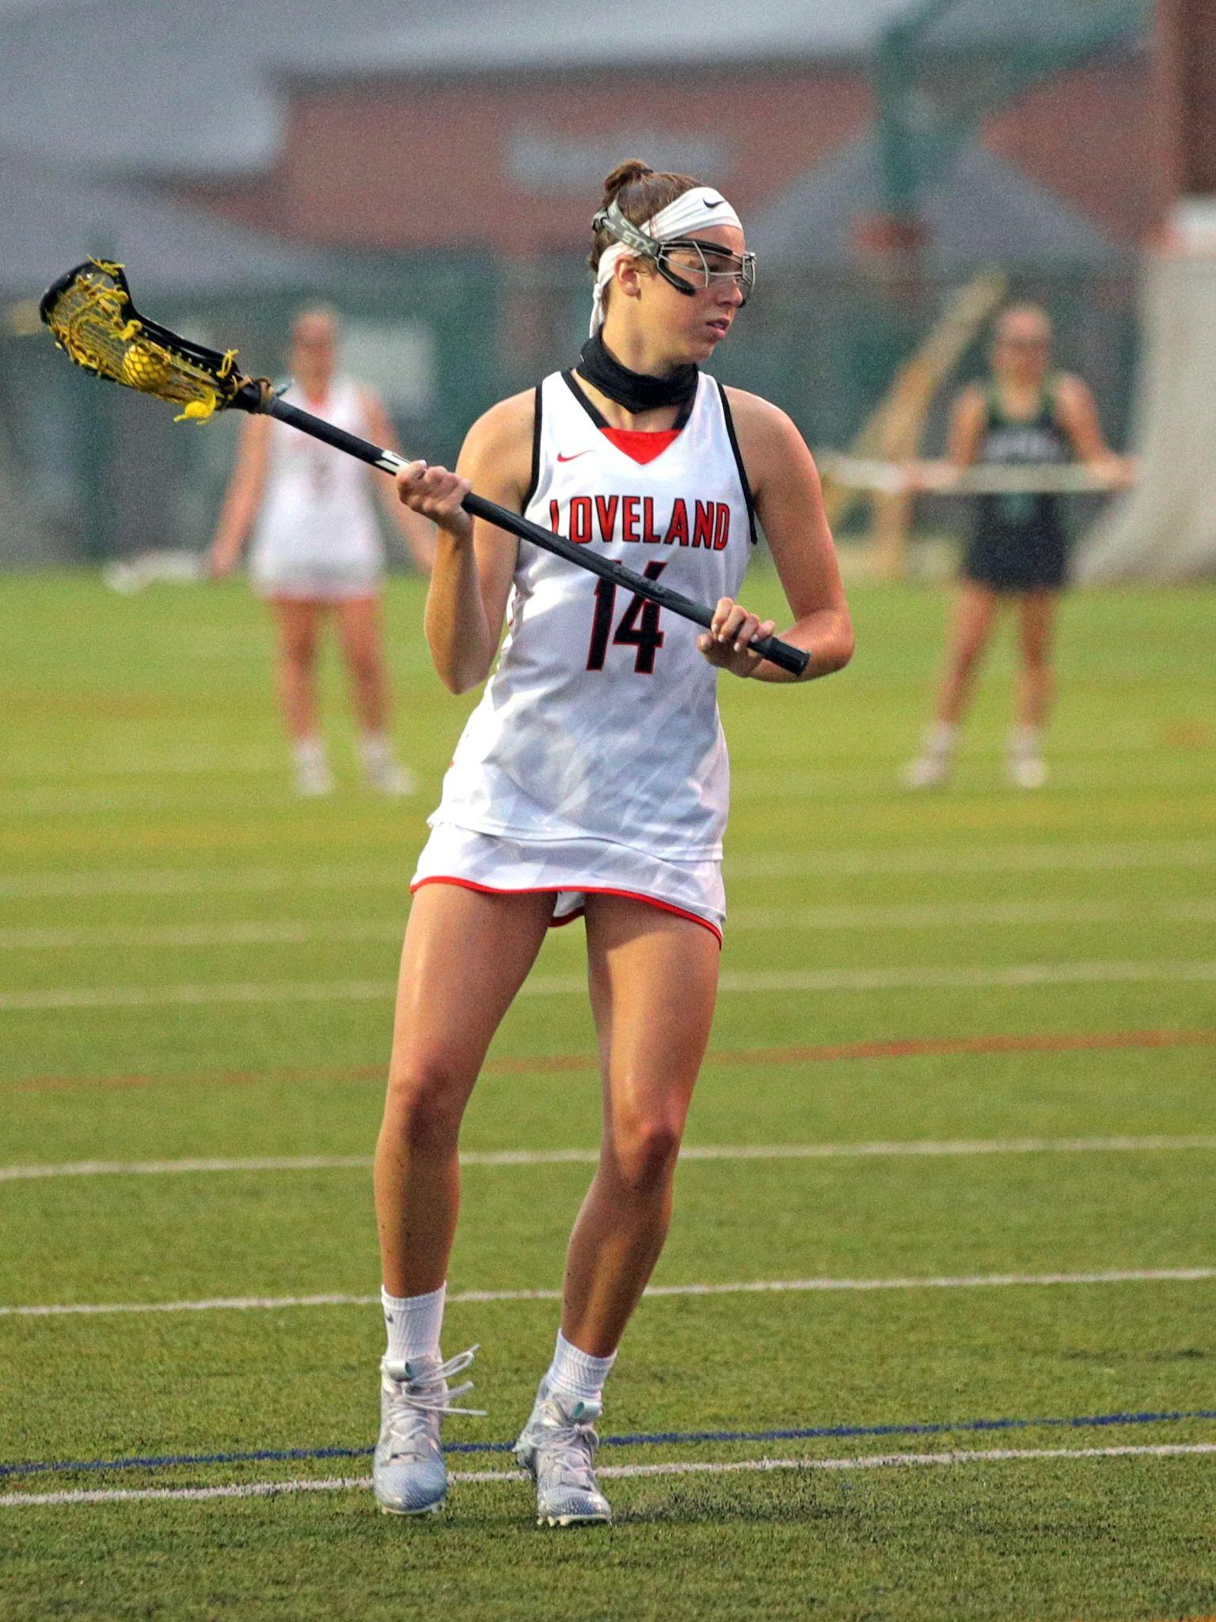
Field Player Stats
Field player=not the goalie
If your goalie plays both
on the field and in the goal
they should be listed twice

Slide 9
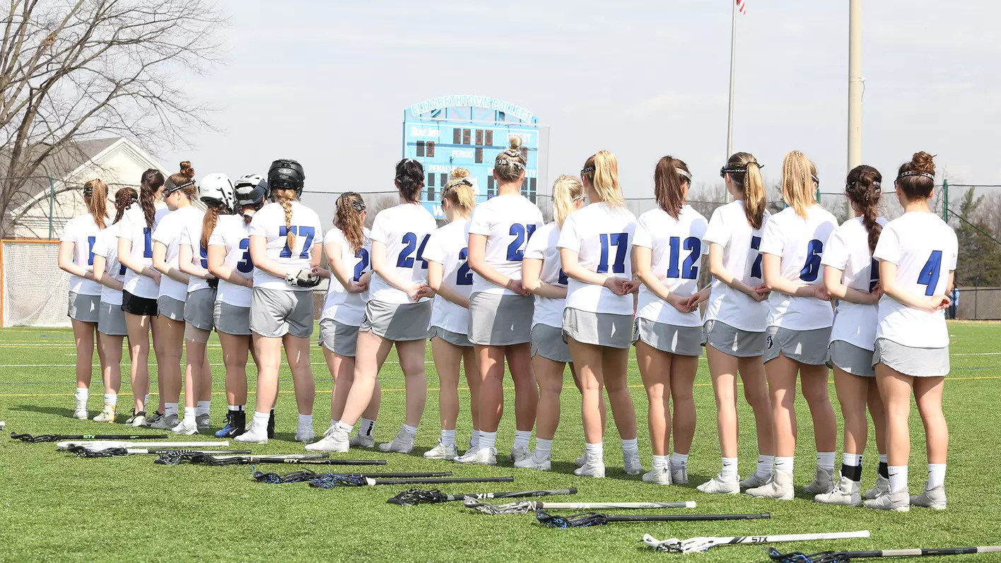
Games
Played
(GP)
-Easy to start - When to look for subbing
-Clock running= game played - Quarters rule for IHSAA
Players can only play 5 quarters in a V/JV contest
Maximum of 8 quarters on a playday. Playday counts as 2 contests (games)
Notes:
Games played is very important for USAL awards- they have to have a minimum number of games
It doesn’t matter if you get a stat, if you are in the game when the clock is running you played in the game
Girls sub often during time outs and injuries

Slide 10
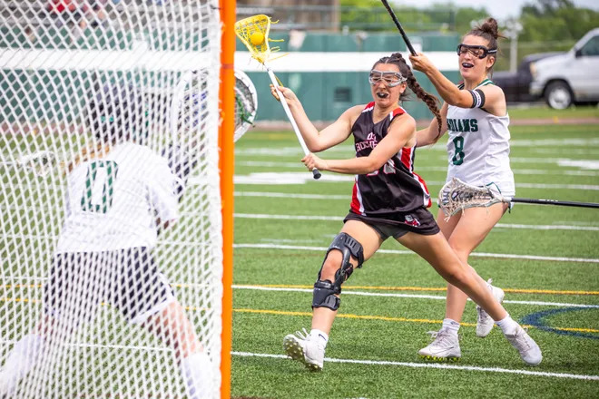
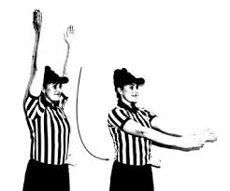
Goal (G)
Notes:
goal should be credited to the player who shot the ball, scoring a goal for her own team. In certain situations, a Team Goal (also known as Own Goal) may be credited. However, statisticians should err on the side of awarding the goal to the player who took the original shot. Unless the girl who deflected the ball with her stick (not the head of the stick) was trying to do something tricky, the goal should be attributed to the shooter. If there was a missed pass that became a goal, that girl is the “shooter”. Off to the side, it is also helpful to put the time that each goal was scored “#17 as 10:55” . If you aren’t sure who scored - most times the crowd will tell you.

Slide 11
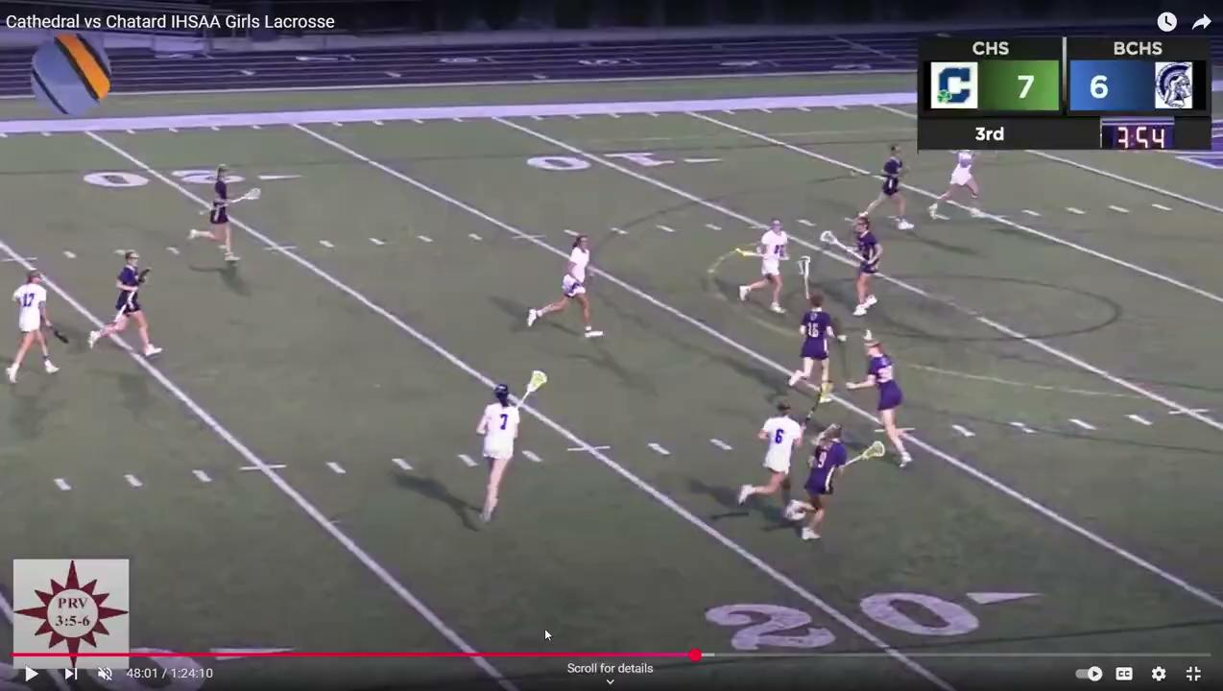
Assist (A)
A pass contributing directly to a goal
In your (the statistician’s) opinion
#7 white starts with the ball
Notes:
A player is credited with an assist when she makes, in the opinion of the statistician, a pass contributing directly to a goal. An assist cannot be credited to any player other than the one who had the ball immediately before the player credited with the goal. No time or step limit. An assist should not be credited on a play when the goal scorer dodges a defensive player after receiving the pass before shooting unless, in the opinion of the statistician, it was the pass itself and not the dodge that led directly to the shot. (play video twice). Yes- not much of a dodge, more of getting a better shot off.

Slide 12
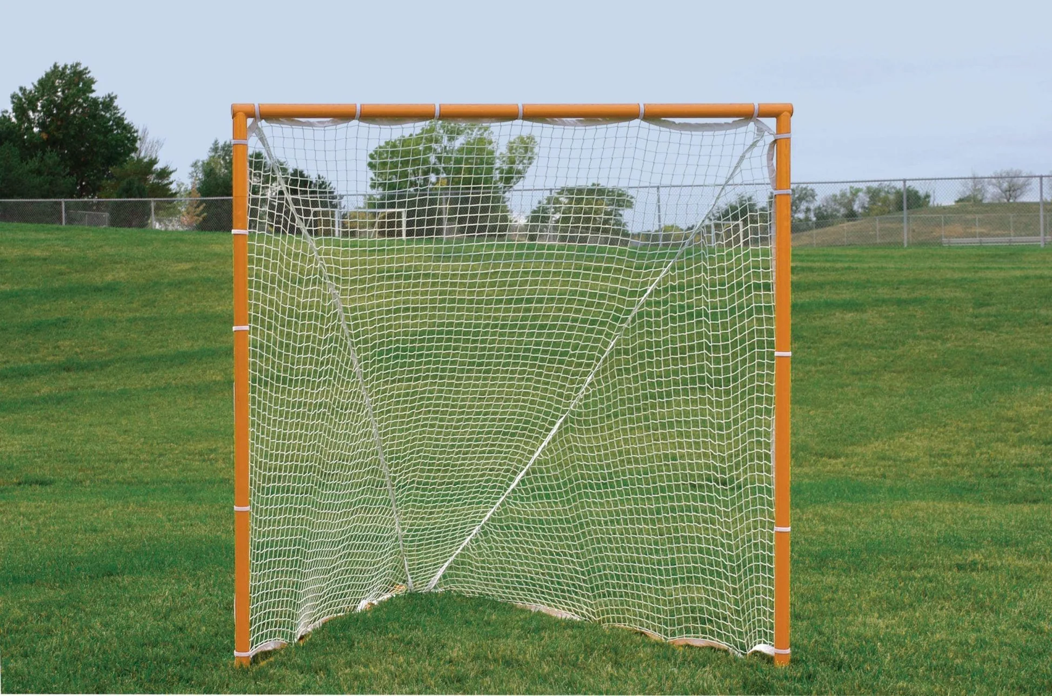
Shots on Goal
A shot on goal is not the same thing as a shot at the goal. The latter encompasses all shots; the former encompasses only shots scoring and those having been saved by the goalie
Notes:
We ask that you keep shots on goal for INGLA. Most teams keep all shots.

Slide 13
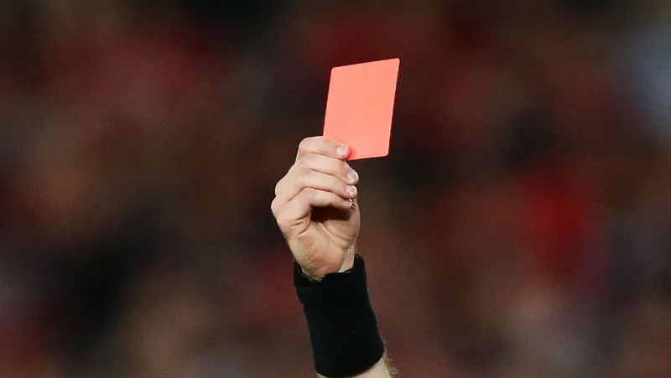
(Penalty)
Red Card
-Referee will hold up card -”Person In Major” Trouble
- Player may not return to game

Slide 14
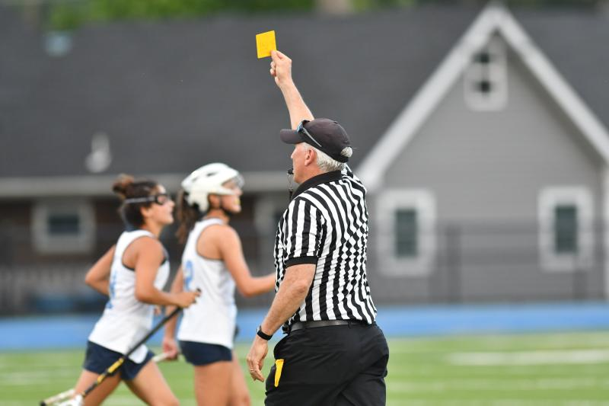
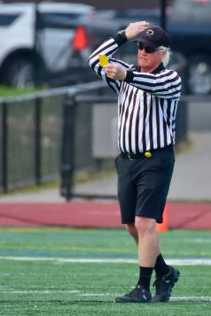
(Penalty)
Yellow Card
Referee signal
Player comes off the field
Clock stops
Player # is very important
2 yellows=cannot return to game
4 team yellows= team plays down a player

Slide 15
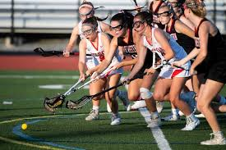
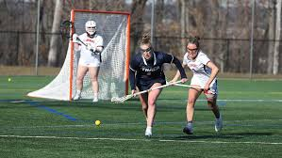
GB
Ground Balls
When a ball changes possession between teams during live-ball play
Off an interception?
Yes- Ground ball & Forced Turnover (FT)
Off of a shot?
Yes- ball stays in
No- ball goes out of bounds
Notes:
ground ball is recorded when a ball changes possession during live-ball play. A shot returned to the field of play is considered a change of possession regardless which team gains possession of the ball. A ground ball shall not be awarded if the ball (pass or shot) is sent out of bounds as the ball is dead before possession is gained. Should a player be fouled in the act of attempting to possess a ball, while said player’s stick is in contact with the ball, possession is to be assumed When a defensive player makes an interception, please credit the player with both a ground ball and caused turnover. If you drop the ball then pick it up, you don’t get a ground ball stat. If you pick it up from the draw (on the ground) you don’t get a ground ball stat, you get draw control stat.

Slide 16
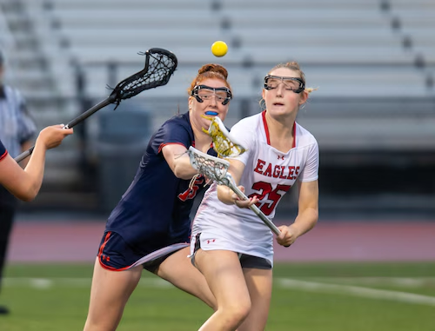
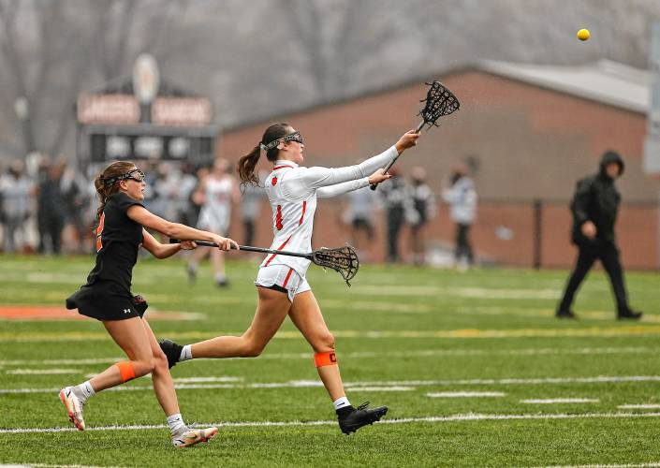
Turnover/Unforced Error (UE)
-When a player loses possession of the ball
Judgement call on which player is “responsible”
Missed shot ≠ turnover
-NCAA (College) lacrosse records more team stats
-Turnover ≠ forced turnover
-Turnover = caused turnover = unforced error
Notes:
Throw a bad pass, fumble, stats people make the judgement call on these. I don’t see these recorded very often… which I assume is out of niceness? A forced turnover will always have a related turnover but not vice versa. Think of it like a rectangle/square

Slide 17
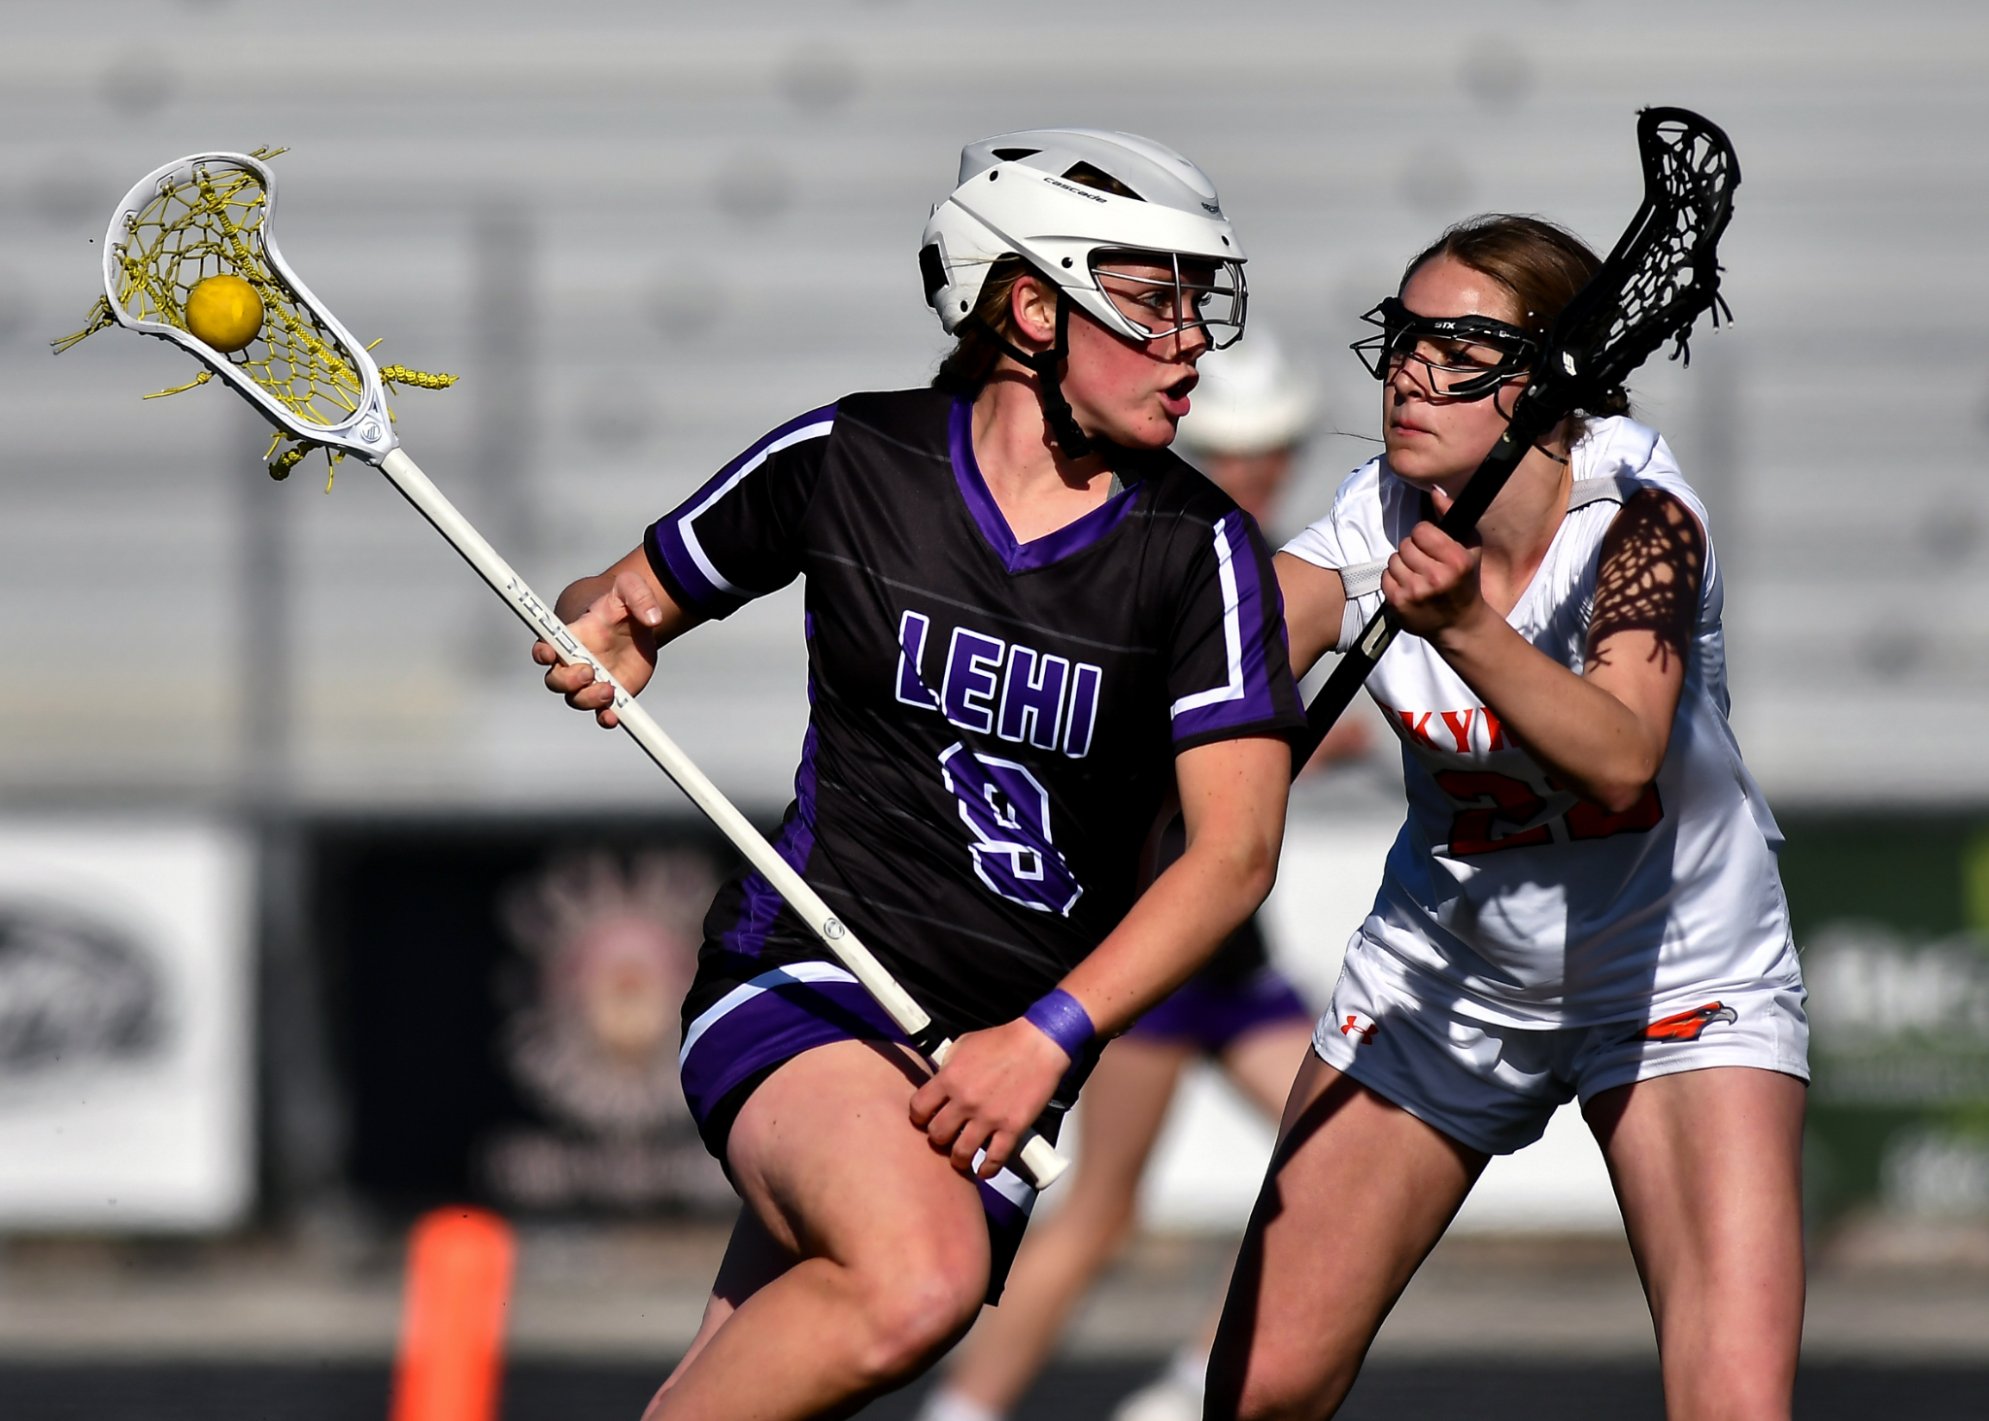
Forced
Turnover (FT)
-when a player’s positive, aggressive action(s) causes a turnover by the opponent
-Turnover ≠ forced turnover -interceptions
- must change possession between teams
Notes:
A forced turnover is a credit to the defensive player so someone who is playing very good defense, they disrupt the person who has the ball, and they create a change of possession. They don’t have to be the one who physically gets the ball when it changes possession but they have to be the one who caused the ball carrier to lose the ball. So a FT is likely to have a ground ball with it, but it won’t always be the same person who gets the ground ball.
If you make a great check but the team who had the ball picks up that ground ball, there is no stat.

Slide 18
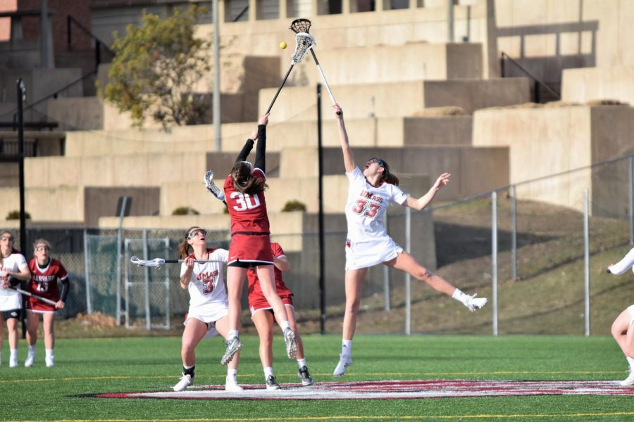
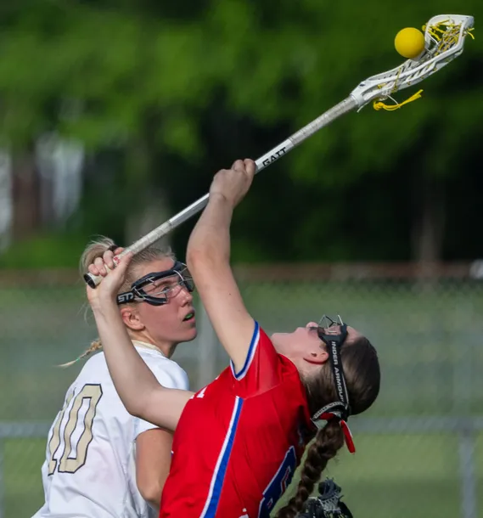
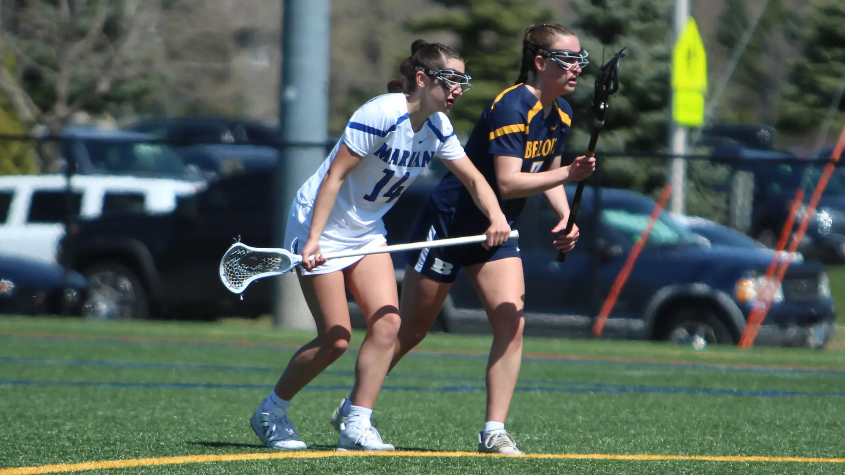
Draw
Control (DC)
awarded to the player who controls the ball and/or creates an opportunity to play after the taking of a draw
Referee signal
Draw control ≠ Ground ball (even if picked up off the ground)
AP/Foul?
No credit
Notes:
Player who gains possession of the ball from the draw.
This is only one person who gets the stat
This could be someone on low defense, low attack if the ball goes far
No one gets the stat if there is a foul or AP situation determining who gets the ball
It is not necessarily the “center” or the person who literally takes the draw
Kick to their own player leads to a draw control stat

Slide 19
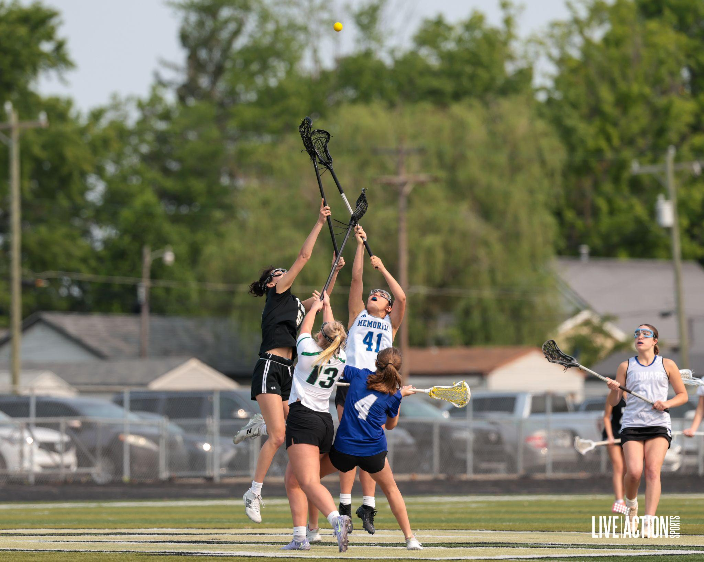
Draw Attempts/
Draws won
New stat in Maxpreps we (INGLA) are not requiring
Draw Attempt=player taking the draw in the center position
Draws won= the team won possession of the draw

Slide 20


Slide 21
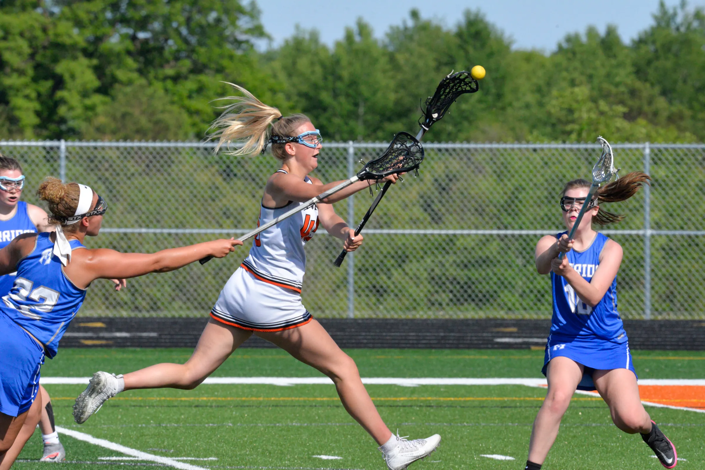
Field Player Stats not on Maxpreps
Shots
A ball propelled toward the goal by an offensive player with her stick shall be called a shot. The ball may be thrown from the stick or deflected by her stick.
Good Clear
A clearing attempt occurs as when a team has possession of the ball behind its defensive restraining line to the offensive attack area
Broken Clear
A clearing attempt that is unsuccessful
Interception
A forced turnover that happens in the air

Slide 22
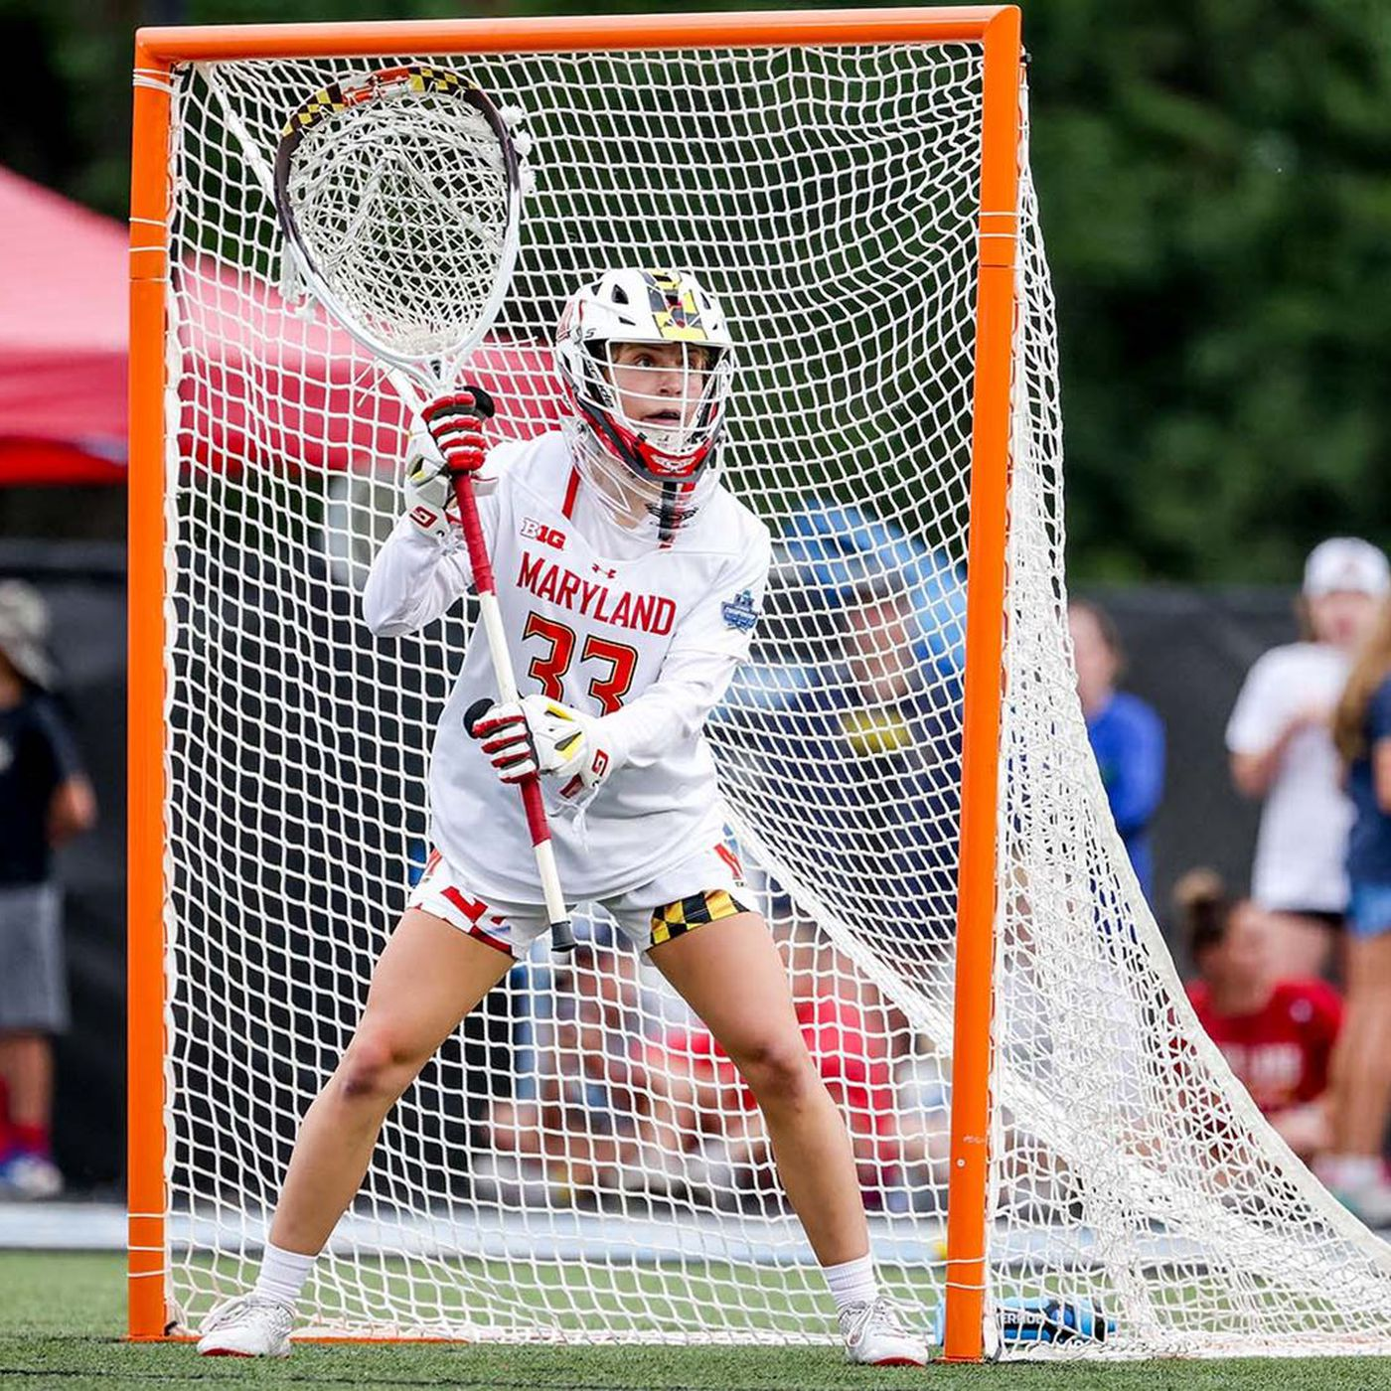
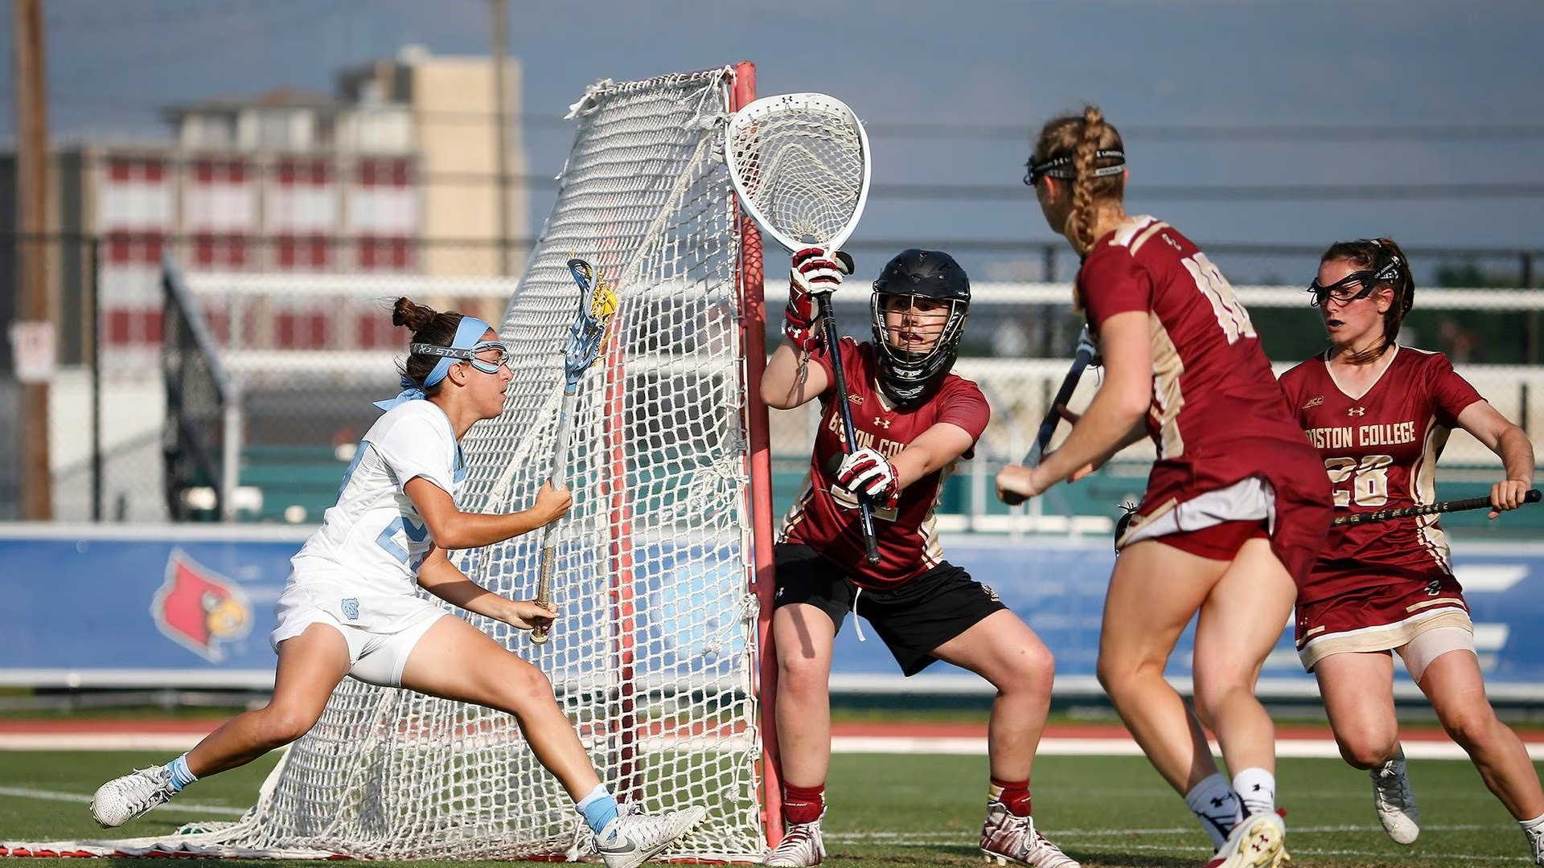
Goalie Stats

Slide 23
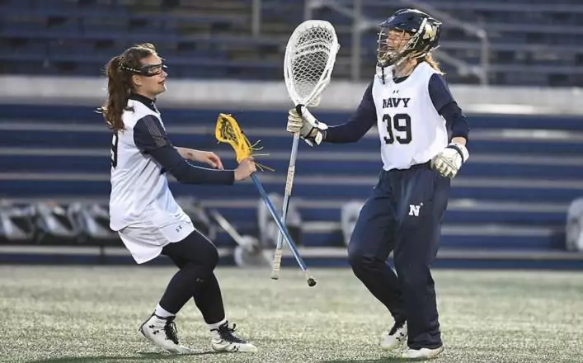
Saves (SVs)
The basic rule of a save is that any time a ball is stopped or deflected with any part of the goalie’s body or stick, which if not stopped or deflected would have resulted in the ball entering the goal, a save is recorded

Slide 24
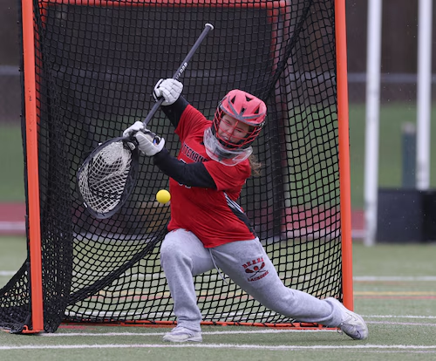
Goals Allowed
(GA)
-aka a goal scored by the other team
-should equal your opponents score
-Goals allowed + Saves = SOG (automatically calculated)
Notes:
Goals allowed needs to equal your opponents score.
Another reminder to write down the time a goal occurs

Slide 25
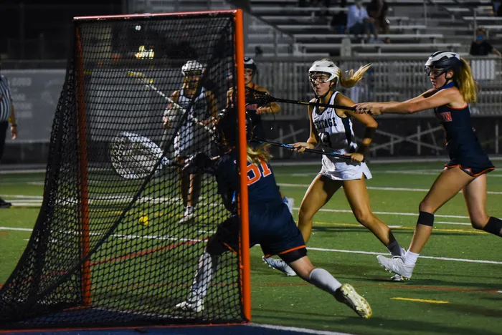
Shots on Goal (SOG)
only shots scoring and those having been saved by the goalie
Notes:
This is recorded automatically when you enter saves and goals allowed

Slide 26
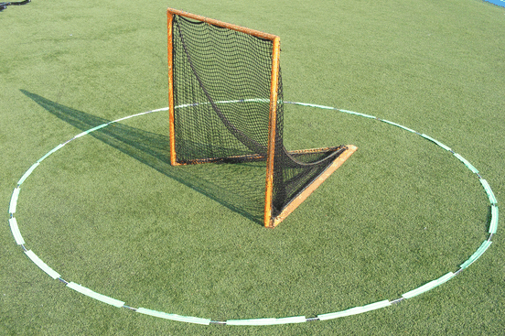
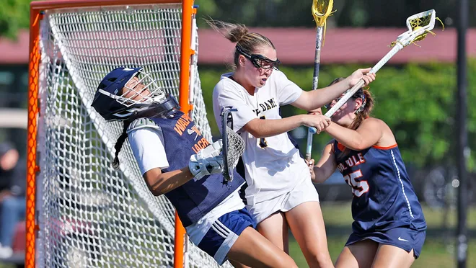
GB
Ground Balls
Must be outside goal circle
Off an interception?
Yes- Ground ball
Inside circle or outside
Can a goalie get a forced turnover?
No - list as ground ball

Slide 27
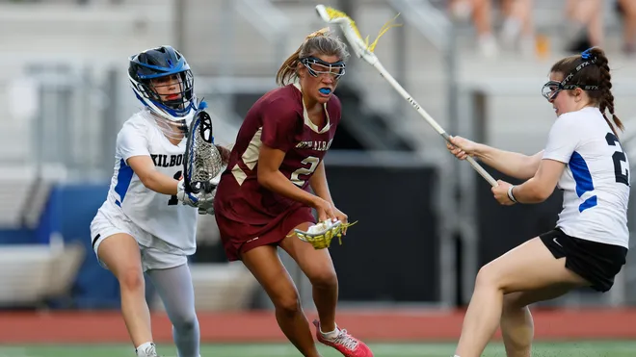
Yellow &
Red Cards
-Very rare but possible; red cards
-goalie doesn’t have to leave field if team has no backup
- in the book it gets attributed to the goalie
Notes:
Keep to what is important for stats takers

Slide 28
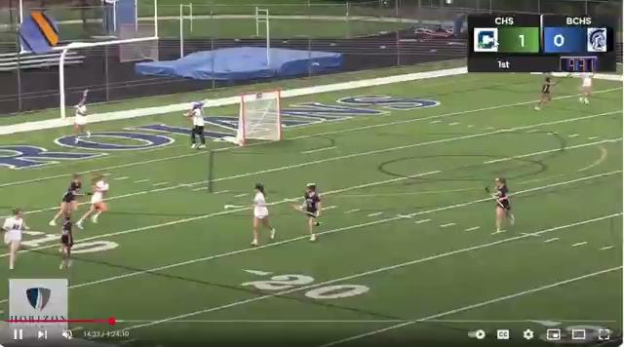
Good Clear/Broken Clear
Notes:
-this is a stat many teams keep
-

Slide 29
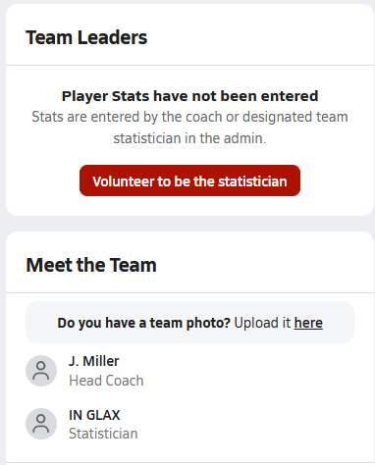
After the game
Notes:
Officials may ask you about yellow/red cards
Physically bringing the paper back to the coach
Some teams ask the referee to sign the score
INGLA requests score be added to Maxpreps in 24 hours, stats in seven days

Slide 30
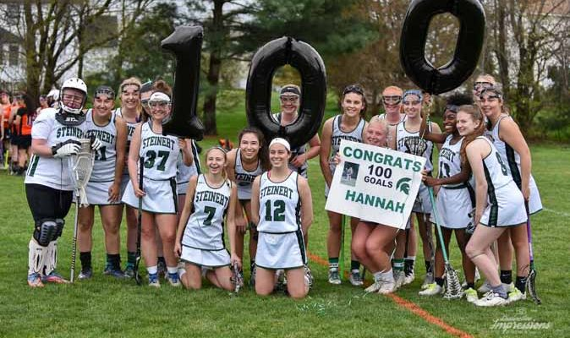
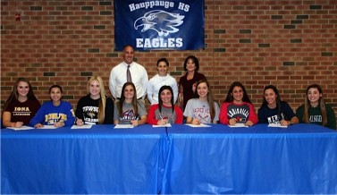

Why do we do this?
Notes:
-the awards committee is watching players, but stats are definitely important
-playing at the next level
- internal milestones: keep separate historical stats records. Stickers, charts, celebrations. Shooting percentage, gound balls vs opponents, clears.
- coaches are looking to see who the leading scorers are
-Defensive stats are really important! They do a lot of the hard work and their stats are not always as recognized.
-Stats people are a partner on the field and can be a really valuable member of your coaching staff.

Slide 31
THANK YOU!

