Slide 1

July 24, 2025
THE Destination for MI Girls Hockey

Slide 2
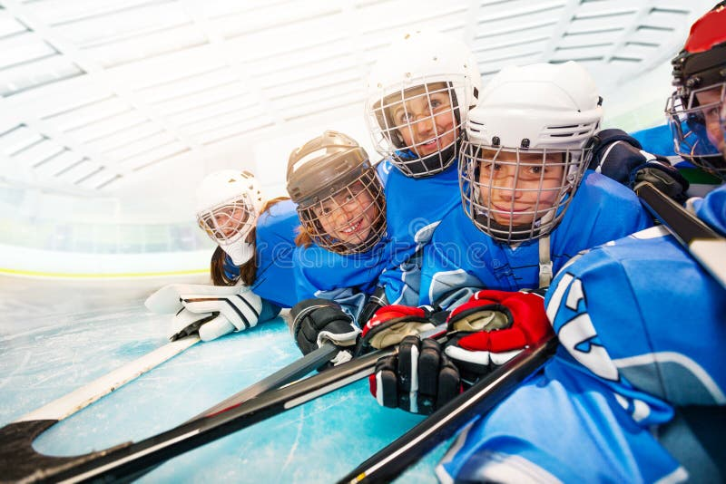
The Mission Stays the Same! PLAYERS FIRST
The Girls
The Girls Game
The Girls Network
15 consecutive years.

Slide 3
Agenda
2025 Directors
Season Framework
Expectations
What’s New
Division Breakouts

Slide 4

MGHL DIVISION DIRECTORS 2025/26
8U Mike Buell
10U Brad Renusch
12U Amanda Vizzini
14U Joe McGrail
16U / 19U Michelle Christ
MGHL BOARD

Slide 5
MGHL 25/26 Season Frame
July – August
Kick off meeting 7/24/25
Rosters built
Exhibition Games
September
Exhibition Games – Thru End of September
October – January
Regular Season Play – Oct 1 – Feb 1
Any games not completed by 2/1 will not be counted towards playoff seeding!
Directors Set Playoff Format – By Jan 15 (Not Teams)
February
Playoffs
March 2025
State Championship T2 National Bound:
State Championship T2: Non National Bound:
State Championship T3:
MGHL Championship Weekend: March 13 – 15 (Brighton TBD)
Nationals (Tier 2 – March 24 – 29)

Slide 6
Trophies & Hardware
Regular Season Champions
Post / Announce Champions – No Hardware
Teams can order banners
Playoff Round Robin
Provides seeding for Playoff Weekend
No Hardware – No Banners. Format varies.
MGHL Championship Weekend
Top 4 per Division Advance
Yes to Hardware. Champions & Runner Up
Yes to MGHL Championship Banners
Yes to Customized Banner Option (By Team)

Slide 7
Important ‘Things’ 2024
Game Sheets Mandatory
There is NO classification for 10/12 or 12/14
Watch your game count.
Teams may not play more than 30% of their games in a higher classification.
Game count required for teams playing MAHA states must be in the same classification and division as the roster
USA Rostered will be collected by the league this year.
19U – MAHA will support a HS Division IF need be
MGHL will support a Split Season Division if there are teams

Slide 8
MGHL Expectations (As a Team in the League)
Games played within time frame
Home & Home means just that
Scores entered by teams within 24hrs
Communicate issues early
Keep it positive
Stay true to the mission

Slide 9

MAHA – USA UPDATE
Girls States – Intent to enter online by 11/1/25
www.maha.org Girls Tier 2 & Tier 3
TEAMS CAPPED AT 8. Play in games will be set if there are more than 8 teams that entire by 11/1
3 Teams are required in any division to host States
Tier 2 States - Non National Bound. Dearborn 2/28 – 3/1
Tier 2 States – National Bound. Dearborn 3/5 – 3/8
Tier 3 States – Patterson Ice Center. . 3/13-3/15
Girls Nationals Host Sites 2026
Tier 1 (14, 16, 19U) March 24-29 Amherst NY
Tier 2 (14U) March 24-29 Rochester MI
Tier 2 (16U) March 24-29 St. Louis, MO
Tier 2 (19U) March 24-29 Wesley Chapel, FL
Rule Changes/Updates for 2025 Season
16 & 19 ONLY – Delayed off-sides & Icing on PK are back.
https://www.maha.org/bylaws-rules
Important Forms. www.maha.org
Dual Roster – Sub Goalie
Coaching HER Modules
www.Coachingher.com
No cost – great resource for female coaches

Slide 10
8U Division Overview
8U Division is a fun / learning division, helping more girls fall in love with “all girls” hockey
Half ice games with more time playing / fewer stoppages and faceoffs
Less focused on winning and results, as our newer girls just love the thrill of playing games
Coaches and teams share a bench, which forces a collaborative and friendly environment
An 8U season is easy to set up:
Coaching: 8U players need work on all fundamentals, making practice plans very easy (basic stations and fun activities vs. positioning and systems)
MGHL League: $300 will get you ~14 regular season games + Championship Weekend
Events: MAHA hosts 4 Mite Jamborees (Nov, Dec, Jan, Feb) and Mite State Cup in March
Building 8U will make 10U efforts easier and more affordable
Pipeline of players and coaches to move up to 10U each year
Ice sharing gets you more practices at lower costs for both age levels
OJG 8U & 10U have a shared 65 Min sheet weekly bringing cost to $12 per player!
→ Each team (T2 and T3) ~80 skates on the season, costs of ~ $300 per skate (almost all 65 or 80 minutes) thanks to 30% ice share with 8U
Takeaway – all organizations should be working to build 8U!
I’m in Year 4 and have the blueprints (my full season plan was complete in June) … if your organization needs help, please reach out (Mike Buell – mpbuell@gmail.com)

Slide 11
Game Sheets (The Joe Show)
MGHL Mandates in 2025. No Change.
No cost for teams
Links with your USA hockey Roster
Can use paper scoresheet – Enter within 24hours to Game Sheets
Everything will be entered in same ‘Season’. Be sure game category is correct.
We will continue to have Non MGHL Girls Division for use with out of state teams.
Paper copy is the official scoresheet for states.
Tablet is for scoring only, like a paper copy – Must use website for everything else.
Game sheets is the only place you need to enter
Will receive team code in an email within the next week – you must be registered by tonight on MGHL site to receive the code!

Slide 12

Social Media
Daysha Pell – Director of Social Media
Share & Like. Share & Like
Facebook: https://www.facebook.com/MiGirlsHockey
Twitter: @MIgirlshockey
Instagram: @mghleague
Send us your events!

Slide 13

MGHL.ORG
MGHL WEB SITE
mghl.org
MGHL Website Resource Section
(Directors, League Info, Rules, Game Sheet help, Website help & more
Team Standings tab is where games & standings will be visible. Only those scheduled in game sheets will be listed there
GIRLS only events tab is where you can find tournaments & other events. We will post for you!
New Girls Director? Please let us know so we can add you to the girl’s hockey finder section on the home page
Please send Photos/Tournaments/Events to be posted on the website to:
Michelle Christ: office@kvhockey.org

Slide 14
So, What’s New - 2025
Rules
Highpoints:
Boundaries
Curfew Arena (Versus Run Clock)
Open Board Meetings
www.mghl.org
North / South Showcase
November: Bay County Civic. Dates Coming
January: Optimist Ice Arena. Jackson. Dates Coming
Livonia 14 & 16 T2 Showcase
Thanksgiving weekend
Details coming soon

Slide 15
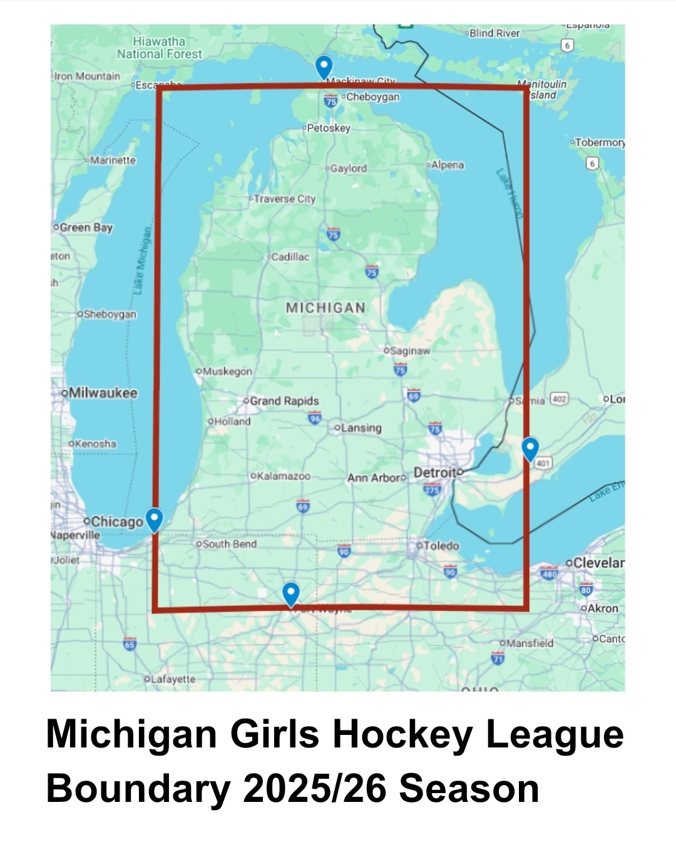
MGHL League Boundary
North: Mackinaw City, Michigan
South: Fort Wayne, Indiana
East: Chatham, ON
West: Michiana, Michigan

Slide 16

Girls Only Events! 2024-25

Slide 17

Girls Showdown November 21 – 23 Muskegon, MI
Trinity Health Arena: 470 W Western Ave, Muskegon, MI 49440 (formerly Mercy Health Arena)
LakeShore Sports Centre: 4470 Airline Rd, Muskegon, MI 49444
Griffs IceHouse West: 4444 Holland Ave., Holland MI

Slide 18
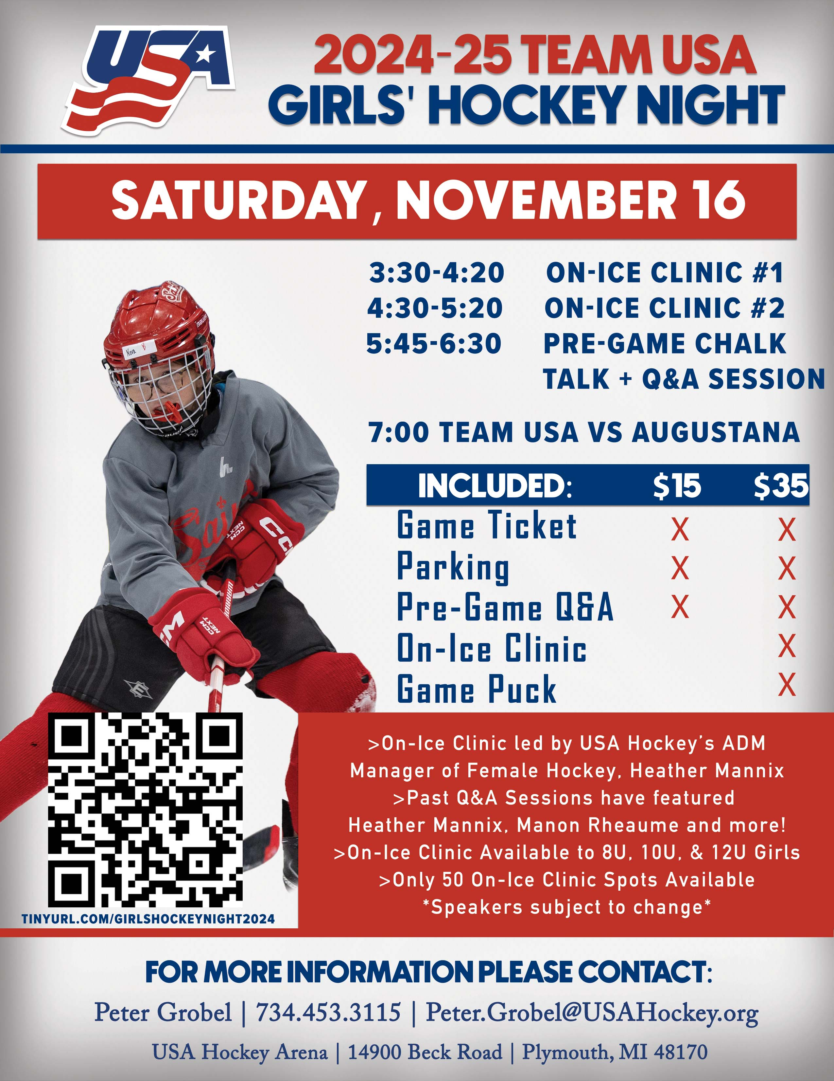
Girls Hockey Night Team USA

Slide 19
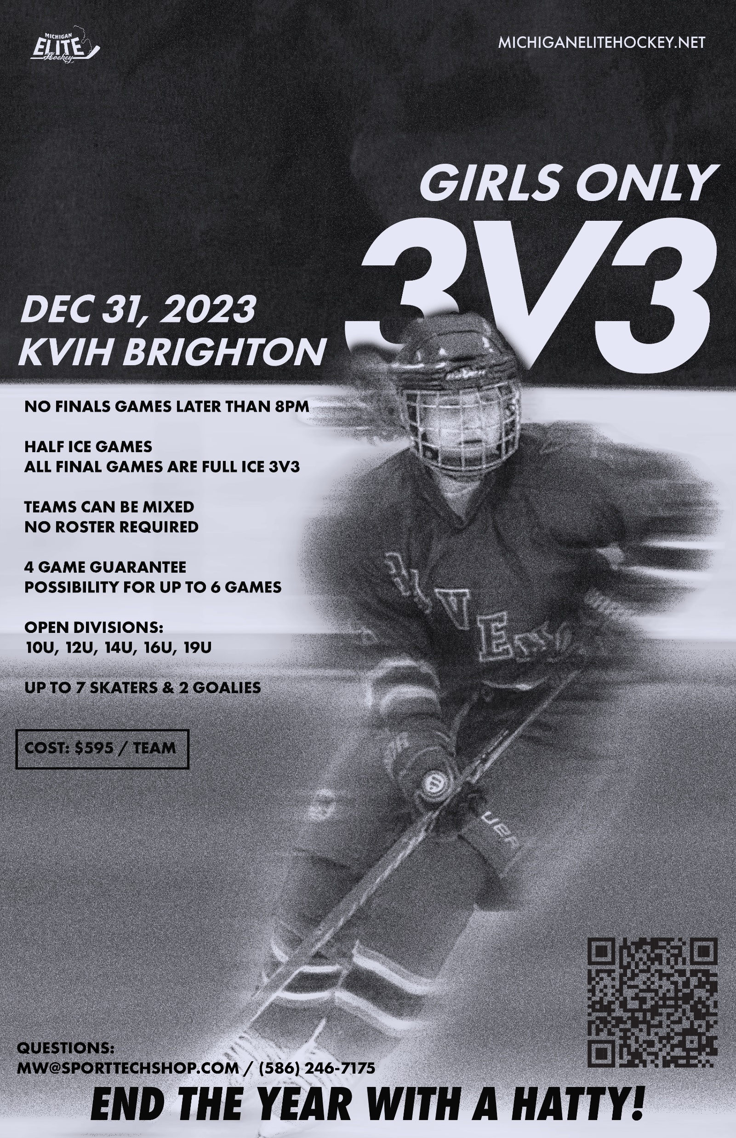
GIRLS ONLY 3v3 NEW YEARS EVE Wednesday December 31st, 2025

Slide 20
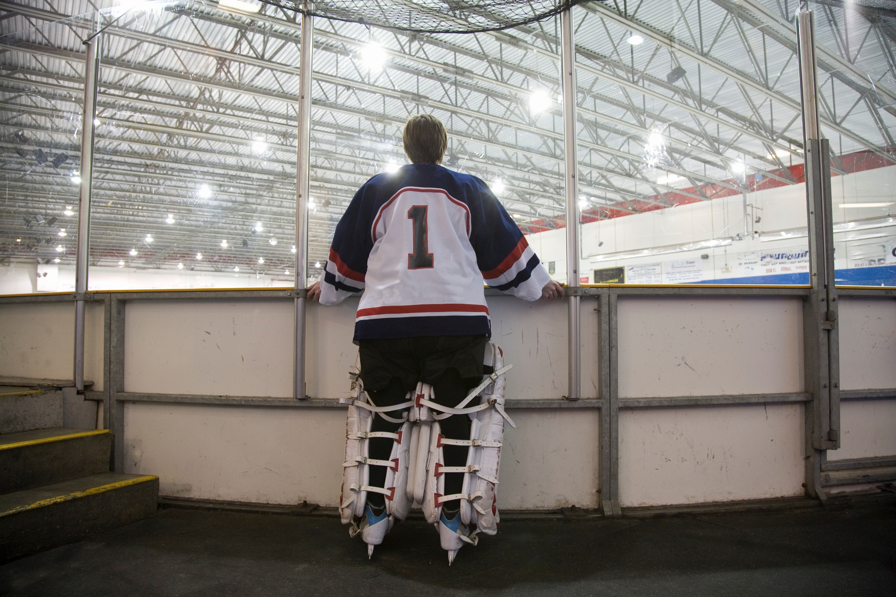
MGHL NORTH & SOUTH SHOWCASE
November: Bay County Civic. Dates Coming
January: Optimist Ice Arena. Jackson. Dates Coming

Slide 21
Divisional Breakouts

Slide 22
Exhibition Games
Now thru end of September
Avoid Home & Home
Play some games!
Play up / Play down
Game scores to Director Pls.
There is no Trophy

Slide 23

ALL YOU DO IN KEEPING THIS FUN - AND PUTTING THE GIRLS FIRST!!

