Slide 1
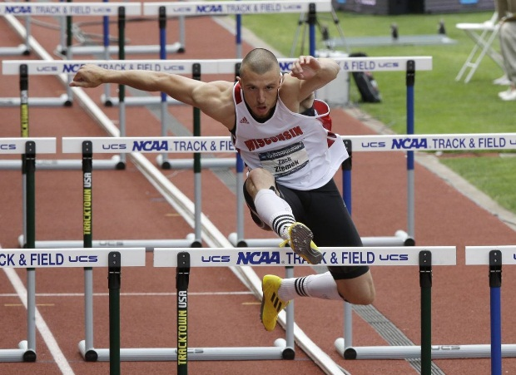
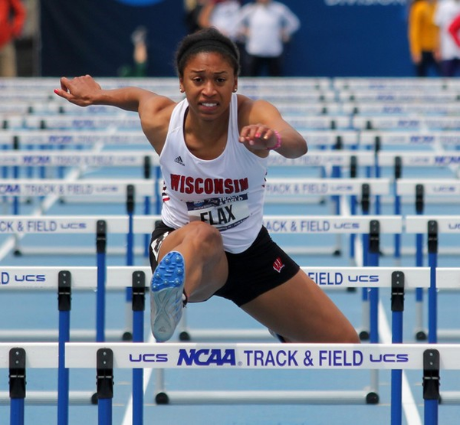
THE DIFFERENCES BETWEEN THE 100 HURDLES AND THE 110 HURDLES
Nate Davis, M.S., IAAF Elite Coach, USATF Level III
Assistant Track and Field Coach
University of Wisconsin

Slide 2
HURDLE HEIGHT DETERMINES TECHNIQUE
BOYS HURDLES ARE SIGNIFICANTLY ABOVE THEIR CENTER OF MASS.
GIRLS HURDLES ARE ABOUT EQUAL WITH THEIR CENTER OF MASS.
FUNDAMENTAL DIFFERENCE IN TECHNIQUE IS NECESSARY!!!!!!

Slide 3
DIFFERENT DRILLS FOR DIFFERENT GENDERS
BOYS DRILLS – TECHNIQUE, TECHNIQUE, TECHNIQUE.
Mobility is the biggest limiting factor for boys hurdlers.
Teaching the take-off and mechanics between the hurdles is the second factor.
GIRLS DRILLS – SPEED, SPEED, SPEED.
Mobility is a minimal performance limiter
Speed between the hurdles is a major factor

Slide 4
SPEED AND RACE DIFFERENCES
BOYS RACE: TECHNIQUE AND MAINTAINING THE FASTEST RHYTHM POSSIBLE. HOPEFULLY THERE IS AN ACCELERATION, BUT MOST HIGH SCHOOL BOYS ARE DECELERATING OR TRYING JUST TO MAINTAIN THEIR SPEED.
GIRLS RACE: PURE ACCELERATION THE ENTIRE RACE IF RUN CORRECTLY. THE BEST GIRLS MAINTAIN, MOST ARE TRYING NOT TO DECELERATE.

Slide 5
MODELING PRACTICE
WITH THIS IN MIND HOW DO YOU SET UP
PRACTICE:
BASICS:
BOYS –
MOBILITY - Foam rolling, active movements for ROM
TECHNIQUE - “Part” reps of trail leg and lead leg
DRILLS - “Whole” type of repetitions that teach
RACE MODELING - Set up the race to feel it correctly
GIRLS –
WARM-UP DRILLS - Drills that are fast and quick
RACE MODEL - Set up the race to feel it correctly

Slide 6
MODELING PRACTICE
Boys:
First set up a dynamic warm-up as you would for any practice.
Second come up with mobility work that addresses areas of concern. Foam Rolling and active movements rather than static stretching are preferred.
Third address simple technical issues that allow a foundation for the event.
Take-off mechanics and hurdle spacing are priority.

Slide 7
MODELING PRACTICE
Girls:
First set up a dynamic warm-up as you would for any practice.
Second address acceleration work that incorporates small changes in rhythm. Inserting mini hurdles into an acceleration is a great way to teach this.
Third address the athlete’s ability to model what the race should feel like by 1. Discounting hurdles and 2. incorporating some overspeed hurdling into the training

Slide 8
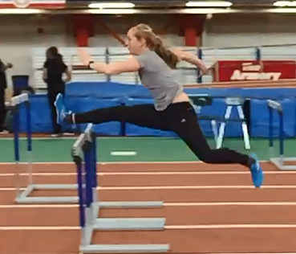
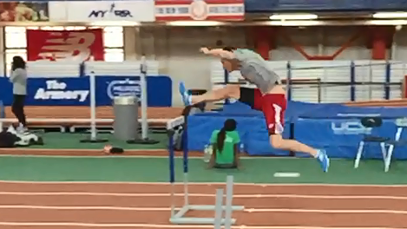
TECHINCAL DIFFERNCE:
BOYS VS. GIRLS
CLEARANCE

Slide 9
COMPLIMENTARY TRAINING PER GENDER
HURDLE SPACING FOR RACE MODELING IS CRUCIAL TO SUCCESS.
Discount your hurdles!
TAKE-OFF POSITION AND FUNDAMENTAL CONCEPTS ARE SIMILAR.
Put tape at take-off spot
200’S & 150’S ARE GREAT TRAINING FOR HURDLERS.
Trains acceleration and conditions the feel and rhythm of the event.

