Slide 1
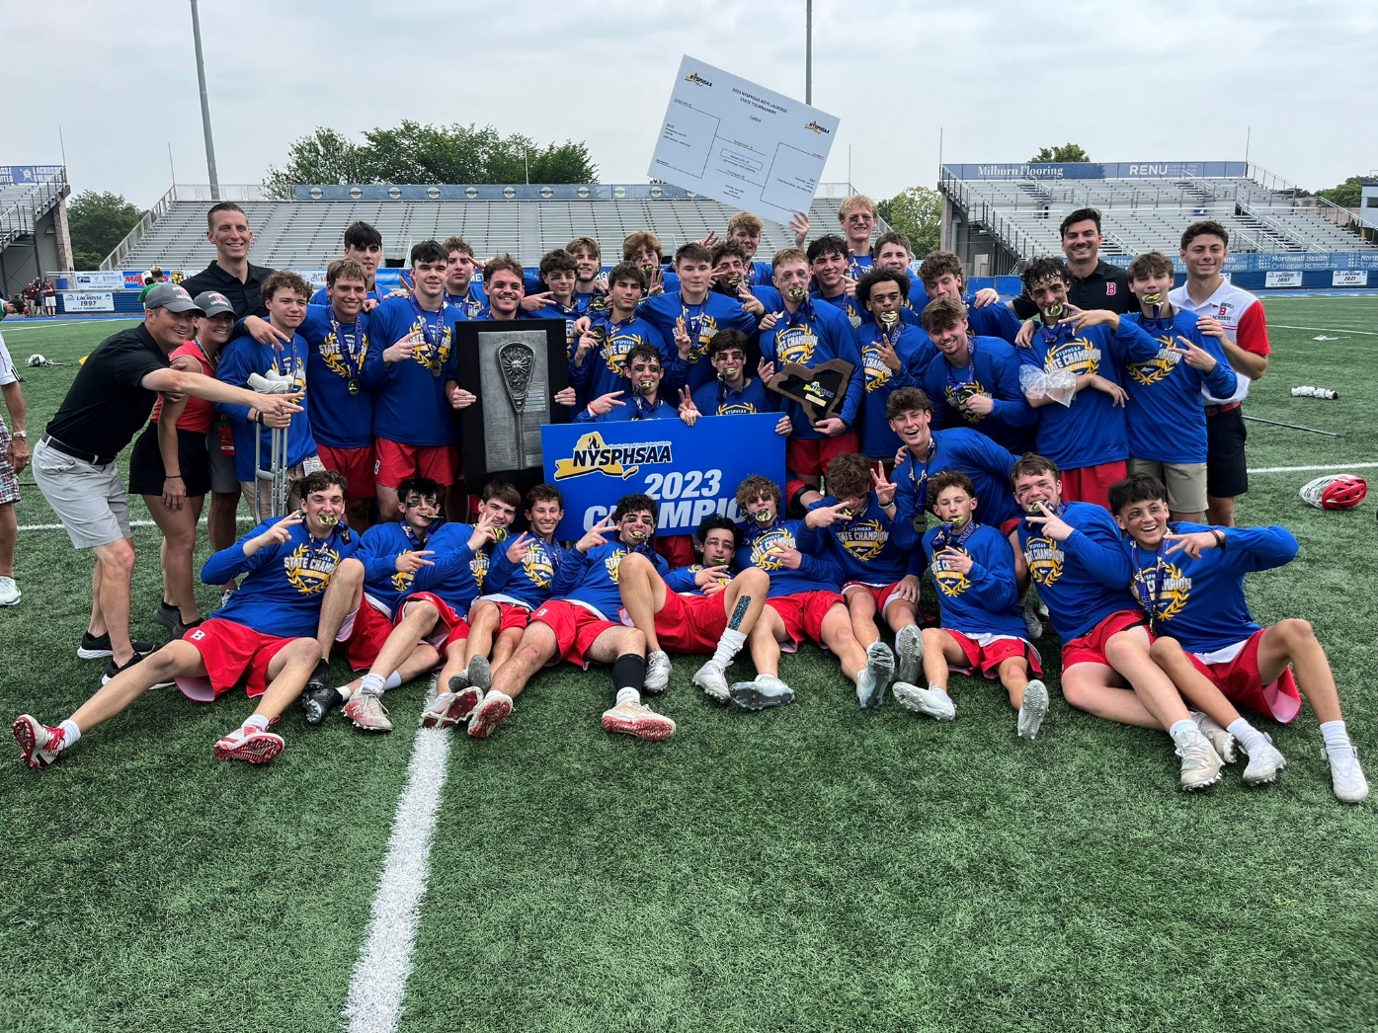
WELCOME TO THE 2024 BALDWINSVILLE BOYS LACROSSE
PRE-SEASON MEETING

Slide 2
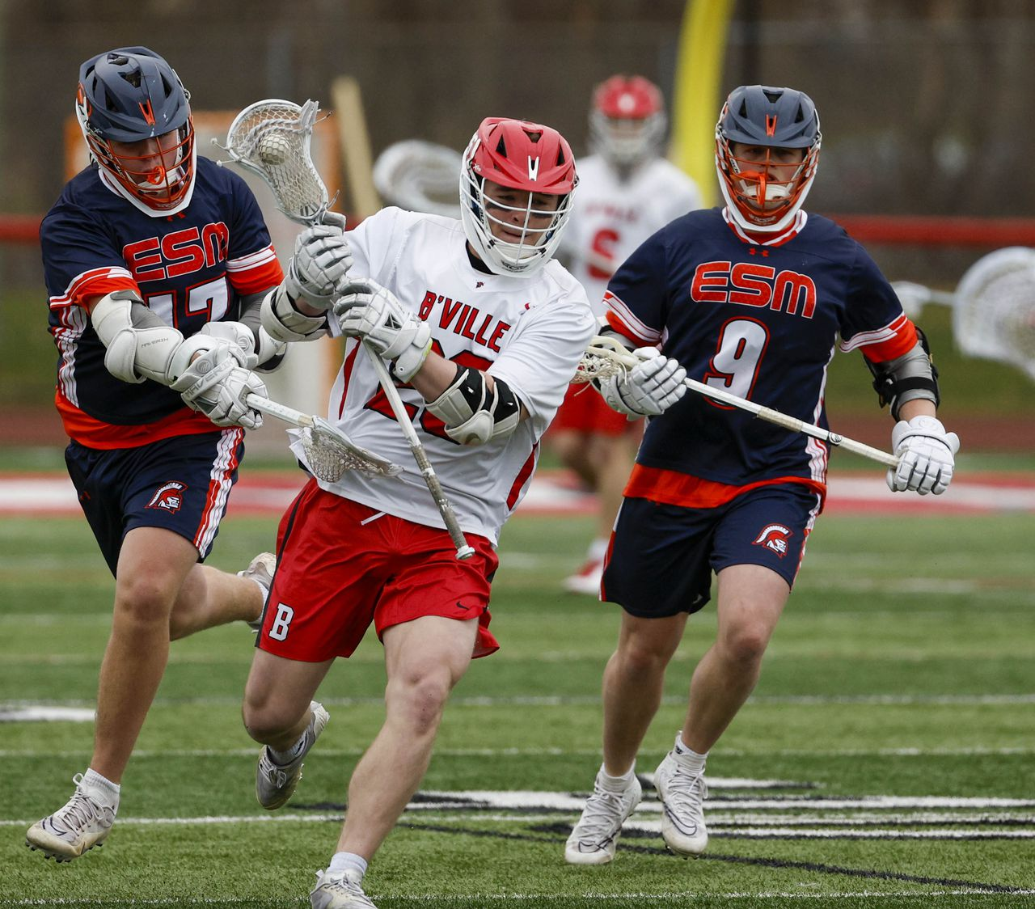
Make Sure That You….
  Filled out a “Season Info Card”
- Player Name
- Grade
- Position
- Player Shorts/Shirt Size
- Parent/Guardian Name
- Parent/Guardian Cell #
- Parent/Guardian Email
- Player Cell #

Slide 3
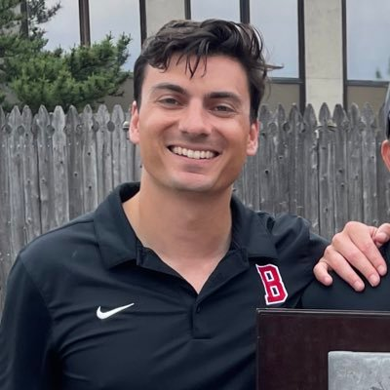
COACHES
Matt Wilcox- Varsity Head Coach
Andy Lamb- Varsity Assistant Coach
Dylan Borkowski- Varsity Assistant Coach
Tim Solomon- JV Head Coach
Mike Malecki- JV Assistant Coach
Mike Diglio- 7/8 Modified Coach
Glenn McCaffrey- 7/8 Modified Coach
Jeff Abbott - 7/8 Modified Coach
Mike Lewis- 7/8 Modified Coach
Matt Brennan- 7/8 Volunteer Modified Coach

Slide 4
Coach Wilcox’s Goals of the Baldwinsville Boys Lacrosse Program
To be a role model and leader for the program.
Continue to build continuity and culture within both the youth and school programs.
To build relationships with players to help better them on/off the field and in life.
To win championships (league, sectional, regional, state)

Slide 5
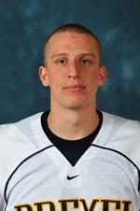
Baldwinsville Lacrosse Coaches General Thoughts on the Program
1) Your foremost goal should be to develop yourself as a student.
Baldwinsville has a great academic program that can make a significant contribution to your life. Maximize your time in class. If you’re missing practice time due to neglecting your academics, you are hurting the team.
2) Your second goal should be to develop yourself into a high-quality student athlete.
When it comes to the spring lacrosse season, give your total effort to the team. Playing other sports is essential and encouraged, but you need to concentrate on lacrosse during Spring season. Nothing else should disrupt that.

Slide 6
Baldwinsville Lacrosse Coaches General Thoughts on the Program
3) The coaching staff has confidence in you as a young man, a student, and as an athlete.
Set high expectations in the classroom and on the field… and live up to them!
4) Never get into a situation that would cause embarrassment to yourself, the team, your coaches, your school and most importantly your family.
Abide by the athletic code of conduct with respect and integrity. Any actions against the School Code of Conduct will not be tolerated. Do the right thing and appropriate life rewards will eventually come to you.

Slide 7
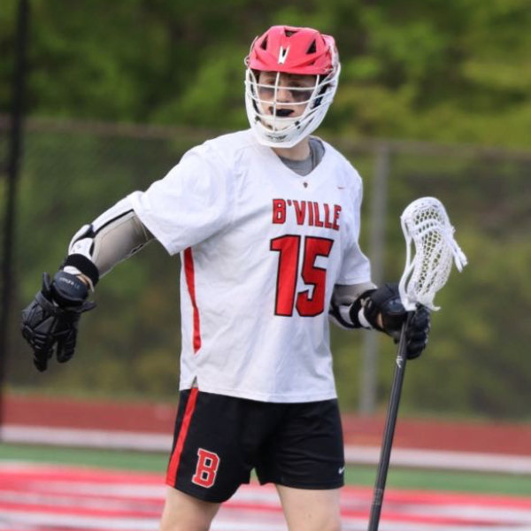
ACADEMICS
ACADEMICS BEFORE ATHLETICS!!!!
Academic Code of Conduct – Please Review.
Academics open many more doors than Athletics.
2016 NYSPHSAA State Champion Scholar-Athlete Team for Boys Varsity Lacrosse With a 96.39 GPA
Academic All-American: Brayden Penafeather-Stevenson (2022) and Ryan Quinn (2023)
2024 Highest Player GPA:

Slide 8
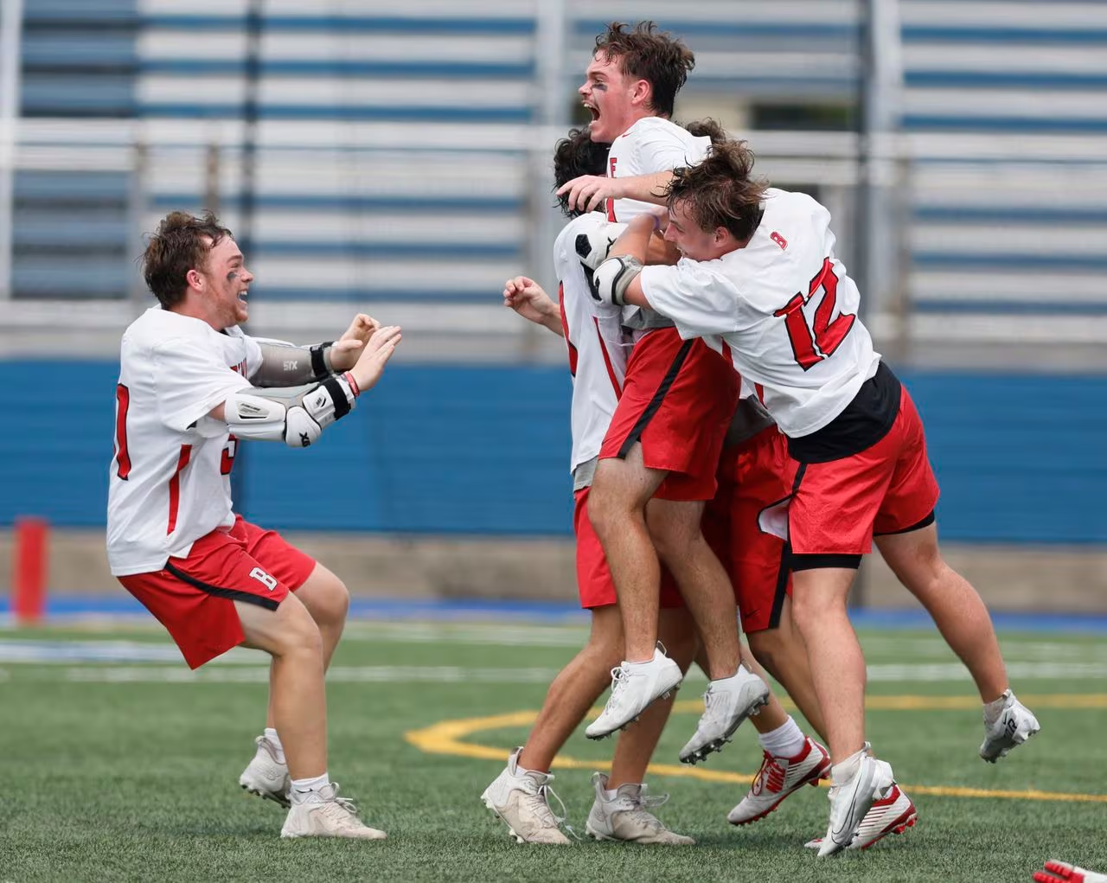
“ E.A.T.…”
E.A.T
Effort- Give your best effort as a player, student, and person.
Attitude- Have a positive and team first attitude both on and off the field.
Toughness- Be as physically and mentally tough as possible.

Slide 9
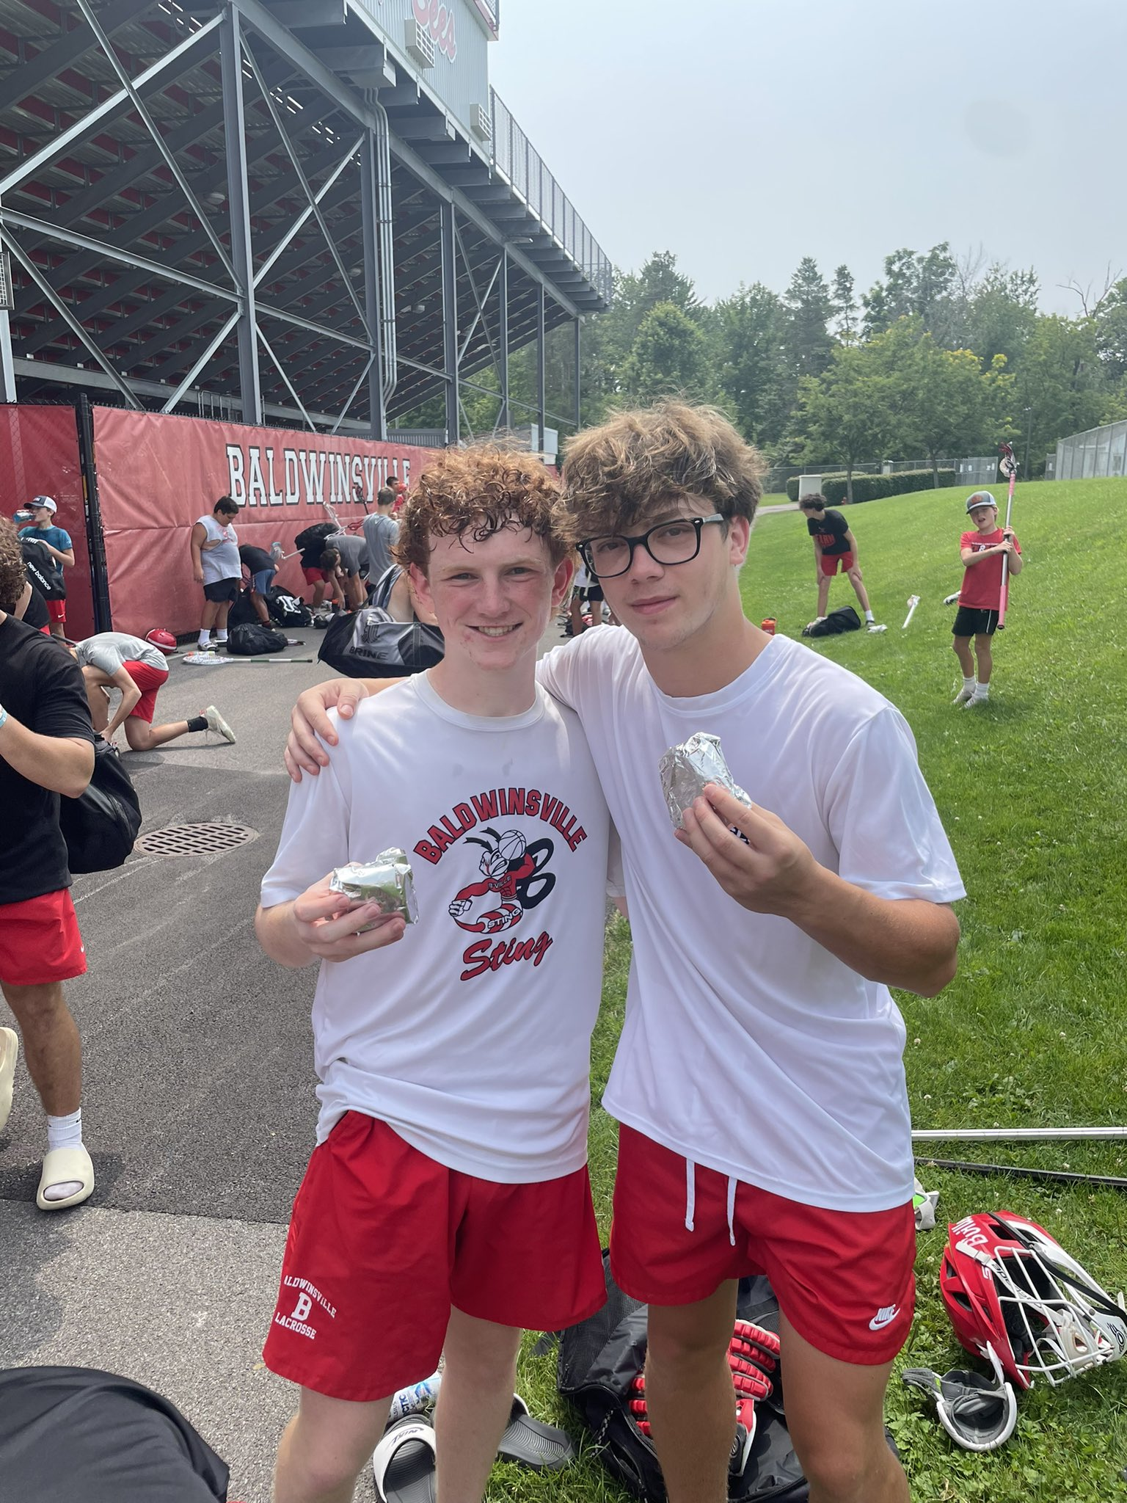
PROGRAM LEVELS
Varsity (11th and 12th graders or any other player that Coach Wilcox recommends to try out for the varsity team)
Junior Varsity (All 9th and 10th Graders or any other 8th grade player that Coach Wilcox recommends to tryout for the JV team)
7/8 Modified Red Team
7/8 Modified White Team

Slide 10
TRYOUTS DATES
Varsity (Start on Mon, 3/11 Practice is #-# (Turf). Please be in Team locker room by #
JV (Starts on Mon, 3/11)
  Practice is at 3pm (make sure to bring old sneakers). Meet at 2:45pm in the Boys Baker High School locker room.
7/8 Modified (Starts on Mon, 4/8 from 3pm-5pm @ Ray Middle School)
  7th grade players will meet in the locker room right after school.
  All 8th grade players will take the shuttle bus from Dugree to Ray and immediately report to the locker room after.
  Coaches will then give you further instructions for practice.

Slide 11

What You Need To Tryout
FAMILY ID REGISTRATION:
This will take care of:
  Physical Forms
  Other medical information
  Concussion information
  Academic/Athletic Code of Conduct
Varsity and JV Dates:
Family ID opened Saturday 2/10
Family ID closes Monday 3/4
Modified Dates:
Family ID opens Saturday 3/9
Family ID closes Monday 4/1

Slide 12
What You Need To Tryout
Hands
  Legal gloves
  2 Sticks if available (Don’t use good stick in bad weather practices!)
Body (Worn For All Practices & Scrimmages)
  Red or white t-shirt
  B’ville red practice shorts (red shorts if you don’t have them)
  Warm clothes to be layered in bad weather
  Shoulder pads
  Elbow pads
  Mouthpiece
  Cup (not mandatory but recommended)
  Hat and coats for after practice if it’s cold

Slide 13
General Guidelines for Tryouts
Each player will have a minimum of 3 days of tryouts.
Cuts are made based on the needs of the team at different positions. Competition varies from year to year at each position (will not cut at modified levels)
Team rosters for all levels are usually at a maximum of 35 players (can be less).

Slide 14
TEAM LEVEL PHILOSOPHY
Players at all levels are chosen for their skills, work ethic, and potential as a player & teammate.
At the 7/8 and JV levels:
  The purpose is to develop players for Varsity.
  The emphasis is not on winning or losing, but on skill and player development.
  All players have an opportunity to have game experience.
At the Varsity level:
  The emphasis is primarily on winning games to ensure participation in League, Sectional, and State level games.
Notes:
Cut as a 7th grader -

Slide 15
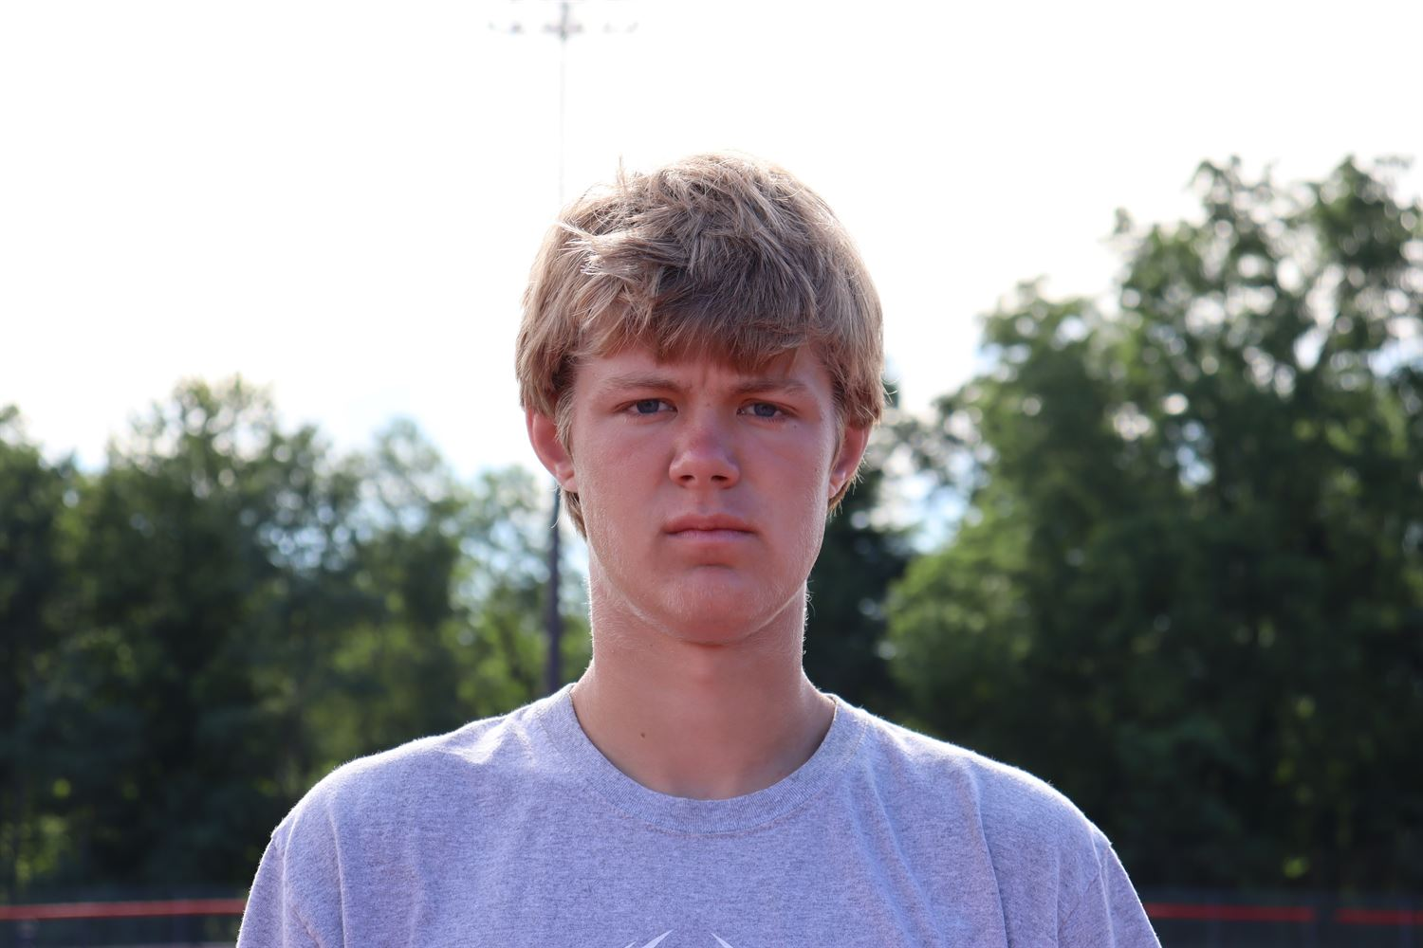
EVALUATION
Athletic Ability: speed, quickness, strength, agility
Conditioning: endurance
Academics: grades, attendance, and teacher recommendations
Characteristics: hustle, mental toughness, loyalty, commitment, trust, reliability, citizenship, desire, coachability, attitude
Skills: passing, catching, ground balls, offense/defense skills, foot work, on and off ball ability

Slide 16
Practice Guidelines
Missing practice for negative reasons (skipping, school punishment, late to school, etc.) is not tolerated and is punishable by a possible one game suspension. Any subsequent missed practices will result in additional suspensions or dismissal from team, depending on the level at which you play.
Missing a little time of practice to stay after school once and a while is acceptable. However, abusing this can hurt your cause.
It doesn’t always necessarily hurt you missing practice. However, it doesn’t ever help your cause on the playing field.

Slide 17
Parent/Coach Relationship
The coaching staff is available to discuss concerns you have regarding your child.
Appropriate concerns to discuss with coaches:
  The treatment of your child mentally and physically.
  Ways to help your child improve.
  Concerns about your child’s behavior.
  Your child’s academics.

Slide 18
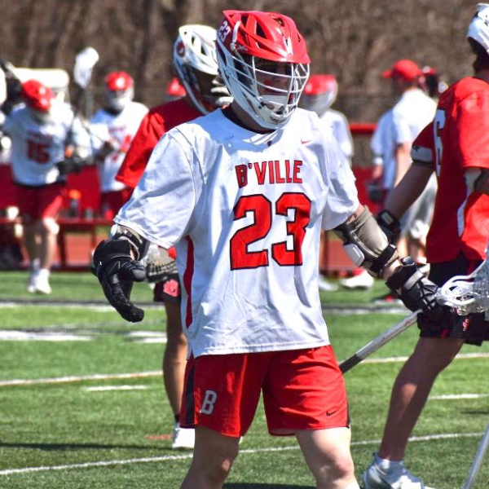
Parent/Coach Relationship
Issues not appropriate to discuss with coaches:
  Playing time.
  Play calling/team strategy.
  Other student-athletes.
*All practices and Locker Rooms are closed to everyone except players and coaches*

Slide 19
Player/Coach Communication
Communication is a very important aspect of the team’s success during season.
Any time there is an emotional, mental, and/or physical problem that is occurring with a player they are supported and encouraged to tell the head coach immediately.
Any other issues, such as playing time, positioning, and team schemes should be communicated through the chain of command.

Slide 20
Chain of Command
Player to Positional Coach
  The player must first go to the coach who is coaching their particular position, (offense/defense/goalie), and try to resolve their problem.
Player to Head Coach
  If the problem cannot be resolved through the positional coach, the player can discuss their problem with the Head Coach.

Slide 21
Chain of Command
3) Parent/Guardian & Player to Head Coach
  Subjects that are appropriate for parents to speak with coaches include treatment of their children physically and mentally, ways to help their children improve, and concerns about their children’s behavior.
  It is NOT considered appropriate to bring up playing time, team strategy, or other student athletes with the coaches.

Slide 22
Chain of Command
4) Parent/Guardian to Head Coach and Athletic Director
  Serious problems regarding an issue of physical or mental harm to player, academic contract problems, and any other extreme events or problems that occur (Playing time will not be discussed with the Athletic Director but rather dismissed)

Slide 23
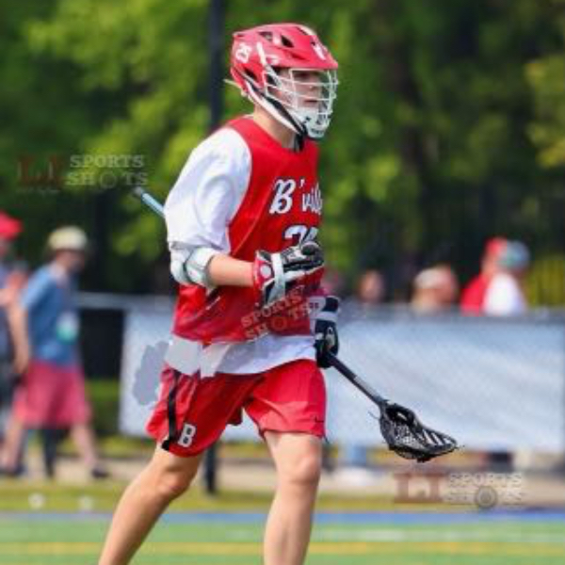
Player Injuries
Please inform the coach if you are injured (especially head injury). Without doing so can result in a more severe injury
When an athlete has seen the athletic trainer, the coach will go by the trainer’s protocol for the injury. A player will not practice until he is cleared by the athletic trainer.

Slide 24
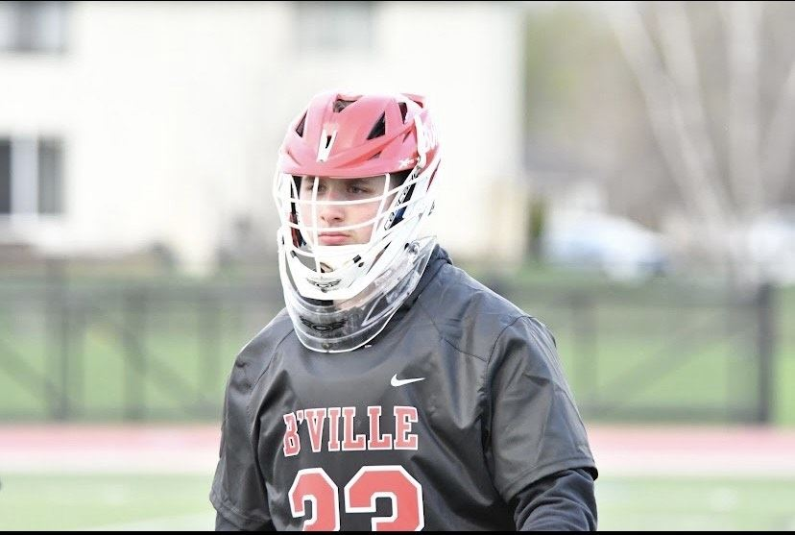
Player Injuries
If a player sees a doctor, he must notify the coach and athletic trainer regarding the diagnosis given by the doctor. A player must give their medical release from the doctor to the school nurse NOT the coach/athletic trainer.
The only time that a doctor's note should be given to a coach is if a student was at a doctor or dentist on that day and was either late or released due to the appointment.

Slide 25
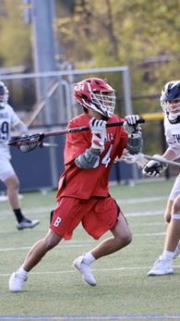
CONCUSSIONS
Report all head injuries to your COACH!
Must follow protocol set for by the athletic trainers/school district.
Board/State/National Policy
Part of FamilyID.

Slide 26
Other Medical Information
Athletic Trainer: Megan Fitzpatrick
Email: mfitzpatrick@bville.org
Inhalers/Epi-pens
-NEED FOR TRYOUTS if labeled on participation form
  -Label and put in medical kit
Notes:
Get doctors note even if you go for a totally different reason

Slide 27
SCHEDULES
Practice/game times are subject to change due to weather and gym availability.
Any cancellations will be announced in school as well as on the Schools’ Athletic Website. Please bear with us as the weather is very unpredictable and changes without warning.
Visit www.bville.org and select Athletics.
Game schedules for all teams are on the Athletics website under SCHEDULE GALAXY.

Slide 28
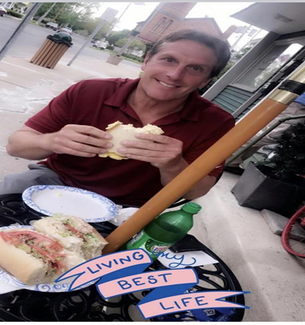
V
Vacations and Weekends:
Varsity/JV Levels:
Lacrosse games and practices are held during vacation week and on weekends. If you plan on being away during the week of vacation, please do not try out. Your attention should be with your in-season sport.
7/8 and 8/9 levels:
We are a little more understanding at the lower levels. We won’t have practices over holidays and vacations.

Slide 29
Social Media
Players:
Use social media in a positive way. There will be no use of it in a negative way.
Parents:
Positive use of social media regarding the program.
Email coaches with questions or comments.
Join our groups to stay up on all Lax Events:
  Facebook - Baldwinsville-Boys-Lacrosse-Booster-Club-BBLBC
  Instagram - baldwinsville_boys_lax
  Twitter - @Bville_Boys_Lax

Slide 30
THINGS TO DO
PARENTS:
  Register and be approved for FamilyID (www.familyid.com). Make sure everything is completed before the deadline (sooner than later)
  Register on www.bvillelax.com so you can receive important information from BBLBC.
PLAYERS:
Prepare yourself for the upcoming tryout and season with having all your equipment ready to go.

Slide 31
WHAT WE ARE LOOKING FOR IN A PLAYER
Selflessness
Teamwork
Relentless Effort
Resiliency
Continuous Improvement
“Life’s a Journey NOT a Destination”

Slide 32
Questions and/or Concerns
With any questions/concerns regarding on field information please email Varsity Head Coach- Matt Wilcox
    Email: mwilcox@bville.org
With any questions/concerns regarding off field information (fundraising, helping out, etc...) email Booster Club President- Frank Garcia
    Email: frank_garcia_cpa@yahoo.com

Slide 33



ALLOW ME TO INTRODUCE…
Greg Marinelli (Senior Defenseman)
Anthony Nicolucci (Senior Defensman)
Trevor Sutton (Senior Goalie)

Slide 34
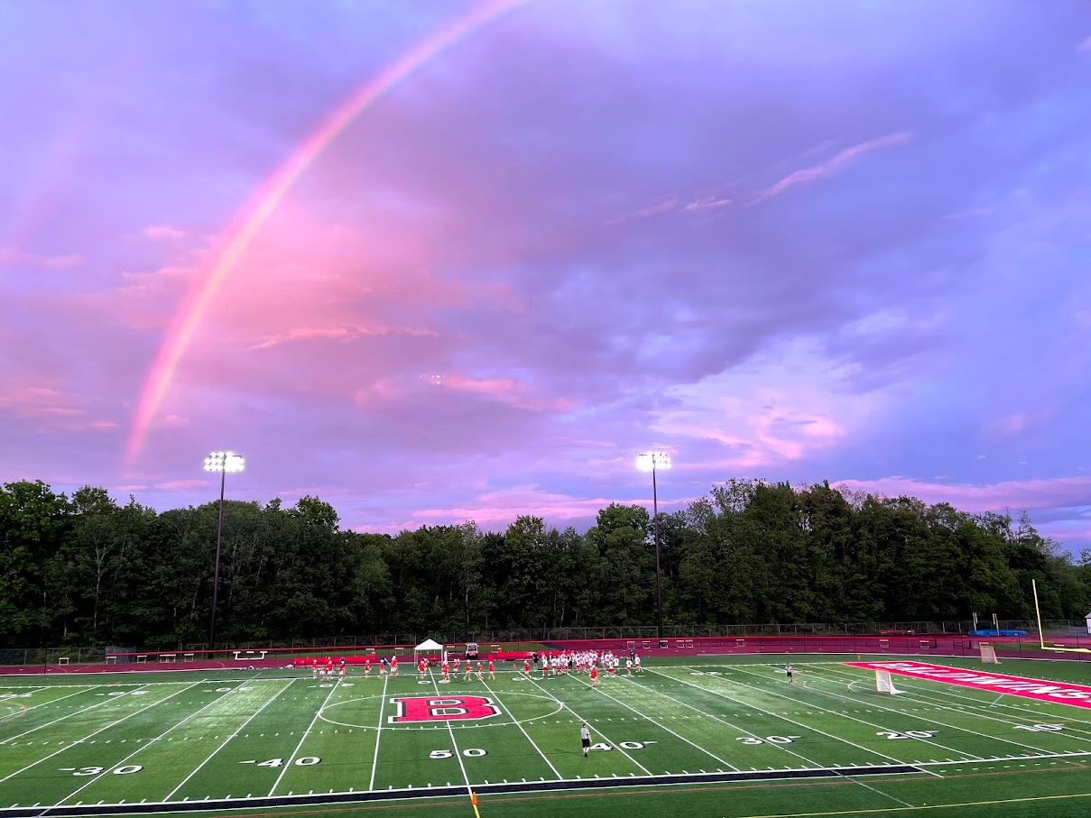
BALDWINSVILLE BOYS' LACROSSE BOOSTER CLUB (BBLBC)
bvillelax.com

Slide 35
MISSION OF THE BOOSTER CLUB
The Baldwinsville Boys Lacrosse Booster Club (BBLBC) is a not-for-profit organization (501(c)3) whose role is to support, assist and enhance the lacrosse athletic program of the Baldwinsville School District. This includes financial, community and volunteer support which will serve to enhance the scholastic lacrosse experience for all.

Slide 36
BOOSTER CLUB
  Executive Board
  President: Frank Garcia
  Vice President: Jennifer Garcia
  Treasurer: Dave Dixon
  Secretary: Jennifer Marinelli (OPEN 24-25)
  Board of Directors
  Director of Merchandise: Wendy Ianno
  Director of Fundraising: Matt Medwid
  Director of Tournaments: Chad Lynch
  Director of Communications: Sarah Tyner
  Director of Concessions: Angela Sutton (OPEN 24-25), Erica Doherty & Modified/
  JV Parent (CURRENTLY OPEN)

Slide 37
How Can You Get Involved?
  Become a JV or Modified Team Parent – Communications
  Game Day Volunteers – scorebook, penalty box coordinator, announcer/music, scoreboard operator, game clock operator, videographer and concession stand baristas.
  Support and assist in our fundraising campaigns – Big raffle, Syracuse Nationals, Amphitheater concerts, Program, etc.
  Attend our monthly board meetings via Zoom. Link on website. Next meeting March 18th at 7pm.
  Join the Board - Annual Officer Elections ~ June 2024. Only 1-year terms.
  Become a Director or join a Sub Committee (Senior Trip, End of the Season Banquet, etc.)

Slide 38
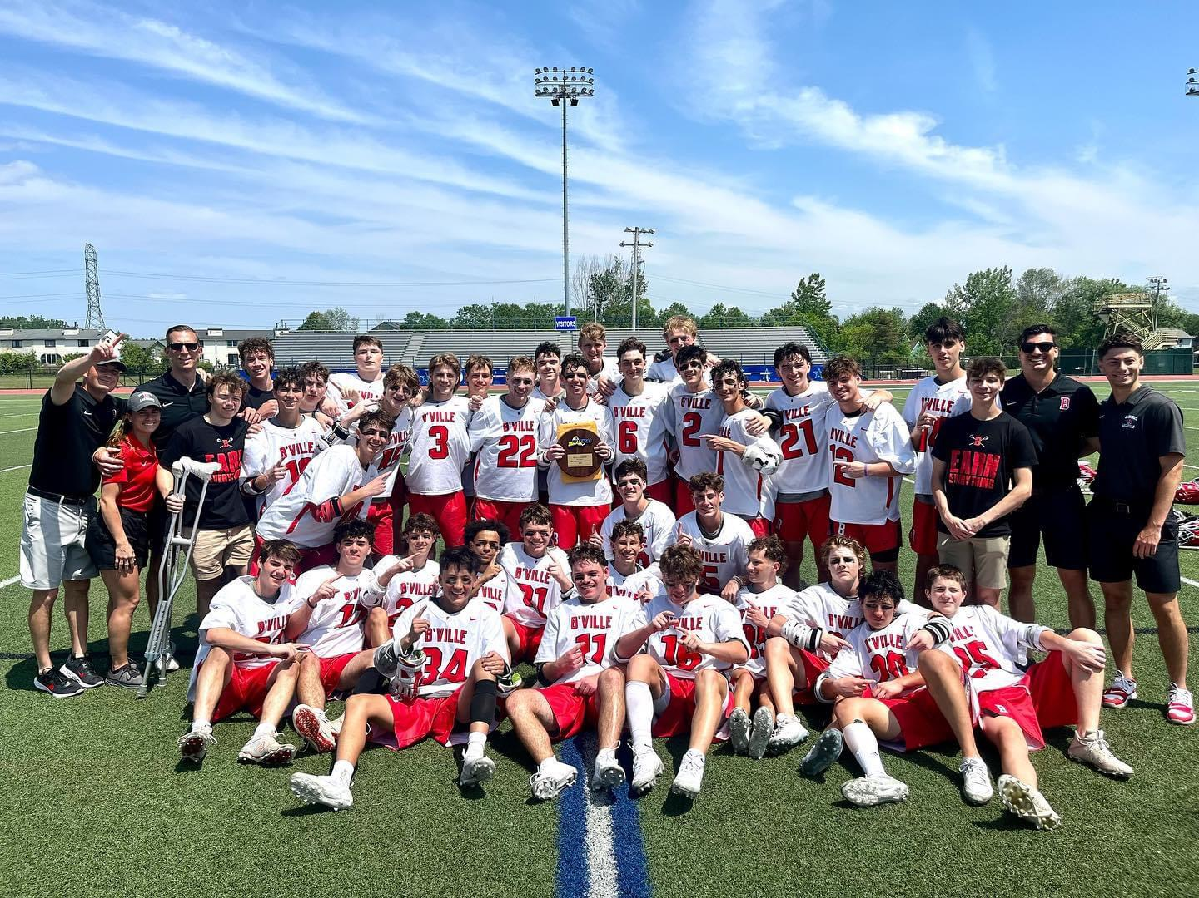
FUNDRAISING

Slide 39
WHAT DOES THE BBLBC FUND?
PRE-SEASON | SEASON | POST SEASON
Indoor Turf Contract Ultimate Goal $2,000 to $3,000 | Assistant Coaches Salaries All Levels $6,000-$8,000 | Scholarships $1,500
Lacrosse Balls & Supplies $500 | Indoor Practice Time Inclement Weather $300/day | Lacrosse Banquet & Modified Event $2,000-$2,500
 | Practice Pinnies Season Logo T-Shirts $2,000 - $3,000 | Subsidize the Cost of Highly Competitive Tournaments for all Levels $10,000-$15,000
 | Helmet Decals $1,000
 | Bus Transportation $1,000-$2,000
 | HUDL Subscription Recruitment & Training $1,000
 | Varsity Trip $6,000-$8,000

Slide 40
WE NEED YOUR SUPPORT
Fundraisers
Super Bowl Squares, Chipotle Nights, Sal’s Nights,
Apparel Stores, Program Ads, Ampitheatre Concerts
The Big Raffle Sale – $25,000
It’s a collective effort!
We must reach our goal of 1,000 tickets
10 tickets per family
The Syracuse Nationals - $15,000 - $25,000
Maguire Chevrolet sponsors the event (July 19-21)
We are provided all tee-shirts ($0 Cost) and keep all profits ($20)
Many hands make light work – save the date!!!

Slide 41

Fundraising App

Slide 42

SCAN ME TO ACCESS GIVE BUTTER

Slide 43
