Slide 1

Threshold Training
Theory and Application

Slide 2
  Threshold Training?
  Benefits
  Application

Slide 3


Slide 4
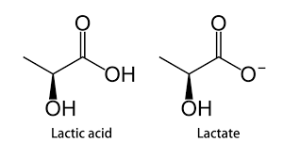
Notes:
Now before we get started I need to take a 2 minute detour to talk about Lactic Acid in the body.
I’m simplyifying but within the body “Lactic acid” does not exist there is a lactate bit and a acid bit. The acid bit is the thing that correlates strongly with fatigue. But the lactate bit can actually be a benefit! Now some great coaches have known this generally for a long time but the science is just now starting to catch up. We know that Lactate can be USED as a fuel in the muscle. When it is used as a fuel then we actually prevent the “Acid” bit from leaving the cell, which prevents the fatigue.
Threshold Training is TEACHING the body to USE lactate instead of throw it away. The body adapts very specifically to the demands that we give it. If we encourage it to use lactate as a fuel, it will get better at it.
Now Coaches for a long time have been split into two groups. You have your “Aerobic Coaches”, working with long distance runners, who many times look at lactate as an enemy, and the “Anaerobic Coaches”, working with specialists of middle distances (mainly 800m), looking at lactic training as the best way for increasing the performances of their athletes, but thinking that a good aerobic level is useless.
We are going to talk about how we can leverage this idea of threshold training to how we can USE lactate as a benefit for the body and our race performances.

Slide 5

“Threshold”
What is it & why should you care.

Slide 6

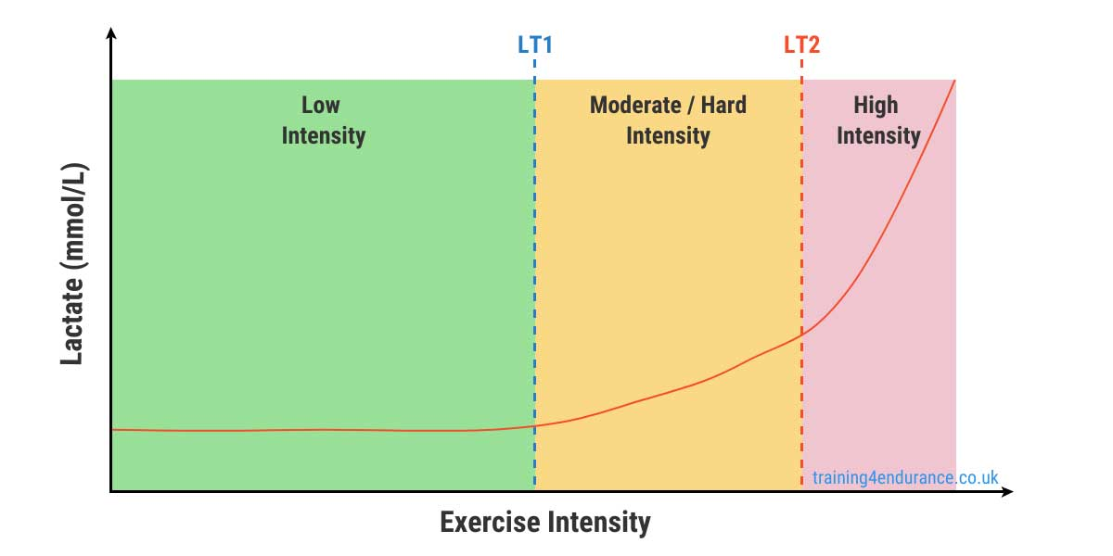
Notes:
MODERATE is the key word here
We can use the talk test / breathing as a good sign they are in this zone.
Can they answer a question with a short sentence then it’s a good sign they are in the correct zone.
We can also use their breathing as a indicator. If their breathing becomes labored or disconnected from their steps then we are also probably over the line and into the high intensity zone.

Slide 7
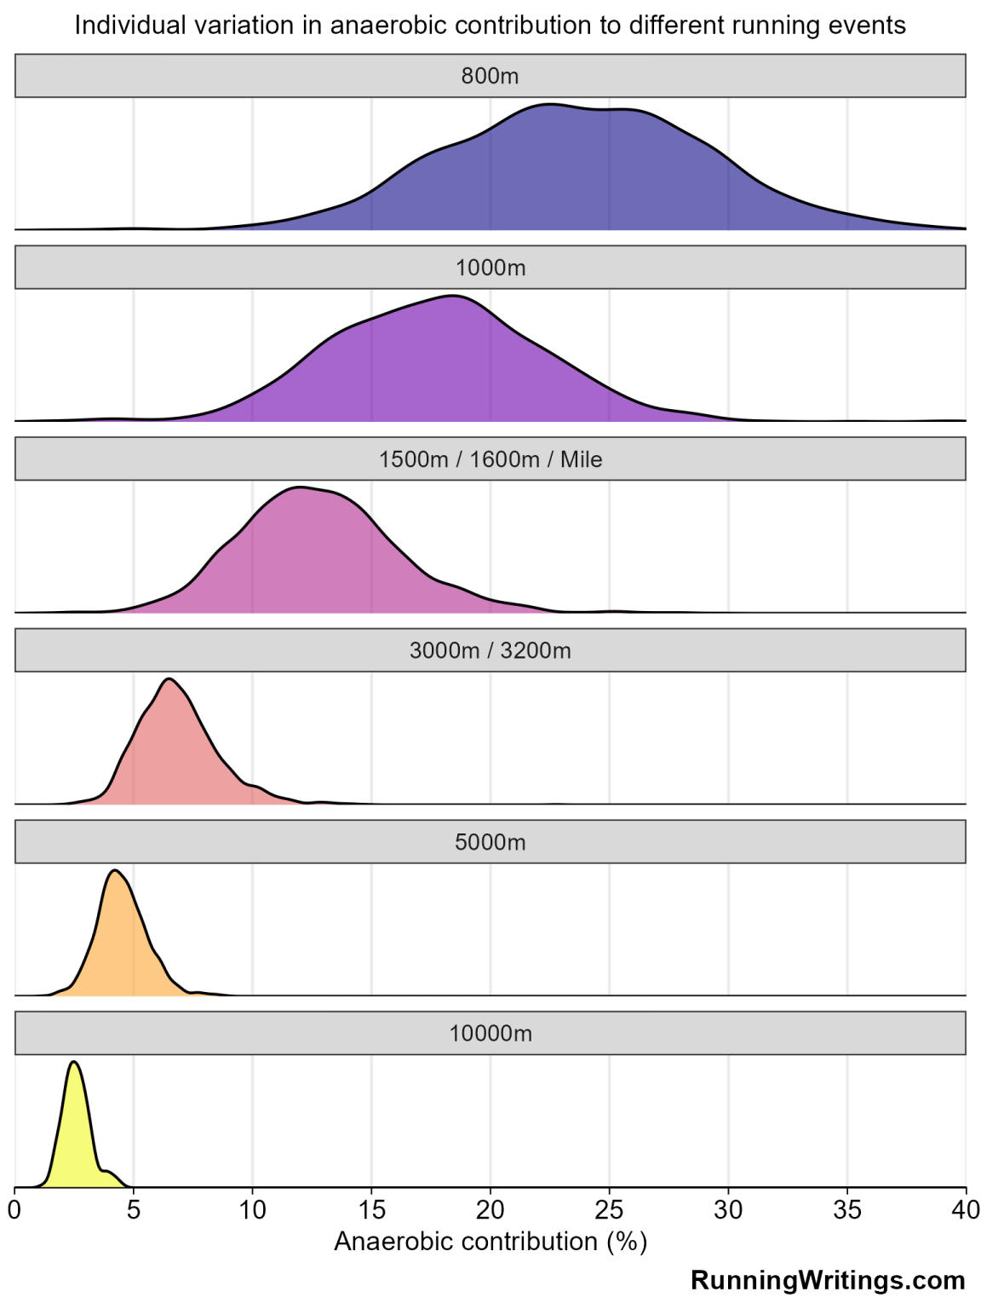

Slide 8
Threshold Cont.
Threshold training represents the top of the aerobic intensity scale with the lowest possible lactate levels.
It’s been made popular in recent years by Jacob Ingebritsen & the “Norwegian Method”
Primary benefits come from trading intensity for ‘large’ volumes.

Slide 9
What does it do and why does it work?

Slide 10

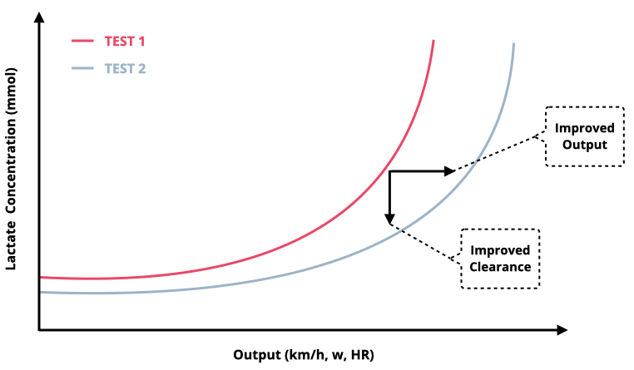
Notes:
Training allows you to run at a faster pace without producing an overload of lactate.
We teach the body to uptake and use the lactate that we produce as a fuel.

Slide 11
Clearance
Capacity
Ability to tolerate high levels of lactate is increased.
Total work capacity is much higher due to low relative levels of intensity.
Lactate is a fuel source and by training in this “Zone” we increase the rate at which we can use lactate as a fuel.
Muscles become better at clearing waste products from fast paced running.

Slide 12
Benefits
Threshold training is sustainable - generally requiring shorter recovery windows and less chance of injury
Flexible application - can be differentiated for different types of runners
-Improved Sustainable Speed
- Improved endurance
- Improved Efficiency
- Can build other qualities while doing this training

Slide 13
Application

Slide 14
Application
Application can be quite different based on training goals / athlete strengths.
EG - 800m Specialist
We can manipulate rep length/rest to get get a threshold workout from running that is relatively close to race pace.
In season it’s best used as a “bridge” between harder training sessions. Build first, then maintain.

Slide 15
Application
Application differs for 800/1600 and 1600/3200 runners quite markedly.
Our goal is to create a sets and reps scheme that creates just enough of a response to move our fitness forward without overloading the system.
Highly variable between athletes based on their age and training history.
Threshold training is typically easier than the athlete thinks it is. Strong priority on intensity control.
Again, best used as a bridge between race specific training sessions and/or races.

Slide 16
800m runners
Typically we group 800m runners into two different categories.
For our “speed based” 800m runners sometimes this training can be the ‘most difficult’.
We are trying to insert an aerobic component into their training schedule, in a way they are going to understand. Groups of short intervals with short rest @ slower than 800m pace are perfect.
3 x (6 x 150m) w/ 50m walk between reps, 3-4’ between sets. 150’s @ 800 pace + 2.5-3.5 seconds.
2:00 800m = 25-26 second 150’s
2:35 800m = 30-31 second 150’s

Slide 17
800m Cont.
3 x (6 x 150m) w/ 50m walk between reps, 3-4’ between sets.
Extend
3 x (8 x 150m) w/ 50m walk between reps, 3-4’ between sets.
3 x (10 x 150m) w/ 50m walk between reps, 3-4’ between sets.
Intensify
4 x (5 x 150m) w/ 50m walk between reps, 3-4’ between sets.
5 x (3 x 150m) w/ 50m walk between reps, 3-4’ between sets.
Notes:
So we can’t just give them the same workout over and over. So lets talk about progression.

Slide 18
MD examples
10 x 300 w/ 100m easy jogging rest. Done @ 1600 pace + 8-10 seconds per 400m
4:45 -> 300’s in 61->63
6:00 -> 300’s in 75-77
Extend
2 x (7 x 300m) w/ 100m easy jogging rest, 3-4’ between sets.
Intensify
3 x (5 x 300m) w/ 100m easy jogging rest, 3-4’ between sets. Done @ ~3200m pace.

Slide 19
1600m / 3200m
Threshold training for athletes skewing towards 3200m looks much more like traditional T workouts you might find in training books.
Our goal is to have a relatively high volume of medium effort running.
Typically easier than the athlete thinks it is. Strong priority on intensity control. We’d rather miss slow than miss fast.
In the early season this may take priority for the 1600m / 3200m athlete and as we approach the mid/late season we just need it for maintenance.
General Guideline for pacing. Date 1600m SHAPE + 1:10 to start.
4:40 -> 5:50
5:45 -> 6:55

Slide 20
1600m / 3200m
General Guideline for pacing. Date 1600m SHAPE + 1:10 to start for mile repeats.
4:40 -> 5:50
5:45 -> 6:55
Every distance down subtract ~ 10 seconds per mile.
1600 repeats - 5:50
1200 repeats - 5:40 pace (4:15)
800 Repeats - 5:30 pace (2:45)
400 repeats - 5:20 pace (1:20)
Rest guidelines - Short recoveries. Can build these over time. Start w/ :90 and cut over weeks to :60.
1600 repeats on :60 to :90
1200 repeats on :60 to :75
800 repeats on :45 to :60
400 repeats on :30 to :45
Notes:
We know that most high school athletes don’t have the pace control or fitness to execute LONG reps at threshold paces without going overboard and turning it into a race.

Slide 21


Thank you!

