Slide 1
Oregon Youth Hockey General Meeting
2025-2026 Season
Sunday, April 12 - 6:00 PM

Slide 2
Agenda
Call to Order
Introductions
Opening Remarks
Financial Update
Season Review
Player Development
Girls Co-Op
Board Update
Elections
Volunteering
New Business/Closing Remarks
Adjourn

Slide 3
Board Members
Jason Wieser - President
Justin Brooks- Vice President
Vicki Lawry- Treasurer
Sean Kypreos - Secretary
Heather Symdon - Fundraising
Megan Pederson - Volunteer/Dibs
Erika Wiskes - Tournament Director
Andrew Lederer - Registrar
ALD’s
LTP - Dan Kassis 10U - Jim Conklin
6U - Sean Brennum 12U - Derek Blakeslee
8U - Brent Cashore 14U - Sean Dill
HS - Andy Meyer
Non Voting Appointed: Sharon Faust (Girls) Rick Fleming (HockeyDirector)

Slide 4
Opening Remarks
Team | Players
Learn to Play | 37
6U | 21
8U Blue | 11
8U White/Red | 9
10U Girls Bronze | 13
10U Girls Gold | 12
10U Co-ed B | 14
10U Co-ed A | 11
12U B | 12
12U A | 13
14U B | 18
14U A | 20
Thank You!
191 Total skaters
(6) Teams qualify for WAHA State!
Multiple teams winning tournaments
Multiple Players qualifying for the Kohlman Cup and (1) player on the team who won the Tournament

Slide 5
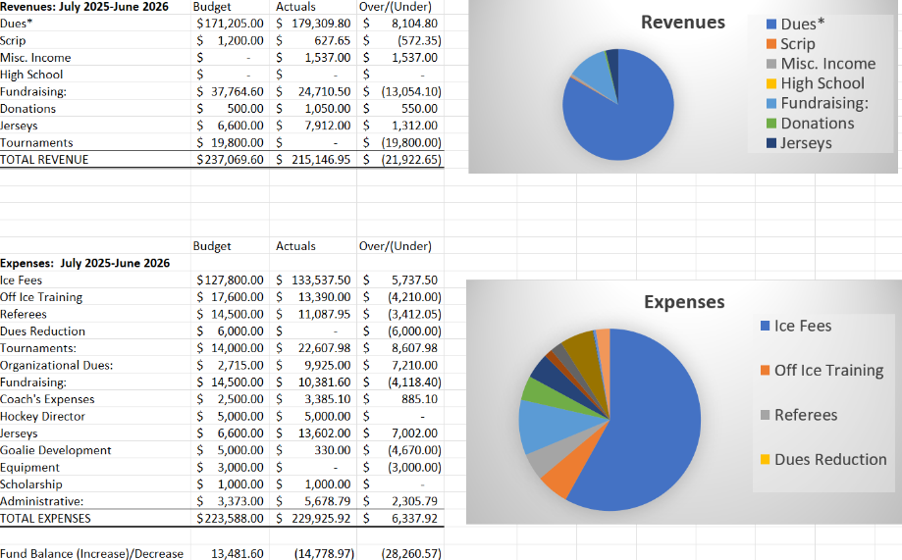
Financial Update
These values are on a cash basis, so there are timing variances in regards to actuals
Missing from this report is ~$13K in dues from the Girls co-op’s as well as the projected revenue from the golf outing (~$13K)
With both of those we expect to come in very close to our budget.
Cash on hand ~$54K

Slide 6
Season Review
LTP | Split it into (3) sessions to give the ability for kids to move to 6U/8U. Successful season, decent amount of on-ice help
6U | (3) teams, which is a good number and much higher than the previous year.
8U | (2) Teams, Blue and a White/Red White/Red team won the Manitowoc Tournament
10U Girls Bronze | 8th place finish at WAHA State
10U Girls Gold | Won the Beaver Dam 10u Girls Tournament 6th place finish at WAHA State
10U Co-ed B | Won the Antigo Tournament Consolation Champions at Baldwin Tournament
10U Co-ed A | Won the Dubuque Tournament
12U B | 8th place finish at WAHA State
12U A | 6th place finish at WAHA State
14U B | 6th place finish at WAHA State
14U A | 4th place finish at WAHA State Won the Badger State Games in Wausau

Slide 7
Player Development
Weekly Off-Ice Training for each team (New in 2025/26 Season)
26/27 plan- Keep and improve plans/hockey specific training plans
Weekly shooting/stickhandling/video sessions (New in 2025/26 Season)
26/26 plan- Keep and provide more coaching plans and resources to improve player experience
Instructor led Goalie Training (New in 2025/26 Season)
26/27 plan- Keep and move to weekly sessions
Plans for next season
Consistent weekly on-ice skills sessions
Pre-Season power skating and stick handling sessions focusing on OYH players

Slide 8
Player+Coach Development
Thanks to all our volunteer coaches
Coaching Committee (new in 25/26)
Oversee fairness and execution of tryouts
Support coaches in securing Coaching eligibility
Provide oversight and support for coaches in season
Escalation point for player/parent concerns
Held in season coaches meetings for idea sharing and growth
Focus areas for 26/27
Consistent vision of player development for the organization.
Continued coaching education and support for knowledge and skills growth

Slide 9
Girls Co-Op
Why all girls? The Women’s Sports Foundation says that by age 14, girls are dropping out of sports at twice the rate of boys, and it identifies lack of access as one of the key reasons girls leave sports
First year supporting all girls teams with new co-op structure
Co-op Stoughton, McFarland and at Peewee(Janesville)
Hosted the two squirt teams at Oregon
Both made State
Successful in retention and attraction

Slide 10
Board Updates
Jerseys - Looking at different vendors to streamline the jersey ordering process to lessen lead time and the administrative burden
Website - Met with Crossbar. Also working to update all content and make things easier to find
Ice Schedule - Have times for the upcoming season but also looking at getting an additional hour to accommodate skills and goalie training
Evaluating Tournaments - Do want to host or continue with the 3rd tournament with one being more local

Slide 11
Board Updates
Oregon Day - 12/12/26 every team will be at home with the Boys High School team playing at 2 and 4. Youth games being played before and after to get our whole community and association out to support all of our teams
Learn to Play program - need to continue to build the program and make sure we have enough players coming through. Looking for someone to run this.
WAHA Rule and By-law proposals submitted and will be discussed with Region 4 representatives on 4/28

Slide 12
Fundraising Update
2025 - 2026 Season
Meat raffle 2026
Raised ~ $8,000
Share Nights (Pizza Pit, Farm42, Me & Julio, Culvers)
Raised ~ $1,500
Golf Outing 2025
Raised ~ $11,000
RaiseRight
Raised ~ $700
Gear-age Sale
Raised ~ $300
Total = $21,500.00
Other Events: National Night out, Homecoming Parade & Youth Night
Upcoming Season
Golf Outing 2026
Monday, July 13
Registration update
New opportunities with the rink
Meat Raffle
RaiseRight
Share Nights/ Dine in
Raffle? Playdowns?

Slide 13
Volunteering Update
Volunteer Opportunities for Next Season
Fundraising & Local Events
Slap Shot Open Golf Outing 2026 (get started early!)
National Night Out
Homecoming Parade
High School Games (more info to come)
Share Nights
Meat Raffle 2027
DIBS
Other Recommendations??

Slide 14
Elections
Expectations - Board members are elected to a three-year term. They are also expected to attend the monthly board meeting, represent OYH in a positive, helpful and respectful manner.
Meet the Candidates
Sharon Faust
Grant Gorman
Angie Lind
Rick Reale
Lena Woodis
Nominations from the Floor
All present members registered can vote, with each family getting a maximum of (2) votes if (2) parents are present.
Vote for up to 5 candidates

Slide 15
New Business/Questions
Items brought for the good and welfare of the organization
All Board Meetings are open to any of our members. Times and locations will be posted on the website.
Questions, Comments or Concerns? Contact us through the website
https://www.oregonhockey.org/page/show/365108-board-members

Slide 16
Closing Reminders
Volunteering for positions
Look for info in emails
Lot’s of opportunities, if you have a specific skill but not sure where it fits in, please reach out and we can figure out where you can help out
April Board Meeting - Targeting 4/22
Survey will be sent out

