Slide 1
Sanctioned Games
Definition of a Game: An ice hockey game is a contest played against another team which is registered with USA Hockey or a member organization of the IIHF.
Registered USA Hockey ice hockey teams shall not participate in games against non-registered teams without prior written approval of the appropriate registrar. The district risk manager and district referee-in-chief shall receive a copy of such written approval. Violation of this rule shall subject the team to suspension by the appropriate Affiliate.
USA Hockey ice hockey teams traveling to Canada to play games against Hockey Canada teams must obtain a Canadian/USA Hockey Travel Permit. This permit is available from your appropriate registrar or his/her designee.

Slide 2
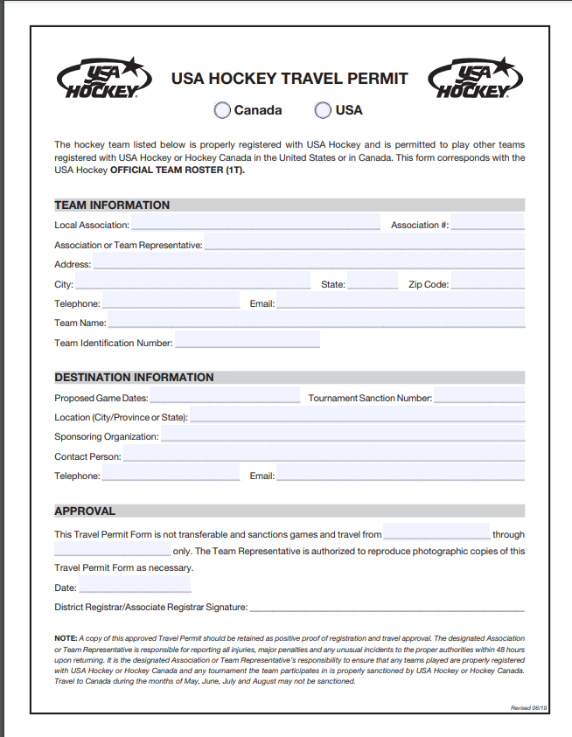
Travel Permits

Slide 3
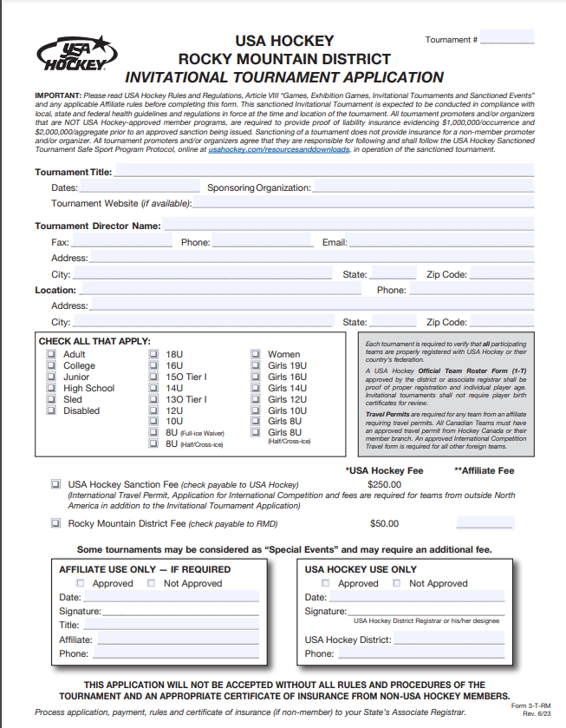
Sanctioned Tournaments

Slide 4
Important update- Due to requirements of hockey equipment changing this season please ADD the following to your tournament rules:
Hockey equipment requirements per USA Hockey Rule 304: Rule 304 | Protective Equipment (usahockeyrulebook.com) [usahockeyrulebook.com]. Starting August 1, players competing in youth, girls, high school or junior hockey within USA Hockey are required to wear neck laceration protectors (NLPs) for all games and practices. In addition, on-ice officials under the age of 18 as well as players in all six disciplines within USA Hockey’s disabled hockey program are also required to wear NLPs.
Per USA Hockey Rules and Hockey Canada Rules Agreement, all Canadian players must wear certified throat protectors.
Process for sanctioning tournaments/showcase/games:
Email (a) tournament rules and (b) USA tournament application
Send via mail two checks: (a) $250.00- “USA Hockey” and (b) $50.00- “Rocky Mountain District (RMD) Hockey”
Mail to: Jess Stich-Hennen
11035 Petunia Drive
Boise ID 83709
I will not review applications/rules until I receive the checks (see above).
I need at least 1 month to process. I will only review tournament applications on SUNDAYS. Please plan accordingly.
Sanctioned Tournaments

Slide 5
Programs hosting an Invitational tournament, are required to sanction the tournament by submitting the Invitational tournament sanction form.
If a tournament is NOT a USA Hockey sanctioned tournament, there is NO coverage in effect from USA Hockey’s insurance.
RMD collects an additional $50.00 for tournament sanctions
USA Hockey tournament sanction fee is $250.00
Tournament
Sanctions

Slide 6
You are also responsible to verify that all participating teams are properly registered with USA Hockey or their country’s federation
If a tournament is NOT a USA Hockey sanctioned tournament, there is NO coverage in effect from USA Hockey’s insurance.
RMD collects an additional $50.00 for tournament sanctions
USA Hockey tournament sanction fee is $250.00
Tournament
Sanctions

Slide 7
Special Event Sanctions are “permission in writing” from USA Hockey to sponsor an event affecting the registered members of USA Hockey.
Issued for the protection of the participants and to ensure all USA Hockey rules and regulations are observed.
All Special Event sanctions that are off-ice events must be approved by the Risk Manger, Ralph Bammert at ralphbammert1@gmail.com.
Special Event
Sanctions

Slide 8
Certain situations not covered by USA Hockey’s policy which are too risky for USA Hockey to cover.
Private ‘for-profit’ clinics
Alumni games
Parent/Child skates
These are always a NO and will not be sanctioned.
Reason: Totally inexperienced skaters or skaters that have not skated for a long time
Never Sanctioned
Events

