Slide 1
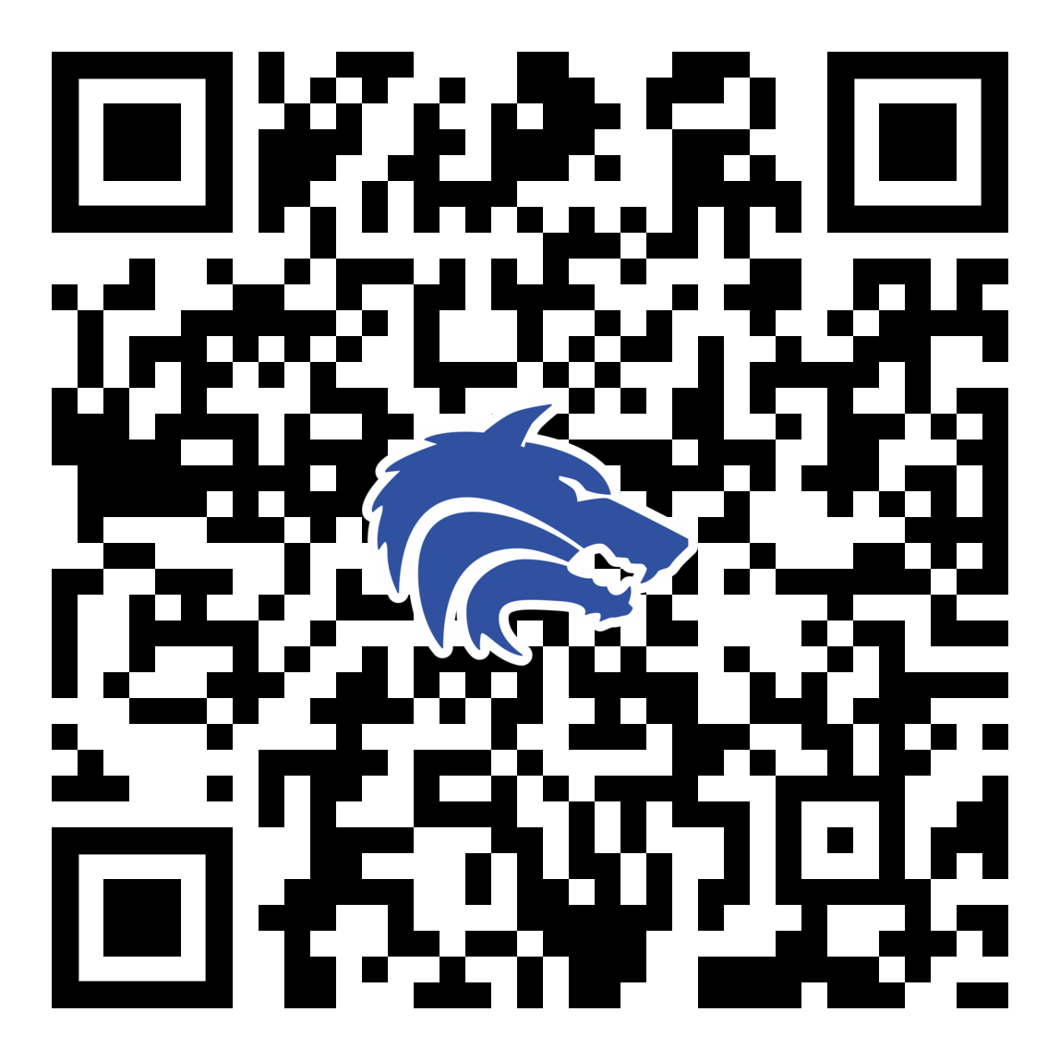
February 2022 Booster Club Meeting

Slide 2
Agenda
Air Force Game
Approve January Meeting Minutes
Treasurer Report
Spring Calendar
Coach’s Corner

Slide 3

SportsYou
DCMN-ZE9D

Slide 4
Booster Club Votes
Approve January Board Meeting Minutes
JOIN THE BOOSTER CLUB
  32 Member Families
  11 new since last meeting

Slide 5
Treasurer’s Report: 1/8/23 – 2/14/23
Our Beginning Balance: $27,509.11
New Income: $16,370.30
$ 1,689.50 Membership
$ 24.00 Concessions
$ 2,000.00 Sponsorship
$11,874.00 Packfunding
$ 542.00 Yard Signs/Decals
$ 240.80 Partnerships
New Expense: $ 3,206.12
$ 568.15 Concessions
$ 76.39 Golf
$ 481.22 Packfunding fees
$ 130.36 Ballfield repairs
$ 1,500.00 Baseball Equipment
$ 450.00 Insurance
Current Balance $40,673.29

Slide 6
Packfunding Fundraiser
Amount Raised: $16,286.00
Fees: $662.58
Net Amount Raised: $15,623.42

Slide 7

Spring Baseball – Upcoming Schedule
February 21: First Pitch Dinner
February 23: OPENING DAY
Plano West Hosting Tournament Games:
  JV Tournament:
    Thursday, February 23 10:00 AM – 6:00 PM
    Friday, February 24 10:00 AM – 6:00 PM
  JV2 Tournament:
    Thursday, March 2 9:00 AM – 9:00 PM
    Friday, March 3 9:00 AM – 11:00 AM

Slide 8
Volunteers and Needs
RSVP for First Pitch
Team Meals Update
Concessions Coordinator
  - Expectation – at least 1 parent of each player volunteer 1 time!
Theme Night Task Force
Scoreboard Volunteers for each team
Varsity GameChanger back-up needed
JV & JV2 announcers needed

Slide 9
Varsity Theme Nights
Friday March 17 Wolfpack Night – BLUE OUT
Tuesday March 21 Teacher Appreciation Night
Tuesday March 28 PSA Night
Thursday April 6 Autism Awareness / Special Needs
Tuesday April 11 PJ’s Night
Friday April 21 Feeder School Night
Tuesday April 25 SENIOR NIGHT

Slide 10
Sponsor Saturday Recap

Slide 11

Coach’s Corner

Slide 12
February 2022 Booster Club Meeting

