Slide 1

2026 EAA Track & Field
Parent Meeting

Slide 2
Meet your 2025 Track Board.
Meet Manager Matt Arneson
Technology Director Justin Johnson
Equipment Manager Luke Twedt
Merchandising Manager Anah Sellers
Announcer Chuck Brooks
Program Director Sara Delgado
Communications Lisa Johson
Treasurer Mary Stoick

Slide 3
Parent Meeting Agenda.
Program Numbers and Team Information
Spirit Wear
Team Expectations
Feature Races
Meet Logistics & Reminders
Volunteers
Website Information
Practice Clinics
Awards
Events Review
General Guidance for Events

Slide 4
Team Information.
Registration by the Numbers:
K: 110 athletes
1st grade: 136 athletes
2nd Grade: 168 athletes
3rd Grade: 137 athletes
4th Grade: 111 athletes
5/6th Grade: 160 athletes
>820 total athletes participating this year! THANK YOU ALL!!!
Team Formations:
Teams are formed based on rankings from the previous season
This allows for balanced teams and more competitive races

Slide 5

Spirit Wear
Apparel Pick Up: Tentatively April 17and 18 at Eagan High School Track
  Communication will be sent once orders have been confirmed
  Order issues? Send email to trackmerchandisedirector@eaasports.org

Slide 6
Season Expectations.
EAA Track Mission Statement: Our mission is to create an environment that reinforces the importance of team, friendship, sportsmanship and development in the sport of track and field.
Coaching Expectations:
  To provide a positive, inclusive and energetic environment for all athletes.
  Our commitment spans to each and every athlete, regardless of age or skill level.
  To encourage the development of athletes through fundamental principles.
    Running mechanics
    Race strategy for middle distance events
    Technique and form for hurdles, jumps and throws
Parent Communication: Parents should expect to receive an email from their coaches no later than Friday, April 3. The email will include the team roster, practice dates/location and some logistics of the season.

Slide 7
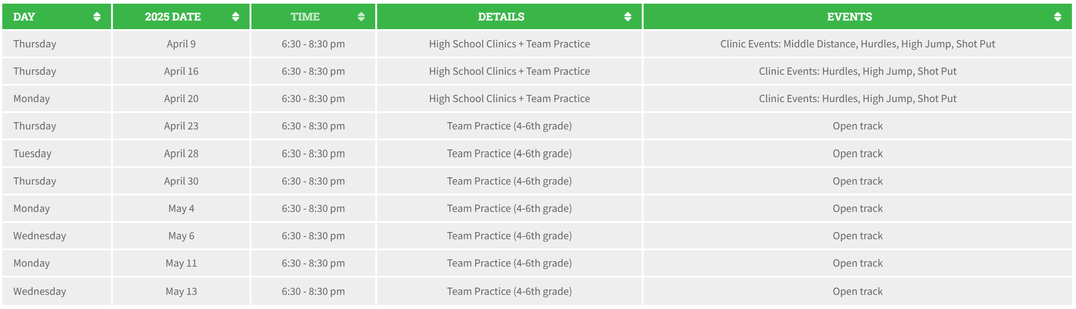
What to Expect - Practices.
Practice Expectations
Practice Locations
***THE MINIMUM EXPECTATION IS ONE PRACTICE PER WEEK***
Coaches will set their practice schedules. Look for communication by Friday, April 3.
K-3 practices focus on positivity and enthusiasm
Basic mechanics at this age level
  Running form
  Baton hand offs
  Field event technique
  Race strategy (200M, 400M)
4th grade athletes have five (5) new events they will participate in at this age. These practices are pivotal to their comfort level, performance and to prevent injury.
High School Track
Availability listed on EAA Track website (practice/meet dates ).
Northview Track is always open!

Slide 8
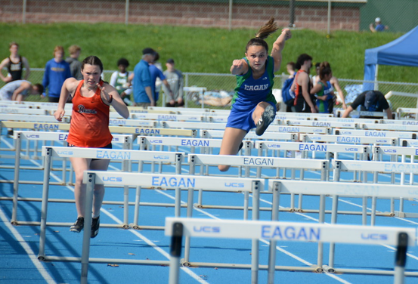
Practice Clinics.
Event Clinics (4-6 grade) are hosted by High School athletes. The goal is to teach fundamental skills that coaches can reinforce throughout the season.
Hurdles
High Jump
Shot Put

Slide 9
Kindergarten & 1st Grade Meets
Races: 50M, 70M, 100M Dash, 50M/70M shuttle relays
Field events: Baseball throw, broad jump and long jump
Race Order: Oldest grade girls always go first in field and running events.
Shuttle Relays: Odd numbered runners line up at starting line, even numbered runners at the finish line.
Races: 50, 70, 100 Meter Dash
  Second grade NEW EVENTS: 200M Dash and 4x100 Relay
  Third Grade NEW EVENTS: 400m Run
Field events: Turbo Javelin, broad jump and long jump
Shuttle Relays: Odd numbered runners line up at starting line, even numbered runners at the finish line.
Race Order: Oldest grade girls always go first in field and running events.
2nd and 3rd Grade Meets

Slide 10




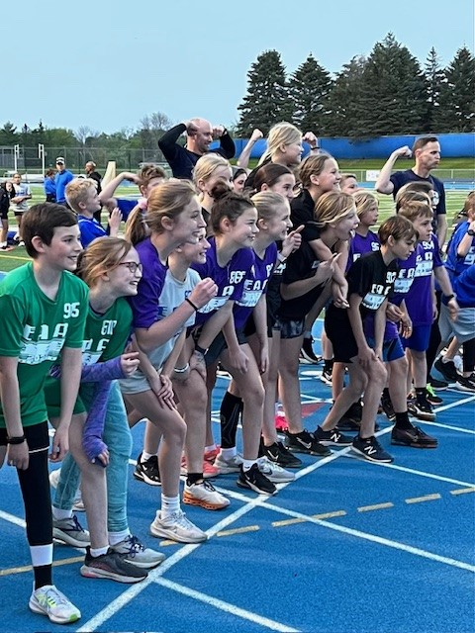
4th - 6th Grade Events.
Races: 50M, 70M, 100M, 200M, 400M
New Events (Incoming 4th Graders):
Hurdles
800M Run
Shot Put
High Jump
4 x 200M Relay and Sprint Medley Relay (100M/100M/200M/400M)
Mile Run (optional): This will be run by grade and gender. Communication will be sent in advance so coaches can promote this event.
5/6 Girls: Week 2
5/6 Boys: Week 3
All 4th Grade: Week 4

Slide 11
General Guidance for Races
Coordinate athletes by ability: For races, place your developing runners first and most accomplished runners run in the last heat. This allows for the most competitive experience for all athletes.
Equal races for each athlete per meet: No child can compete in more than one race than any other teammate. In other words, no athlete can run in three (3) races if any teammate is scheduled for only one (1) race.
Do not stack events: Athletes may not participate in any individual event more than twice during the season pending special circumstances and approval. This will be monitored during the season. Additional races beyond this guidance will not be scored or recorded.
Event Participation: Coaches should strive to have every athlete compete in each race and field event. This includes the longer events (400M/800M).

Slide 12

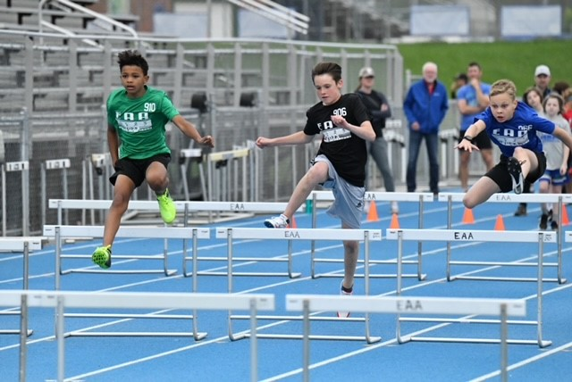
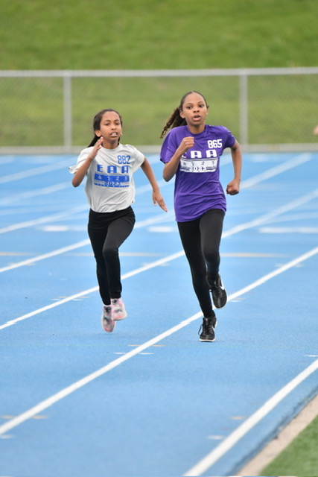
Feature Races (4-6 grade only).
What are Feature Races?
We also call these popcorn races, as in “Grab your popcorn and enjoy the show.”
Coaches select their most developed athlete(s) to compete in the individual feature race and/or relay event.
This allows each team the opportunity to have their best athletes compete against each other.
We will run all 8 lanes for these events.
The head finish line caller will record video in case of a photo finish.
Week 2
800M Run
4x200 Relay
Week 3
200M Dash
Medley Relay
Week 4
400M Run
4x100M Relay
Week 5
55M Hurdles
100M Dash

Slide 13
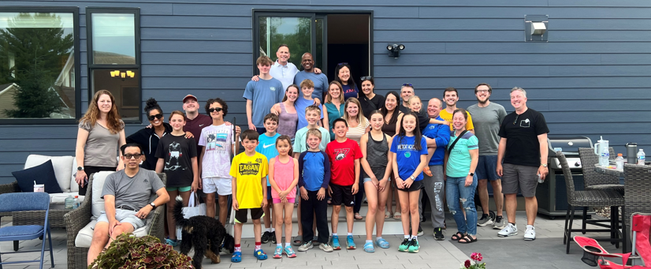
Volunteers
A huge part of the success of our program is because of our parent and youth volunteers. Please always be respectful and considerate and direct any feedback to trackdirector@eaasports.org.
We are looking for a new technical director for next year. If interested, please reach out for more information on this paid position.

Slide 14



End of Season Awards – 4-6th Grade.
Top Performers: The top 3 athletes from each event will receive medals for their performance.
Most Improved: The athlete who shows the most improvement throughout the season will be awarded.
Spirit Award: This award will be rewarded to one athlete from each team that displays tremendous support, positivity and is considered the “best teammate”.
Award Selection Process: Based on program feedback, we ask that coaches not select their child for the Most Improved and Spirit awards.
NO RELAYS last week: To shorten the last week of the season, there will be no relay events. This includes the 4x100, 4x200 and Medley relay.

Slide 15
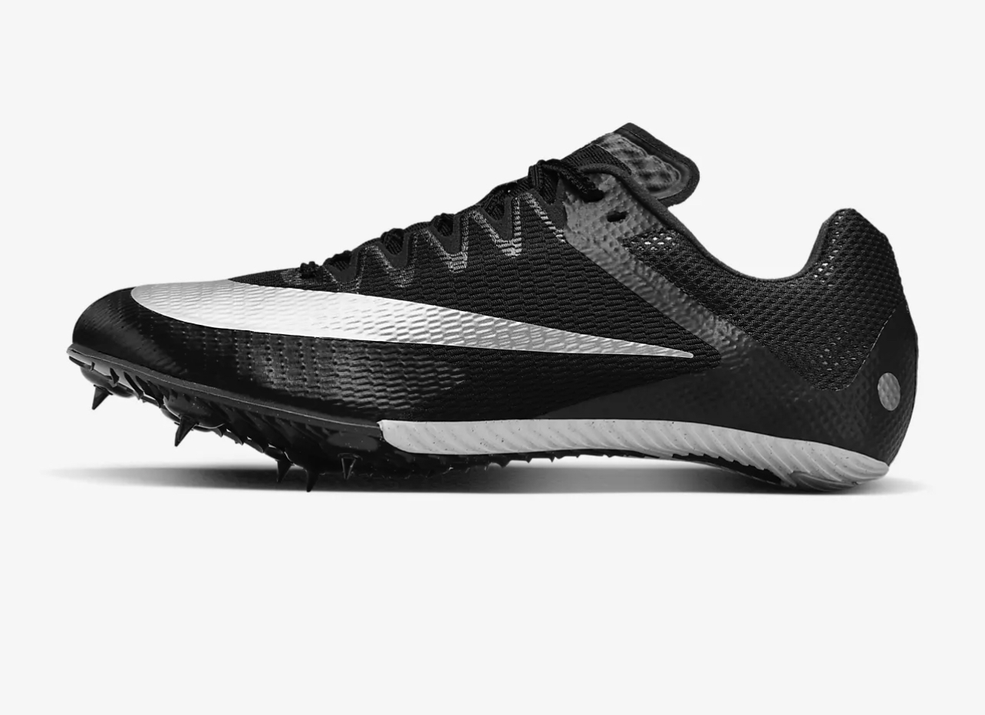

Spikes
Allowed in grades 4-6
Kids may wear only 1/4” pyramid spikes.

Slide 16
Race Day Reminders.
Arrive Early: Athletes should plan to arrive 30 minutes early meet day so they have time to locate their base camp and warm up for their first event.
Be Ready: Our announcer will call first call, second call and final call for all events.
Finish Line Cones: For the safety of the runner, coaches and athletes must stay behind the cones.
Finish Line Etiquette: Coaches remain with their athlete until they are escorted to the recorders.
Post Race: Once athletes time has been recorded, they should return to their team location.
Safety First: With 850 kids participating this year, you will need your head on a swivel at all times!
No Unauthorized Personnel on the Field: NO EXCEPTIONS. This includes parents, friends, etc.

Slide 17
Weather.
We will have beautiful weather this year, but just in case…
Meets are only canceled when necessary for the safety and overall experience of our athletes and families.
If cancellation is necessary, it will be posted on the website immediately. Teams should check the website if in doubt. An email will also go out to all participants.
We will cancel as far in advance as possible but sometimes it is a last-minute decision.
Every attempt will be made to reschedule a missed meet. As the high school programs have priority over the space, it is not always possible.

Slide 18
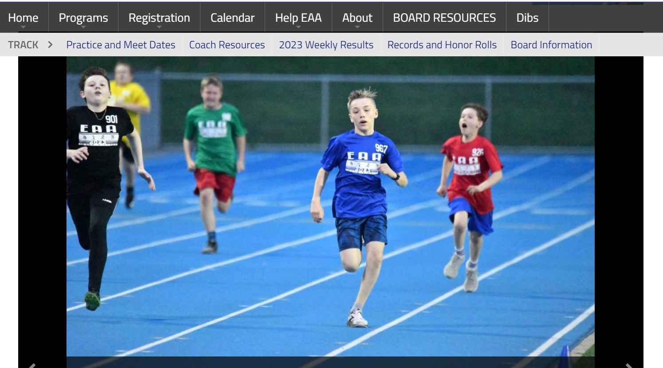
Check out the Website.
Training Videos
Coach Resources
Practice/Meet Dates
Clinic Dates
Weekly Results
Annual Honor Roll
All Time Honor Roll

Slide 19
Questions/Comments.
Website: www.eaasports.org
Email: Trackdirector@eaasports.org and track@eaasports.org
Coaches presentation will be posted on the EAA website

