Slide 1





Seacoast United
Home Workout Plan -
April 20th- 24th 2020

Slide 2

Seacoast United & Nike

Slide 3
Seacoast United Home Workout Plan
The Seacoast United Home Workout will consist of a 5-Day Plan to keep our players active in this time away from Team Training Sessions. The activities we have are all designed so players can perform on their own in a limited space, so should be accessible for all our players.
The Home Workout Weekly Plan will consist of the following:
Dynamic Warm Up
Cool Down
Aerobic Workout
Technical Based Workout
Core Workout
Upper Body Workout
Lower Body Workout
Yoga Workout
Soccer Homework
This presentation will include a weekly schedule, plus descriptions of the activities we would like the players to perform in each of the workouts.

Slide 4
Weekly Schedule (4/27-5/01)
Monday 27th April | Tuesday 28th April | Wednesday 29th April | Thursday 30th April | Friday 1st May
Dynamic Warm Up | Dynamic Warm Up | Flexibility & Mobility Workout | Dynamic Warm Up | Dynamic Warm Up
Technical Workout | Technical Workout | Tactical Homework | Technical Workout | Technical Workout
Aerobic Endurance | Core Workout |  | Speed Endurance | Core Workout
Cool Down | Full Body Workout |  | Cool Down | Full Body Workout
 | Cool Down |  |  | Cool Down

Slide 5
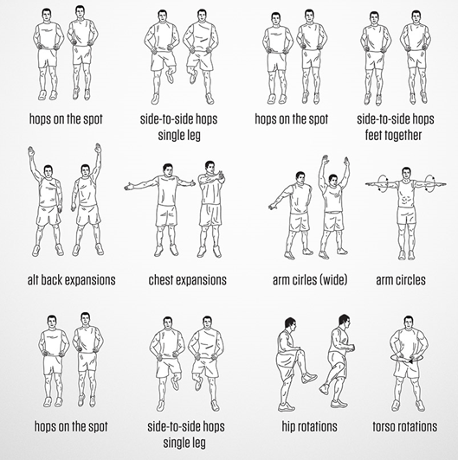
Dynamic Warm Up
~ Mon, Tues, Thurs and Fri ~
***Players should perform each exercise for 10 seconds, before moving onto the next one.
Repeat the exercises for a total of 2 sets***

Slide 6
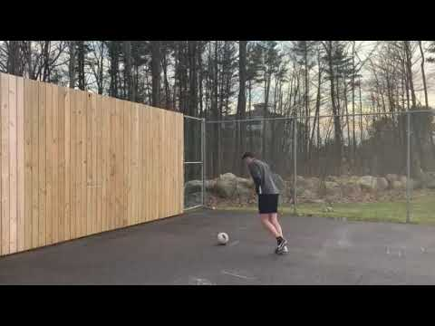
Technical Workout #1
~ Monday, Tuesday, Thursday, Friday ~

Slide 7
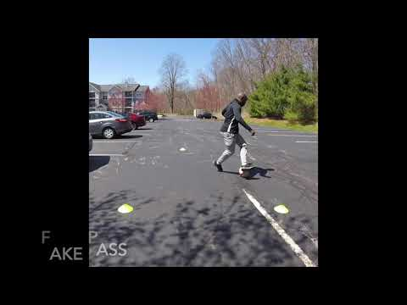
Technical Workout - #2: Turns
~ Monday, Tuesday, Thursday, Friday ~

Slide 8
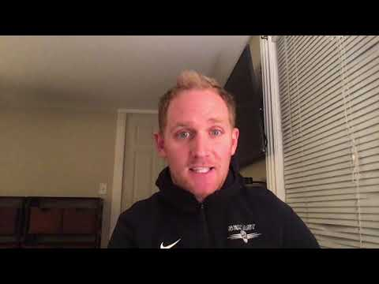
Physical Workout: Aerobic Endurance
Monday

Slide 9
Physical Workout: Aerobic Endurance
Monday
4 Mile Progression Run Challenge
4 mile continuous run
Challenge is to pace yourself so at least each mile is 10 seconds quicker than the previous mile
For example:
  1st mile: 7:00 minute mile
  2nd mile: Quicker than 6:50 minute mile
  3rd mile: Quicker than 6:40 minute mile
  4th mile: Quicker than 6:30 minute mile
Please email your Head Coach a screenshot of 4 mile run. Most apps will show a split time for each mile. Please send this screenshot so we can see times for each mile.

Slide 10
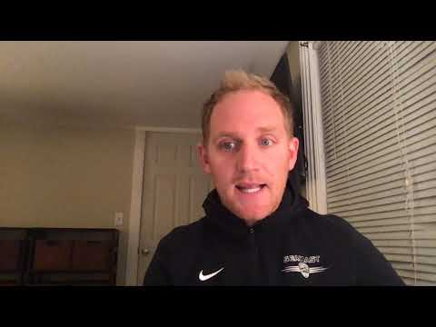
Physical Workout: Speed Endurance
Thursday

Slide 11
Physical Workout: Speed Endurance
Thursday
High Intensity 20 Sprint Challenge
30 second sprint followed by 60 second recovery period x 8
40 second sprint followed by 70 second recovery period x 6
50 second sprint followed by 80 second recovery period x 4
60 second sprint followed by 90 second recovery period x 2
Please email your Head Coach a screenshot of complete 20 sprint challenge workout with rest periods included.

Slide 12
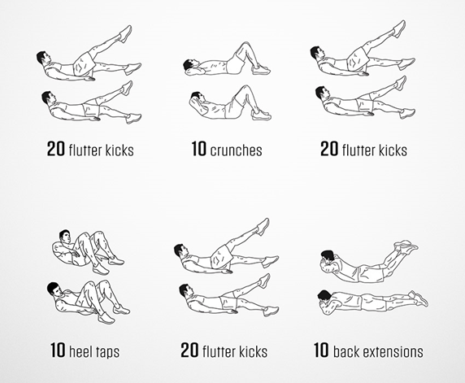
Core Workout
~ Tuesday & Thursday ~
***Players should complete 1 set of all 9 activities, before taking a 3 minute rest.
Repeat this process for a total of 2 times**

Slide 13
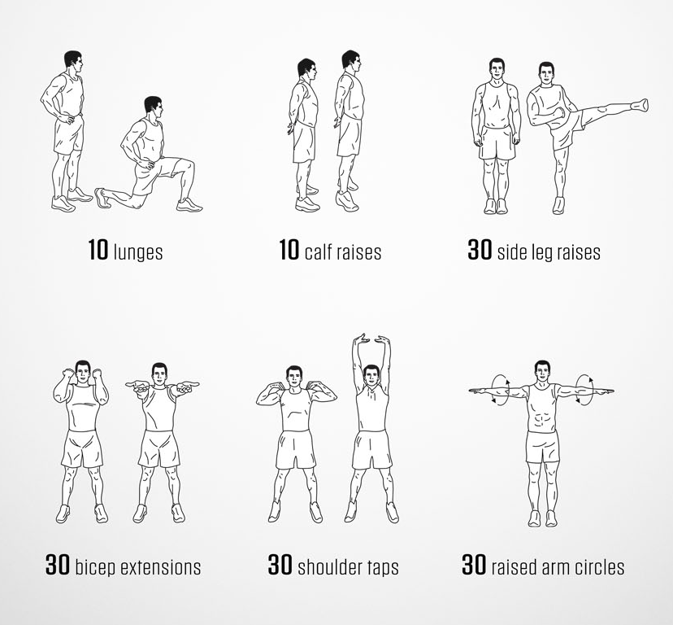
Full Body Workout #1
~ Tuesday ~
***Players should complete 1 set of all 6 activities, before taking a 2 minute rest.
Repeat this process for a total of 3-4 times***

Slide 14
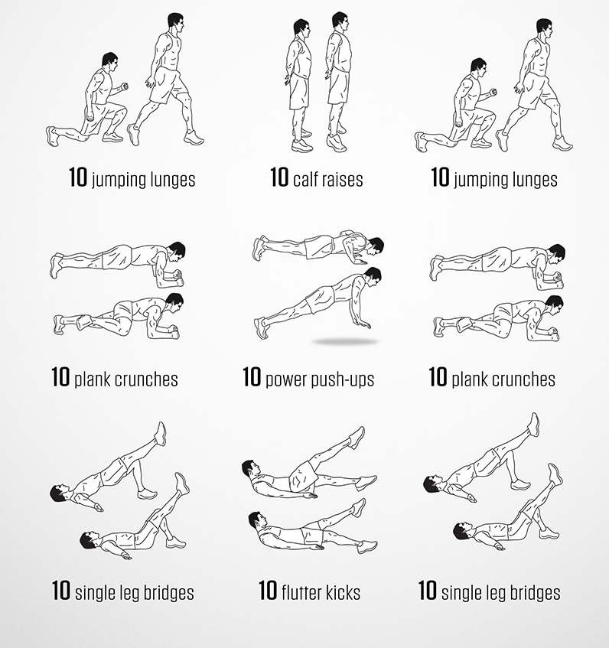
Full Body Workout #2
~ Thursday ~
***Players should complete 1 set of all 9 activities, before taking a 2 minute rest.
Repeat this process for a total of 3-4 times***

Slide 15
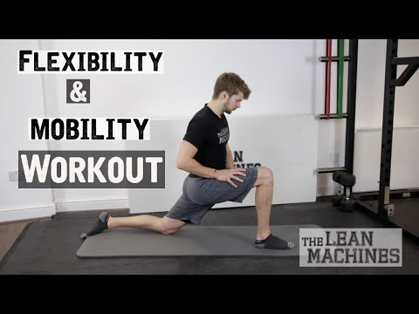
Flexibility & Mobility
~ Wednesday ~

Slide 16
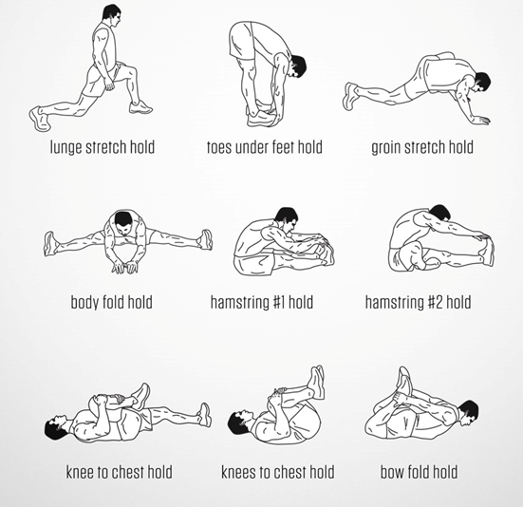
Cool Down
~ Mon, Tues, Thurs and Fri ~
***Players should hold each stretch for 40 seconds before moving onto the next one.
Repeat the exercises for a total of 2 sets***

Slide 17
Challenge / Homework
~ Wednesday ~
For this week’s homework assignment, you are going to recreate a goal of your choice in your backyard, or chosen area. We understand that everyone may not have an abundance of space, so try to get creative.
Include the original goal, followed by your attempt.
Replicating the celebration is strongly advised.
Best / most creative ones will be shared on social media.
An example can be seen in the next slide.
Please tag Seacoast United on all social media platforms, and also email your coach your submission.

Slide 18

Challenge / Homework: Example
~ Wednesday ~

Slide 19

Stay Safe & Stay Fit

