Slide 1
Flyers 2025: Professional Development
Andy Gillham, PhD, CSCS*D, CMPC

Slide 2

Professional Development Questions
You want to get better.
  How do you know if you are?
  How do you even know what to try to get better at?
What happens if everyone does the same things?

Slide 3
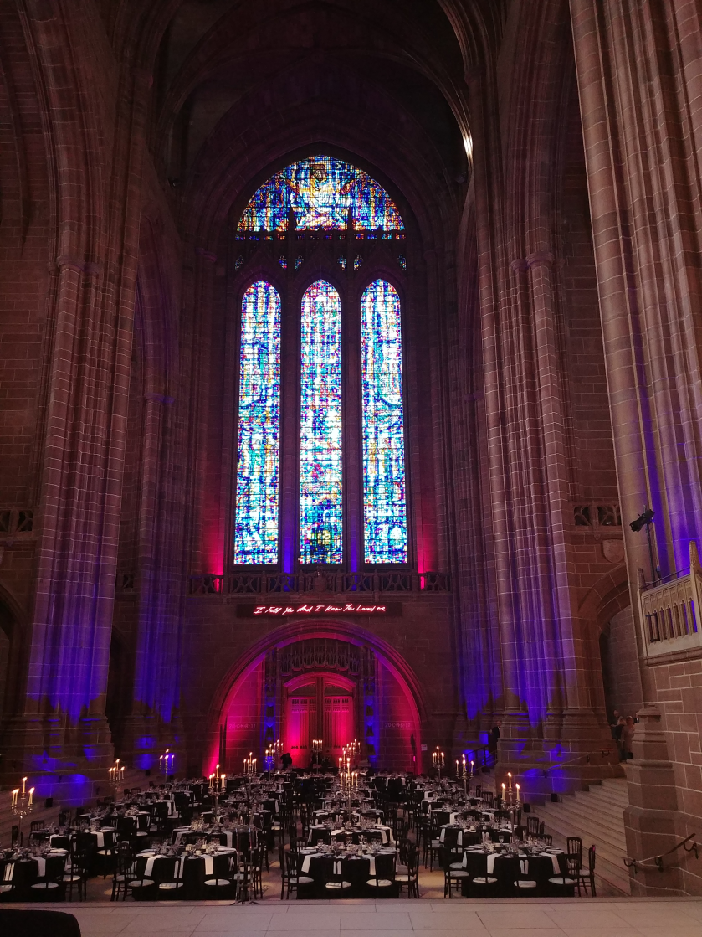
Formal vs. Informal
Formal
Informal
Context
Meaning
Individualization
Top-Down
Quality Control
Direction
Feedback
Innovation

Slide 4



Self-Serving Bias
Attributions are used to enhance and protect self-esteem.
  People take credit for success but not the blame for failure.
  More responsible for successful or positive than negative outcomes.
  Reasons for failure are externalized.

Slide 5
Areas of Effective Coaching
Training Programs
Testing Protocols
Interpersonal
Intrapersonal
Training Variables
Leadership
Self-Confidence
Resilience
Recreational
Development
Elite
Côté & Gilbert, 2009

Slide 6

INTRApersonal Example
Intrapersonal
Coach Philosophy
Space Diagrams
Reflection

Slide 7
INTERpersonal Example
Interpersonal
Feedback
Motivational Climate
Mentorship
Teaching

Slide 8
Have a Think…
How often do you actively question your own practices?
Are you confident enough to invite someone else in to critique or evaluate you?
What is the best day of training in a week? When do you get the most accomplished? Why is it the best? Do the players agree and recognize those factors?
What is the least effective day of training in a week? Why? How can we fix that?

Slide 9
March 22, 2025- Completed player evaluations.
April 15, 2025- Email to Coach Houck:
  2 keeps, 2 discards, and 2 modifications to your 2024/25 Season Plan
May 1, 2025-Email to Coach Houck:
  Identify one thing (concept/tactic/technique) to put into play for the upcoming season for your team and submit this to Coach Houck.
    Pre-season survey for the players?
    How will you use video better?
June 1, 2025- Have looked for a CEP class (if applicable) to get on your calendar and register for before August 1, 2025.
July 4, 2025- Submit to Coach Houck one age-appropriate drill for the level you are anticipating/wanting to coach at for 2025/26.
August 1, 2025- Register to Coach on SFYHA’s Website.
September 1, 2025-CEP/Safesport/Background/Age-Specific Modules Completed.
October 1, 2025- Email to Coach Houck:
  Season Plan for 2025/26 including practice plans for first 2-weeks.

Slide 10
Intention of Player Evaluation
Providing guidance for parents, and kids, on accurate skill level placement.
  What to work on in the summer?
  Skill degradation?
  Help the next coach!
Honesty & Accuracy are critical.
  4’s are truly “special” kids. How many do we as SFYHA have?
NOT meant to be a time suck for you. 10 min/ kid

Slide 11

Questions
Dr. Andy Gillham, PhD, CSCS*D, CMPC
Andy.Gillham@sanfordhealth.org

